Slide 1




Vaccination webinar
For community leaders, voluntary sector and health and care staff

Slide 2
Agenda
  Why is vaccination important?
  How vaccines work
  Vaccine safety
  Vaccine myths
  Vaccination eligibility
  Resources for communities
  Q&A

Slide 3
Why is vaccination important?
  “After clean water, vaccination is the most effective public health intervention in the world for saving lives and promoting good health.”
  World Health Organisation

Slide 4
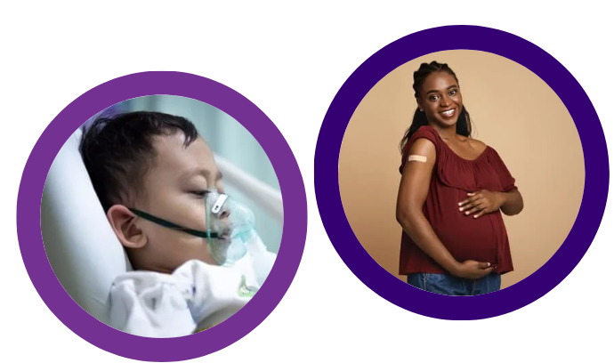
Why is vaccination important?
  2911 measles cases in England in 2024 – the highest since 2012.
  In 2024 we also saw over 14,000 cases of whooping cough nationally that sadly led to 11 infant deaths.
  Around 93 under fives were
  hospitalised in Nottingham and
  Nottinghamshire from flu in Dec 24.

Slide 5
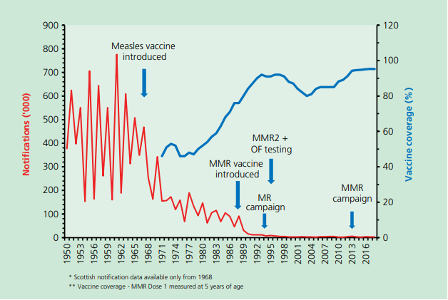
Why is vaccination important?
Pre 1968 about 80% of the population developed measles in childhood.

Slide 6
How vaccines work
  Vaccines teach your immune system how to create antibodies that protect you from diseases.
  Some vaccines require boosters or seasonal vaccination
  If enough people are vaccinated, it's harder for the disease to spread to those people who cannot have vaccines.
  While latest evidence shows that there is high confidence in routine childhood vaccinations:
    85% of parents/carers agree vaccines are safe*
    BUT England is currently below the WHO recommendation that at least 95% of children are vaccinated.

Slide 7
Vaccine safety
  All vaccines are thoroughly tested to make sure they will not cause harm.
  It often takes many years for a vaccine to make it through the trials and tests it needs to pass for approval.
  There is specific guidance about which vaccines can be given together safely.
  Once a vaccine is being used in the UK it's also monitored for any rare side effects.

Slide 8
Vaccine myths
  Vaccines do not…
  do not overload or weaken the immune system – it's safe to give children and adults several vaccines at a time and this reduces the amount of injections needed
  do not contain mercury (thiomersal)
  do not contain any ingredients that cause harm – only ingredients essential to making them safer and more effective and only in very small amounts
  do not cause autism – studies have found no evidence of a link between the MMR vaccine and autism

Slide 9
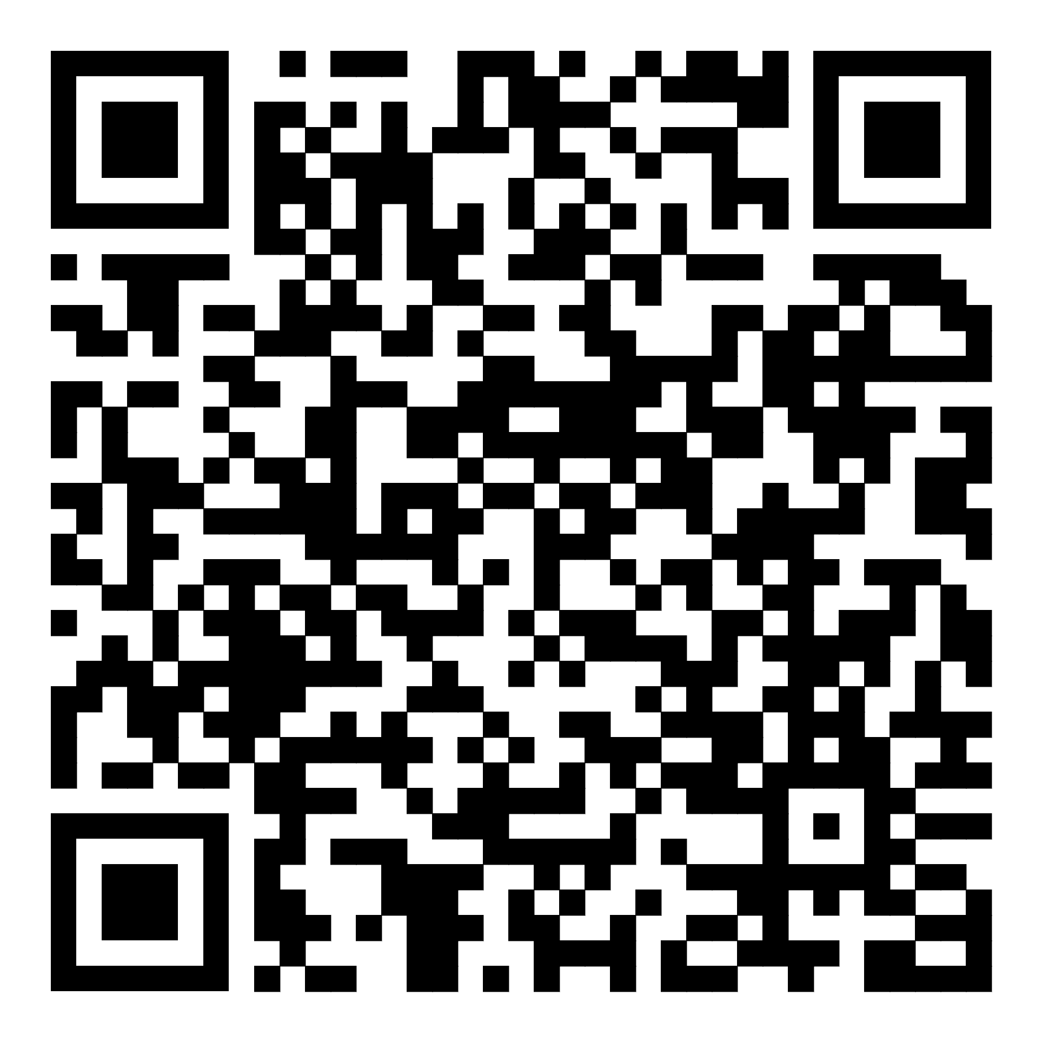
Vaccine eligibility
  https://www.nhs.uk/vaccinations/nhs-vaccinations-and-when-to-have-them/

Slide 10
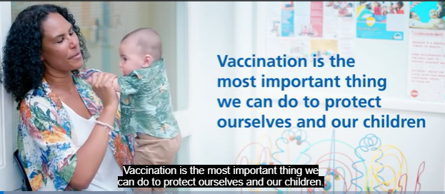
Vaccine resources
  Vaccination in pregnancy video (Ukrainian, Polish, Romanian, Arabic, Urdu): https://www.nottinghamshire.gov.uk/care/health-and-wellbeing/health-protection-hub/vaccinations/pregnancy
  Video: vaccines – are they safe for my child? https://www.nhs.uk/vaccinations/why-vaccination-is-important-and-the-safest-way-to-protect-yourself/

Slide 11
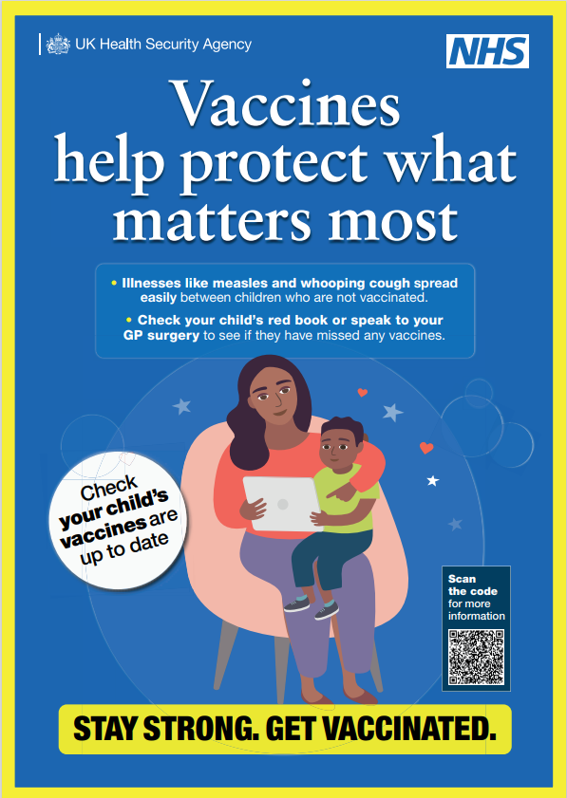
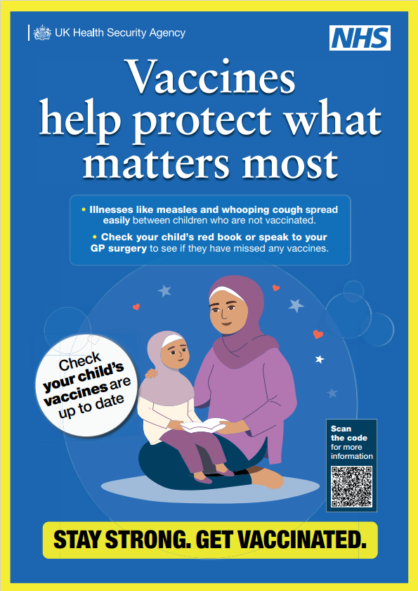


Childhood vaccine resources
  Posters and social media graphics
Assets available from Campaign Resource Centre (registration needed) https://campaignresources.dhsc.gov.uk/campaigns/vaccinations/childhood-immunisations/
or by emailing nnicb-nn.comms@nhs.net

Slide 12
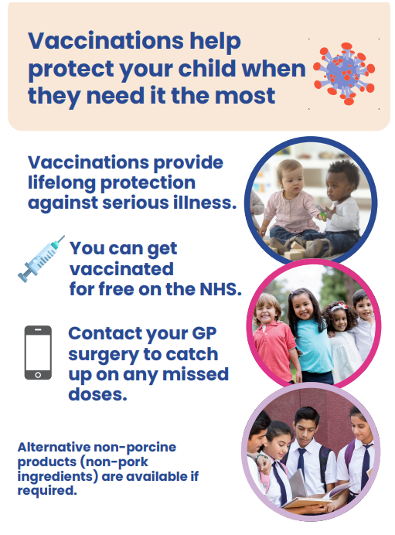
Childhood vaccine resources
  Nottingham City Council flyers for MMR
Available on ICB website: https://notts.icb.nhs.uk/mmr/
Flyer – English
Flyer – Arabic
Flyer – Kurdish
Flyer – Polish
Flyer – Spanish
Flyer – Urdu
Flyer – Punjabi

Slide 13
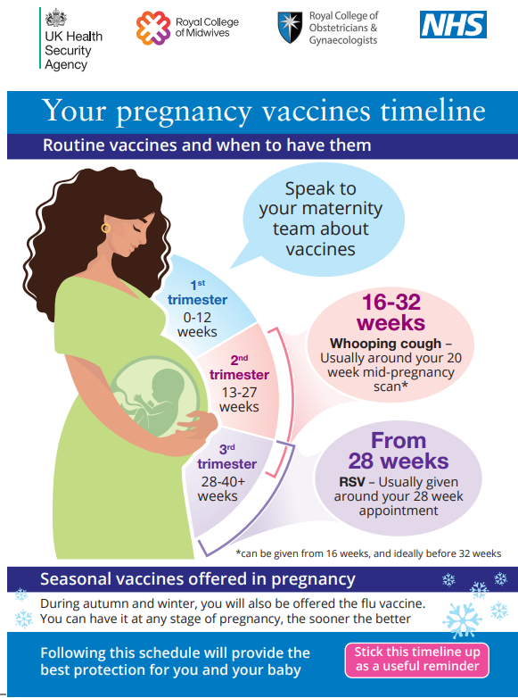
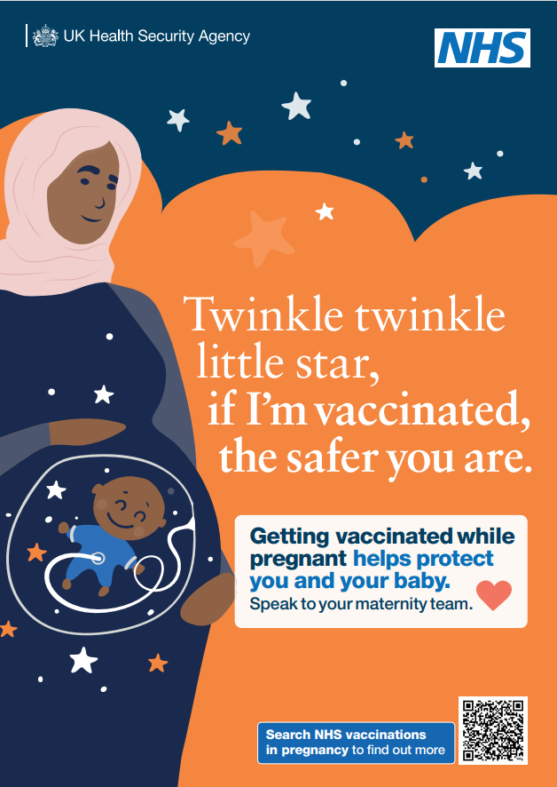
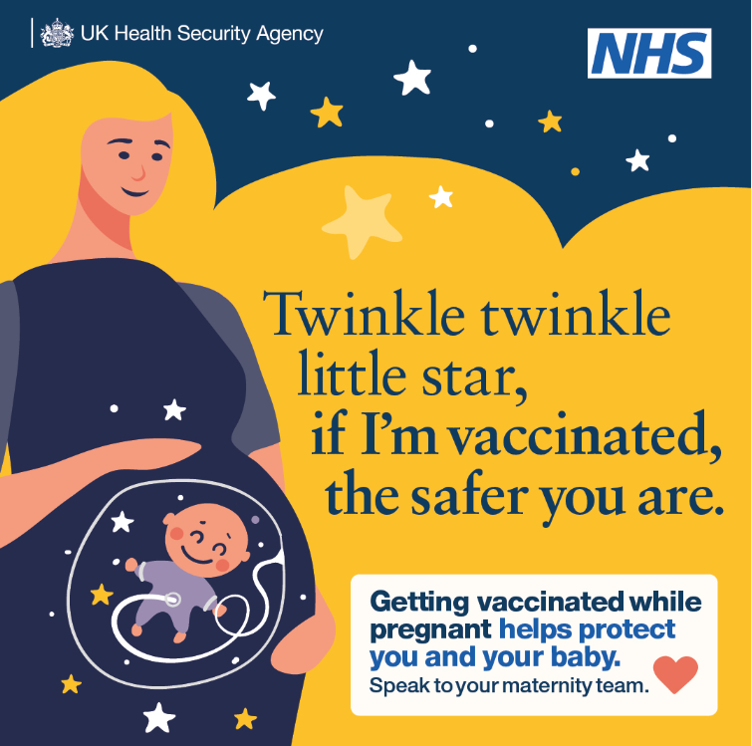
Maternal vaccine resources
Maternal Vaccines postcard with translated versions:
Bengali
Gujarati
Hindi
Polish
Punjabi
Urdu
Yiddish
  Postcards, social media and posters
Postcards available from Campaign Resource Centre (https://campaignresources.dhsc.gov.uk/campaigns/vaccinations/vaccinations-in-pregnancy/postcard/) or by emailing nnicb-nn.comms@nhs.net
https://drive.google.com/drive/folders/1gQmmLN-h2BqW7KVqSqZK9Qg-RqReebMg

Slide 14
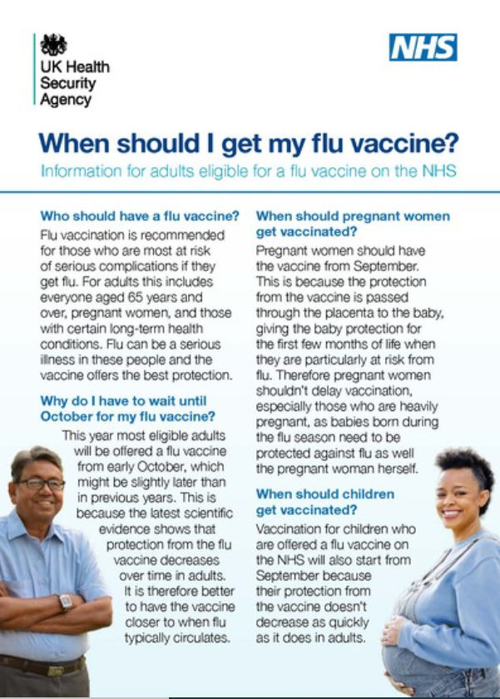
Flu vaccine resources
  When should I have my flu vaccine?
https://www.gov.uk/government/publications/flu-vaccine-supply-when-can-you-get-your-vaccination
Product code:
24FLUWEN

Slide 15
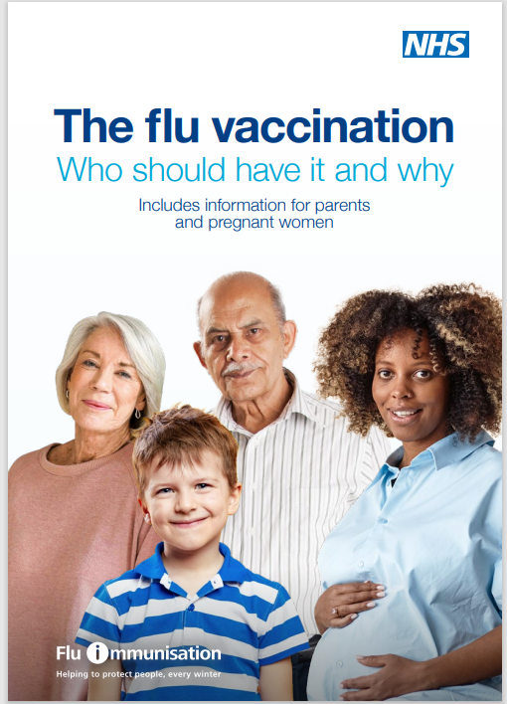
Flu vaccine resources
  The flu vaccination: who should have it and why?
Albanian, Arabic, Bengali, Bulgarian, Chinese (simplified), Chinese (traditional, Cantonese), Estonian, Farsi, French, Greek,
Gujarati, Hindi, Italian, Latvian, Lithuanian,
Panjabi, Pashto, Polish, Portuguese, Romanian,
Romany, Russian, Somali, Spanish, Tagalog,
Tigrinya, Turkish, Twi, Ukrainian, Urdu, Yiddish
and Yoruba.
Accessible formats such as Audio, Braille, BSL video and Large Print are also available.
www.gov.uk/government/publications/flu-vaccination-who-should-have-it-this-winter-and-why
Product code:
FLUMW24EN

Slide 16
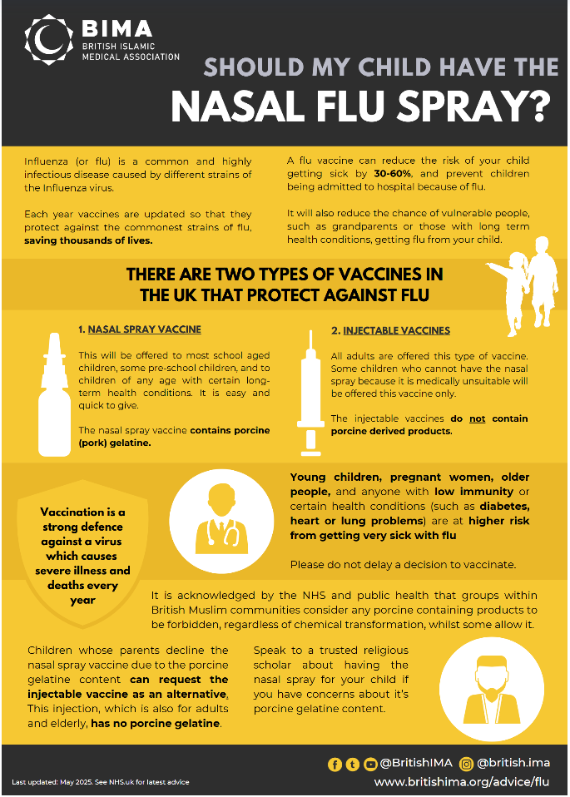
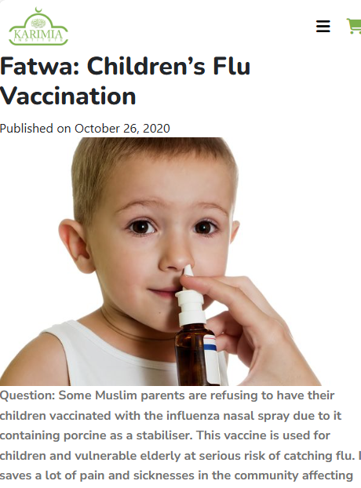
Islamic flu resources
https://britishima.org/advice/flu/
https://www.karimia.com/fatwa-childrens-flu-vaccination/

Slide 17
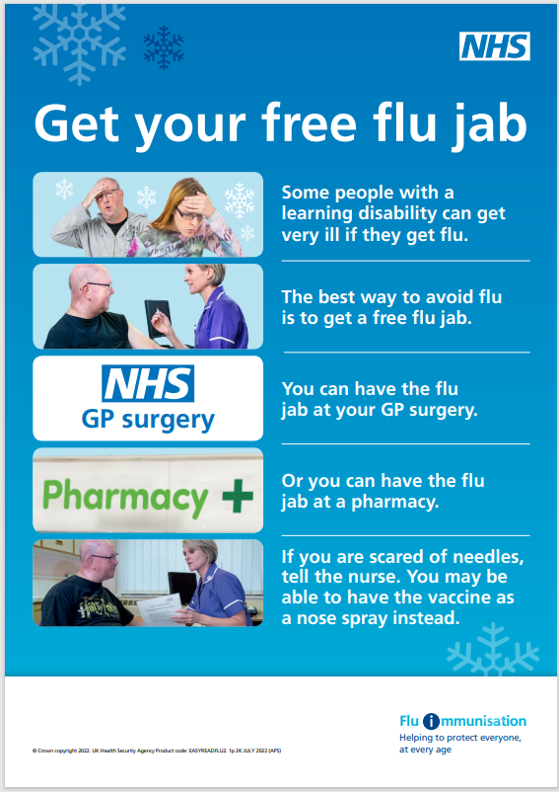
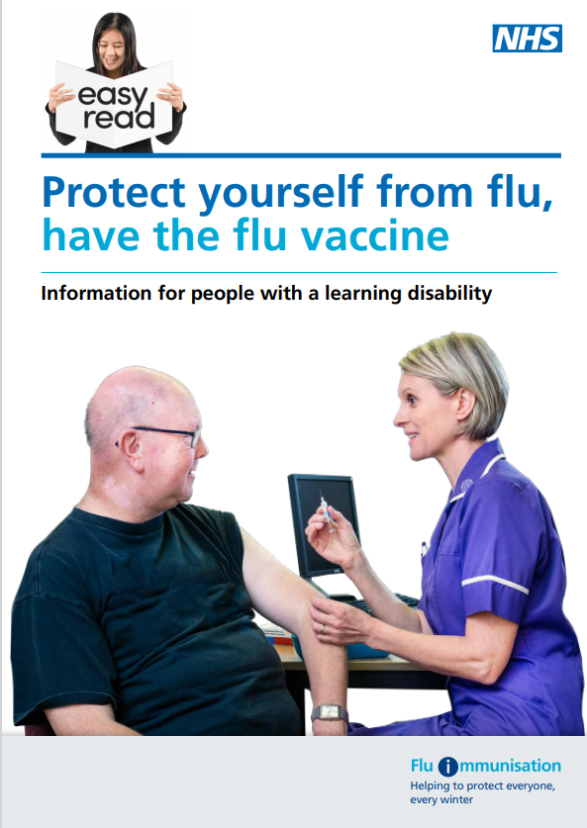
Flu vaccine resources
  Protect yourself from flu: easy read
Product code: EASYREADFLU2
Product code: EASYREADFLU1
https://find-public-health-resources.service.gov.uk/Protect%20yourself%20from%20flu%3A%20easy%20read/EASYREADFLU1
https://find-public-health-resources.service.gov.uk/Protect%20yourself%20from%20flu%3A%20easy%20read%20poster/EASYREADFLU2

Slide 18
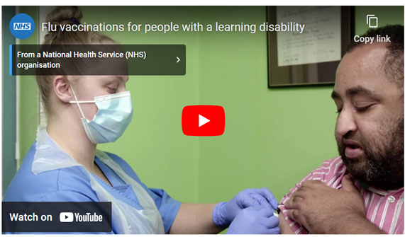
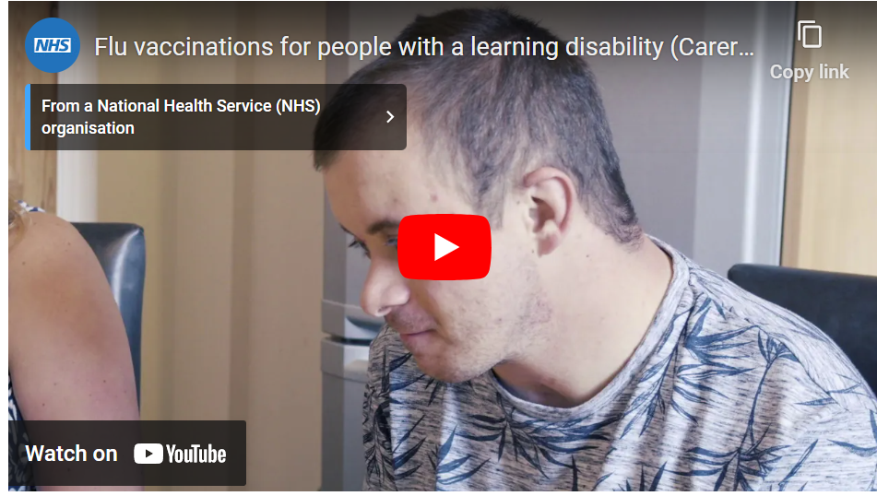
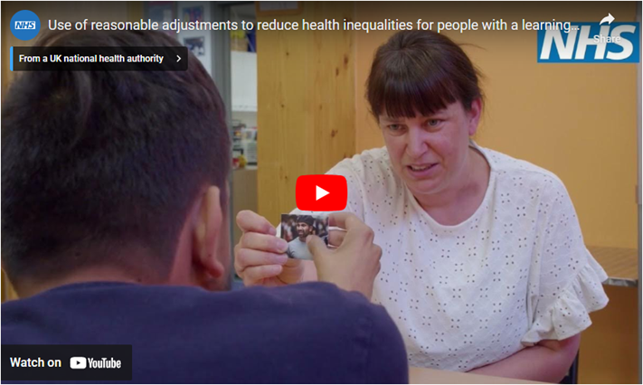
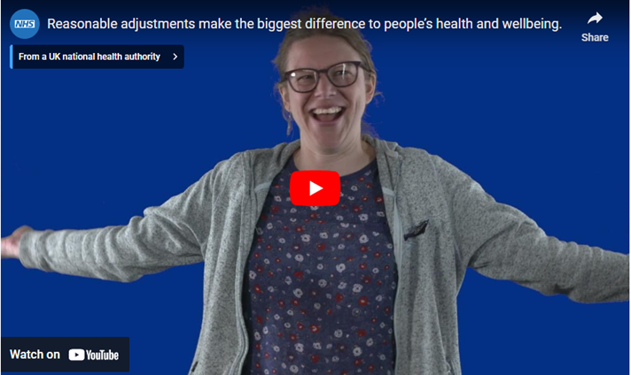
Flu videos and leaflet: learning disability and autism
Flu vaccination video for people with a learning disability
Flu vaccinations for carers of people with a learning disability
www.gov.uk/government/publications/flu-leaflet-for-people-with-learning-disability
YouTube links:
https://www.youtube.com/watch?v=OqGSm0jaF9A
https://www.youtube.com/watch?v=jJ9QdwUitFg
Use of reasonable adjustments to reduce health inequalities video
How reasonable adjustments make a big difference to health and wellbeing video
www.england.nhs.uk/learning-disabilities/improving-health/reasonable-adjustments/

Slide 19
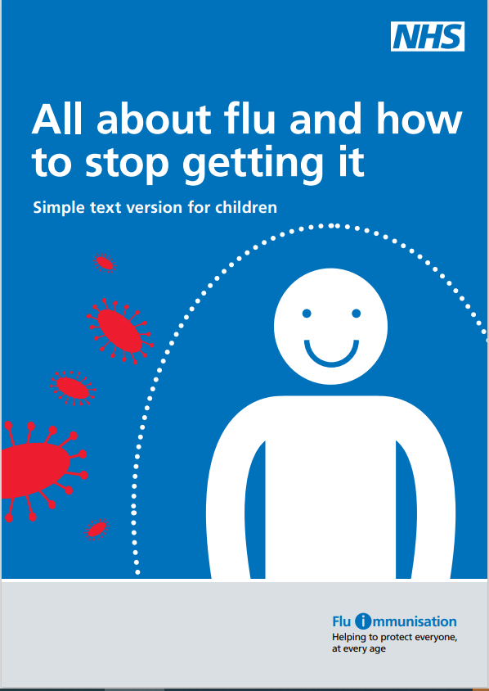
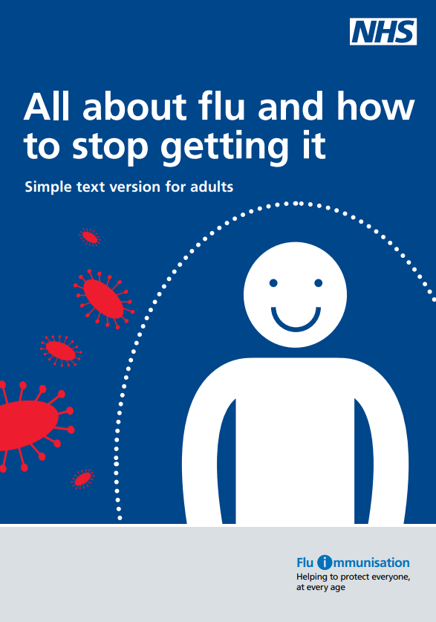
Flu resources for people with a low literacy
Product code: 218467AEN001
Product code: 2184679EN001
https://find-public-health-resources.service.gov.uk/All%20about%20flu%20and%20vaccination%3A%20adults/218467AEN001
https://find-public-health-resources.service.gov.uk/All%20about%20flu%20and%20vaccination%3A%20children/2184679EN001

Slide 20
Key timings
Group | Start Date | Vaccine Type
Pregnant women | 1 September | Flu
Children aged 2–3 years | 1 September | Flu (nasal spray)
School-aged children (4–16) | From mid-Sept | Flu (nasal spray)
Adults aged 65+ | 1 October | Flu
Clinical risk groups (18–64) | 1 October | Flu
Frontline health & social care workers | 1 October | Flu
Adults aged 75+ | 1 October | Flu & COVID-19
Immunosuppressed | 1 October | Flu & COVID-19
Care home residents | From 7 October | Flu & COVID-19 (on-site)
Children | Any time | Childhood vaccines
Pregnant women | Any time during pregnancy | Maternal vaccines
1 Sept:
1 Oct:

Slide 21
Any questions?

