Slide 1
Catheter Care Training Package
A #MidlandsIPC Catheter Care Improvement Group Initiative
Version 0.5
Dated: December 2025
Notes:
Standard title slide

Slide 2

Introduction and Overview

Slide 3
Introduction
This training package has been developed by the #MidlandsIPC catheter care improvement group, a multidisciplinary team encompassing NHS, Local Authority and Social Care colleagues collaboratively working together to standardise the approach of use of catheters across the Midlands region.
The aim of the package is to provide a basis for training in all settings across the region to standardise catheter care and to support the development of everyone who provides catheter care.
The package can be utilised as a standalone training resource or as a reference guide for catheter care. This does not replace competency-based training such as for insertion for catheters.
All the content within this training package is based on the most up to date evidence and policies and will be reviewed on an annual basis or more frequently if there are developments or changes in evidence.

Slide 4
Gram Negative Blood Stream Infections (GNBSI)
The largest group of GNBSI patients are related to urinary tract infections (UTIs), who have been targeted with various strategies over the past few years.
A large proportion of bloodstream infections are caused by E. coli bacteria, which is the
predominant cause of UTIs and which can lead to severe infection in older adults living in the community.
In 2022/23 there were 147,285 admissions with a primary diagnosis of UTI in England – 56% of these were people over 65yrs and with the highest number in the 80-84 age group (17,280 admissions): UTIs: NHS awareness campaign aims to cut hospital admissions | The BMJ
UTIs and catheter associated UTIs (CAUTIs) are one of the leading causes of E. coli and
GNBSIs and are a significant cause of death and serious illness, especially amongst the
older population.

Slide 5
GNBSI
Older adults are more likely to be admitted to hospital with a UTI as this can cause other symptoms such as confusion, agitation, increased risk of falls etc.
● To ensure an accurate diagnosis in older adults (over 65), do not use urine dipsticks to check for a UTI, as they become more unreliable with increasing age. This is especially true for anyone with a urinary catheter.
● These groups are at greater risk of having bacteria present in the bladder/urine
without an infection. This “asymptomatic bacteriuria” is not harmful, and although it
causes a positive urine dipstick, antibiotics are not beneficial and may cause harm.
● In some cases, when a patient becomes clinically symptomatic a specimen of urine is sent for laboratory testing to inform which antibiotics are needed for treatment.

Slide 6
Overview
This training package contains following distinct sections:
Promotion of continence
Catheterisation overview
Daily catheter care
Prevention of Urinary Tract Infections

Slide 7
Promotion of Continence

Slide 8
Urinary Incontinence
Urinary incontinence is the unintentional passing of urine; it is a common problem and thought to affect millions of people.
It impacts individuals and their carers, friends and families in many ways including; being ashamed, anxiety and depression, poor body image, low self-esteem, social isolation, constant tiredness from disturbed sleep, and an increase in risk of skin breakdown.
Incontinence can be a symptom of an underlying cause, which once diagnosed, may be able to be treated.
Urinary incontinence can be divided into 4 main types. People may have one or more types; this is known as mixed urinary incontinence.
People may also have faecal incontinence and or constipation.
Assessment is the key as this may help to identify management strategies, causes and assist with support.

Slide 9
Urinary Incontinence
People often take many years to be brave enough to seek help for a continence problems, as they feel too embarrassed to talk openly about it. It is important that we give people the opportunity to get help – ask them if they have problems with their bladder and or bowel.
Incontinence is one of the last health taboos in modern society. Embarrassment stops many people from accessing the NHS services that can help them (Brett, 2021).
Ensure you sign-post people to appropriate help e.g. your local Bladder and Bowel Service. It may help by contacting their GP practice for advice for onward referral to support/management services.
The next slide explains in more detail the 4 types of Urinary Incontinence, their symptoms and possible treatments.
Incontinence is lonely and hard to talk about | The BMJ

Slide 10
Type of Urinary Incontinence | Symptoms | Underlying Causes / Risk Factors | Treatments
Stress Incontinence | Leaking small amounts of urine: Physical exertion: l lifting, Bending, Climbing stairs, exercising, Standing up Coughing , Laughing , Sneezing, leaking during Intercourse | Chronic constipation and straining / Faecal Impaction Obesity Post prostatectomy Persistent cough Hormonal changes during the menopause | Pelvic Floor exercises Weight loss Reviewing Asthma / COPD, Treat a cough Topical Vaginal Oestrogen Creams Treat chronic constipation Surgical intervention (last resort)
Overactive Bladder (OAB) | Urinary Urgency, urge leakage and Urinary Frequency | Nervous system disease such as multiple sclerosis Stroke Often no organic cause can be found Inappropriate fluid intake - large quantities of caffeine i.e. tea, coffee, coke, drinking chocolate. Inadequate fluid intake Poor bladder/voiding habits Anxiety can make the problem worse | Pelvic Floor Exercises Drink the right amount of fluid. Drink the right types of fluid… Avoid caffeine and alcohol which can be a bladder stimulant and irritant. Bladder Re-training Medication Botox Sacral nerve stimulation
Outflow obstruction / Neurogenic Bladder. Bladder failing to empty partially or fully. | Recurrent urinary tract infections Urinary frequency / Urgency Difficulty voiding / Straining to Void Stop - Start Stream / Hesitancy / Poor stream Dribbling incontinence Post void dribble Voiding without any warning Nocturnal enuresis | An obstruction to the urethra i.e. enlarged prostate. Damage to peripheral nerves preventing the bladder from working properly i.e. spinal damage Pelvic injury Diabetes Neurological impairment i.e. Multiple Sclerosis | Treat constipation Treat Benign Prostatic Hyperplasia Manage female organ prolapse (Pessary's) Intermittent self-catheterisation Indwelling / supra-pubic catheter Prostatectomy Clean intermittent self-dilatation to open urethral stricture
Incontinence due to other causes…(Functional) |  | Dementia, Mobility Problems, Dexterity problems, Poorly managed pain, increased care needs | Referral to occupational therapy Referral to Physiotherapy Referral to GP for pain review Toileting aids – commodes, urinals Penile Sheaths Continence pads

Slide 11
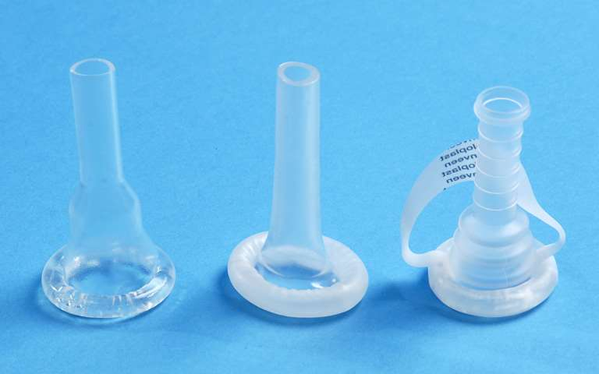

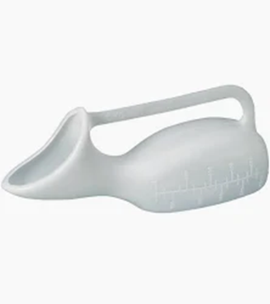
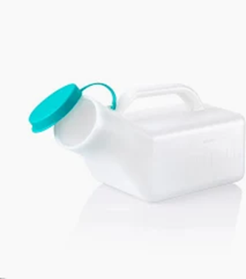
Promotion of Continence
Prevention of urinary incontinence can be helped by:
Lifestyle changes – exercising, alcohol/caffeine reduction, double voiding (a technique used to ensure complete bladder emptying by urinating twice in a row with a short pause between the voids), bulbar milking (‘milking’ the last few drops of urine from the urethra using the fingers; this is used for male post micturition dribble), weight loss, high fibre diet to avoid constipation.
Bladder training and pelvic floor exercises.
Urinary Incontinence can also be managed by disposable products such as pads and reusable underwear for light incontinence. Other appliances may be used such as sheaths and drainage systems for penile incontinence, female external catheters, urinals and medication.

Slide 12
Promotion of Continence
Catheterisation for long-term use may be considered to manage outflow obstruction or a neurogenic bladder, where the bladder is failing to empty. If this is not managed, individuals will be at risk of recurrent UTIs, kidney damage, sepsis and urinary incontinence.
Ideally people will be taught to do ‘Clean Intermittent Catheterisation’ (CIC) or Intermittent Self Catheterisation (ISC) – used to empty the bladder at regular intervals.
People should be considered for ‘Indwelling Catheterisation’ – catheter is inserted and left in place in the bladder with a collection bag attached, as a last resort.

Slide 13
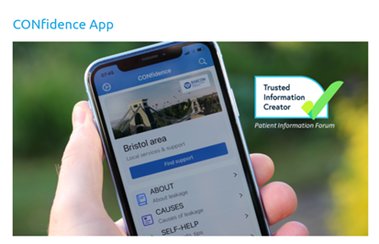
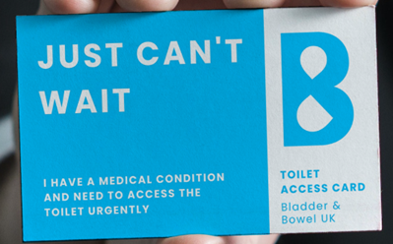

Resources to support Promotion of Continence
The Confidence App is free to download and offers evidence-based information to support people with bladder and or bowel problems.
Bladder and Bowel UK www.bbuk.org.uk are a charity who support bladder and bowel health for everyone. They have a wealth of information on the website and run a helpline.
The Squeezy App is a payable app (£2.99) that offers pelvic health advice to men and women. It offers self management resources or access to clinicians for additional support and resources.

Slide 14
Catheterisation Overview

Slide 15
Catheterisation Overview
This section does not replace the need for training in catheter insertion and for local competency requirements, this acts as an aide memoir for safe catheter insertion.

Slide 16
Catheterisation Overview
Catheters should be a last resort in the management of urinary incontinence because of the risks of infection, trauma and discomfort. They should only be inserted if the patient meets strict criteria as outlined on a later slide. Intermittent self catheterisation should be considered as the first line management, where possible, over the insertion of an indwelling catheter.
Once the catheter is inserted into the bladder, a balloon is inflated with sterile water, this allows the catheter to sit inside the bladder and not fall out.
A new suprapubic catheter will be inserted in hospital and then managed in the community. It is likely that your first suprapubic catheter change will also be undertaken in hospital.

Slide 17
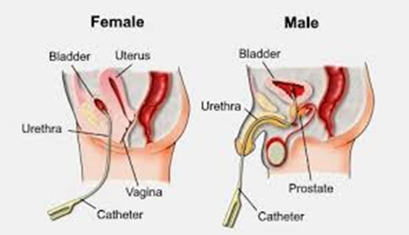
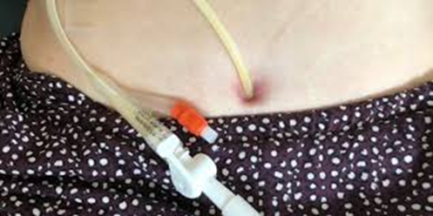
Catheterisation Overview
There are two sites for catheterisation, urethra or suprapubic:
Urethral catheterisation is via the urethra, which is a small tube that is located above the vagina in women and runs the length of the penis in men.
Suprapubic catheterisation is through an incision in the abdominal (stomach) wall where the catheter then passes into the bladder.

Slide 18
Catheterisation Overview
Catheters should be inserted and managed using an aseptic technique, taking care not to touch the component parts.
The following component parts of the catheter would allow direct access into a sterile site if they became contaminated:
the end of the catheter
the fitting on the leg bag and the night bag.
The following slide illustrates what equipment is needed to insert a urinary catheter.
A sterile catheter insertion pack may be used which contains the equipment required.

Slide 19
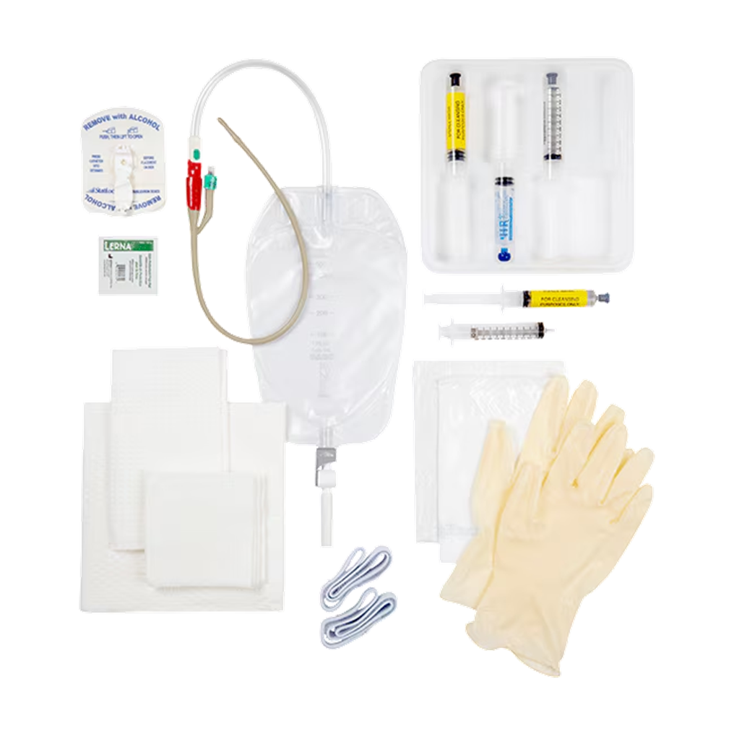
Fixator (secures catheter tubing to leg)
Urinary catheter
Local anaesthetic (e.g. lignocaine)
Drainage bag
Sterile water to inflate catheter balloon once inserted
Sterile field
Gauze to clean insertion area
Sterile gloves
Drainage bag straps

Slide 20
Catheterisation Overview
Catheter insertion should only be completed when there are no other options to manage the patients urinary output. The aim for most patients should always be for the catheter to be removed as soon as possible.
The HOUDINI model for catheter insertion/removal provides a framework for assessing if the catheter is required or whether the catheter can be removed. The requirement for a catheter should be clearly recorded with a minimum of daily review whilst in hospital and review prior to change once managed in the community.
HOUDINI | H | Haematuria (blood in urine)
 | O | Outflow obstruction (such as enlarged prostate, neurogenic bladder, constipation, urethral stricture)
 | U | Urological or gynaecological surgery
 | D | Decubitus ulcer (pressure ulcer/bedsore) – catheterised temporarily as part of tissue viability care plan.
 | I | Input/output monitoring – struct fluid balance in deteriorating patient
 | N | Nursing in palliative care
 | I | Immobility – unstable hip/spinal fractures, neurological deficit

Slide 21
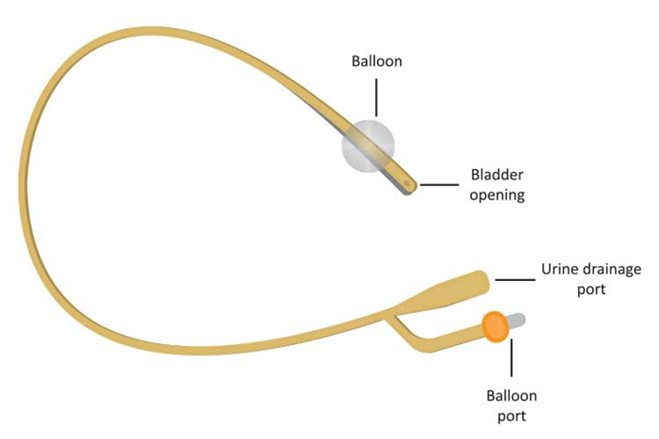
Catheter Insertion
Insertion of a catheter is an invasive procedure and should be undertaken using aseptic technique.
The HOUDINI checklist should be used as a pre-assessment tool to support the rationale for the continued use of the device.
Key tips for catheter insertion:
Patient preparation – information and consent.
Equipment and environment
Consideration of patient allergies
Length of catheter - short or standard-length considering patient gender and reason for catheterisation.
Diameter – use smallest size to avoid trauma and bleeding.

Slide 22
Catheter Insertion
Short term catheters should only be in situ for up to 1 month and long-term catheters can be in place for up to 3 months. The longer a catheter is in place the greater the risk of infection.
If any resistance is felt then the procedure should be paused, excessive pressure should not be used. Bleeding may also occur following catheterisation which should be monitored.
There are limited studies on the use of silver coated catheters; however, these still advocate that regular catheter changes are necessary. Silver coated catheters for recurrent UTIs can be initiated in the community with a four weekly change and review of suitability.
Remember to provide the patient with a catheter passport and supporting information

Slide 23
Catheter Passport
A catheter passport is a booklet designed for people with a urinary catheter to help them manage their catheter at home.
It provides information on catheter care, prevention of infections and details of the prescribed equipment, such as catheter type/size, leg and night bags etc.
It provides a means of communication between patients, carers and healthcare professionals.
The passport is usually issued to the patient by the hospital or healthcare facility where the patient was initially catheterised.
Patients should always keep the passport with them, especially when visiting the hospital, GP surgery or other healthcare service.
The passport helps to ensure continuity of care, clinical information sharing, helps prevent complications and promotes patient safety.

Slide 24
Catheter Valves
A catheter valve is a device that fits securely into the end of a urinary catheter and can be opened at regular intervals to drain urine out.
If attached to a suprapubic catheter valves should be secured to the patient’s abdomen to prevent discomfort, trauma and possible catheter displacement. If a valve is attached to a urethral catheter, then it should be secured to the patient’s thigh ensuring there is no tautness/pulling to the catheter.
Valves are used as an alternative to a leg bag and are often more discreet than a leg bag.
A catheter valve allows a normal pattern of filling and emptying the bladder, and can be used to maintain muscle tone, promoting patient comfort and independence. The use of the valve negates the continuous use of a free drainage system allowing controlled filling and emptying of the bladder, mimicking normal bladder function to some extent. The use of a catheter valve reduces the risk of tissue trauma on the bladder neck, mucosal lining and urethra.

Slide 25
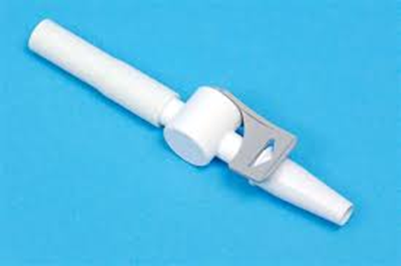
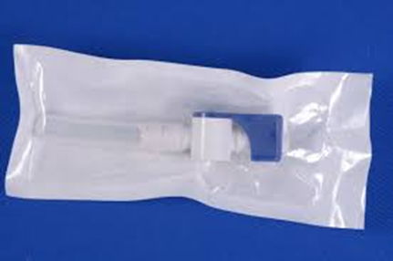
Catheter Valves
Catheter valves can preserve bladder sensation and function in some patients. When used prior to a trial without catheter (TWOC) the use of a valve resulted in more successful catheter removals (Yates, Br. J. Nursing 2016).
Catheter valves are suitable for female and male patients and can be used on urethral and suprapubic catheters.
Catheter valves are contraindicated for patients who have impaired bladder activity, detrusor overactivity, renal impairment, cognitive dysfunction or poor dexterity.

Slide 26
Daily Catheter Care

Slide 27
Catheter Care
Catheter entry sites should be cleaned with soap and water daily as a minimum or after an individual has emptied their bowel. Ensure front to back cleaning for females and under penile foreskin for males ensuring the foreskin has been replaced back.
Drainage bags should be emptied when at least 2/3 full, ensuring appropriate PPE is worn and hands are washed before and after.
Urinary catheters should be secured to the leg using fixation devices such as Velcro leg strap (G-Strap), leg bag straps or sleeves. This will help prevent restriction, stretching or kinking to the tube and mucosal damage. Both the catheter and the leg bag must be secured.
Catheters must not be disconnected from drainage bags. This will maintain a closed drainage circuit and reduce contamination.
Bathing/showering can be undertaken as normal.
Leg bags should be changed every 7 days and dated when replaced with a new sterile one. When changing the leg bag, ensuring appropriate PPE is worn, ensure hands are washed before and after and that you do not touch the end of the catheter or the leg bag during this process.
A new night bag should be attached to the leg bag each night with the tap set to open. The night bag should be removed in the morning and be disposed of to prevent reuse. Appropriate PPE should be worn and hands washed before and after.
Night bags are single use only with a new one needed each night.
Night bags should ideally be used unvalved (without a catheter valve).

Slide 28
Catheter Care
Drainage bags should either be secured to the leg or to a catheter/drainage stand ensuring this is below the bladder level to aid urine drainage. Drainage bags must not be left on the floor as this will increase infection risk.
It is important to ensure adequate hydration (around 1.5 – 2l per day or 8 cups/5 mugs) of various drinks. Keeping to a healthy diet with plenty of fruit, veg and fibre is also important to prevent constipation, which may affect urine drainage and cause bypassing.
Used catheter bags can be disposed of by double bagging using plastic bags with any other catheter care waste and disposed of in household waste.
Carers should ensure that they clean their hands before and after supporting with catheter care, including repositioning the catheter.
Carers should make sure they have access to PPE (disposable plastic aprons and gloves) prior to undertaking catheter care.
Using PPE as a single use for a single task.

Slide 29
Catheter Valve Care
Hand decontamination should be completed before and after catheter valve care, with the appropriate PPE used before changing the catheter valve.
The valve should be released on a regular basis, usually 4-7 times a day and held over a receptacle or toilet taking care the valve does not touch these. The valve is then opened to drain the urine from the bladder and then wiped with a clean tissue/wipe to remove excess urine and then replaced back into the patient’s clothes. Hand should be washed after bladder voiding.
Catheter valves should be changed every 7 days as a minimum using an aseptic non-touch technique, taking care not to touch the part that is fitted inside the catheter itself. The valve can be washed with soap and water as part of routine catheter care.
Hand decontamination should be completed before and after the procedure, with the appropriate PPE used before changing the catheter valve.
If the catheter valve is not working, it may need to be removed or replaced. The valve should be removed to ascertain where the blockage is. If urine does not drain directly from the catheter itself, then a leg bag or new valve should be attached and advice sought from a healthcare professional immediately.
.

Slide 30
Prevention of Urinary Tract Infections

Slide 31
What is a Urinary Tract Infection (UTI)?
A urinary tract infection can affect the bladder, urethra or kidneys, the bacteria can get into the bladder through the urethra or via a catheter. When a patient has a UTI, the bacteria will make the patient unwell, and they will present with UTI symptoms.
Symptoms of a UTI or CAUTI include:
New pain in suprapubic (lower abdominal) region
Pain on passing urine
Need to pass urine more often than usual (even with catheter in place)
New lower back pain
New or worsening confusion or agitation
New blood in urine
New inappropriate shivering, high or abnormal temperature
Catheter bypassing
Pain on removal/changing of catheter

Slide 32
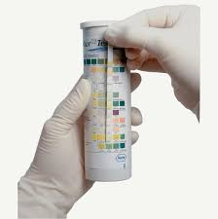
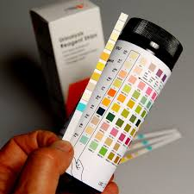
What is a Catheter Associated Urinary Tract Infection (CAUTI)?
The longer a catheter is in place, the more likely bacteria will be found in the urine; after 1 month it is suspected that all people with a catheter have bacteriuria (bacteria in the urine). Therefore dipsticks (urinalysis sticks) should never be used on catheter samples of urine. CAUTIs should be identified through assessing the patients presenting symptoms. If a CAUTI is suspected, a CSU (Catheter Specimen of Urine) needs to be taken and sent to the hospital laboratory.
Urinalysis sticks should be reserved for identifying blood, protein, glucose, ketones, specific gravity, pH. Such as monitoring ketones in diabetic patients.
Indwelling urinary catheters are associated with 75% of UTIs and the risk of UTI increases by 5% for each day that the patient remains catheterised.

Slide 33
Taking a Catheter Specimen of Urine (CSU)
Catheter specimens of urine (CSU) are usually collected for microscopy, culture and sensitivity (MC&S) testing when an infection has been suspected. The urine is tested to identify the organisms causing the infection as well as their sensitivities to antibiotics.
A CSU should only be collected when a patient has clinical signs of a CAUTI. This should not be based solely on the sight or smell of urine in the drainage bag as these are not good indicators of infection in catheterised patients.
A fresh sample of urine is required for a CSU and must be obtained from the sampling port on the catheter bag or in the case of a catheter valve, directly from the valve. The sampling ports are designed to be accessed directly using a syringe and do not require a needle, therefore reducing the risk of sharps injury .An aseptic non-touch technique (ANTT) must be used to obtain a CSU as this reduces the risk of cross infection.
Specimen collection 2: obtaining a catheter specimen of urine | Nursing Times
The next slide shows how a CSU is taken.

Slide 34
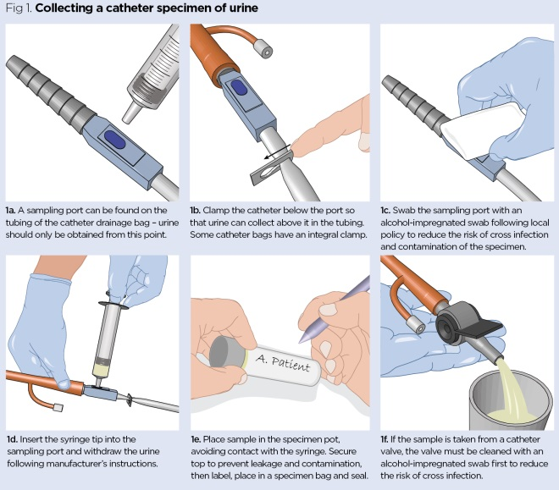

Slide 35
To Dip or Not to Dip? (Urinalysis)
Presence of bacteria in older people’s urine is not uncommon and does not mean there is an infection that needs antibiotics. Bacteria can live harmlessly in older people’s urine, with around 50% of these not causing any symptoms. For those with a long-term urinary catheter this can be higher.
Urinalysis (or urine dipsticks) are often used to diagnose UTIs within younger age groups when indicated by a clinical review. A sample which has a positive result for leucocytes (white blood cells) or nitrites (bacterial marker) may indicate a UTI in one age group, but this could be a normal finding for older people. Other symptoms such as drowsiness or falls can be also incorrectly interpreted to misdiagnose a UTI and miss the actual cause of these.
Antibiotics may then be inappropriately prescribed which increases risk of Clostridioides difficile (C.diff) as well as antibiotic resistance. This can mean infections could be difficult to treat in the future.
Determining a patient’s signs and symptoms is key to correctly diagnosing a UTI, obtaining and sending a urine sample to the lab is key to ensuring the most appropriate antibiotic to treat.

Slide 36
Reducing the risk of CAUTIs
There are several interventions to reduce the risk of catheter associated UTIs (CAUTI) including:
Timely removal of catheters when they are no longer clinically indicated (use of HOUDINI).
Hydration (with the caveat of people on restricted fluids due to medical reasons).
Avoiding bladder irritants, such as alcohol caffeinated and fizzy drinks.
Minimising urethral trauma.
Maintaining a closed drainage system.
Preventing cross infection by inserting and managing the catheter in line with aseptic technique guidance.
Ensuring there is an effective clinical plan and communication by using the catheter passport.
Monitoring for complications and ensuring early intervention.
Ensuring those accessing or caring for the catheter have appropriate levels of competency.
Ensuring catheters are changed in line with the clinical management plan (outlined in the catheter passport).
Changing the catheter if an infection arises, following the commencement of appropriate antibiotics.

Slide 37
Reducing the risk of CAUTIs – Hydration
Urine Scale Number | Description of urine colour | Action:
1 | Clear, pale yellow Suggests well hydrated | No immediate action required. Continue to maintain fluid intake.
2 | Light/transparent yellow Suggests an ideal level of hydration | No action required. Continue to maintain fluid intake.
3 | A darker yellow/pale honey Suggests you may need to have a drink soon | Have a drink as soon as you can.
4 | A yellow, cloudier colour Suggests you need a drink | If possible, please have a drink.
5 | A darker yellow Suggests you are starting to become dehydrated, | You need to increase your fluid intake, please have a drink, and monitor for improvements.
6 | Amber coloured urine Suggests dehydration and needs some fluids/drinks | You need to increase your fluid intake, please have a drink, and monitor for improvements.
7 | Orange/yellow urine Suggests that you are severely dehydrated | Increase the amount you are drinking, if possible. If this does not improve, please contact your healthcare team to discuss.
8 | Dark urine or red/brown urine | Contact your healthcare team to discuss.
9 | Red/brown urine or visible blood clots | Contact your healthcare team to discuss.

Slide 38
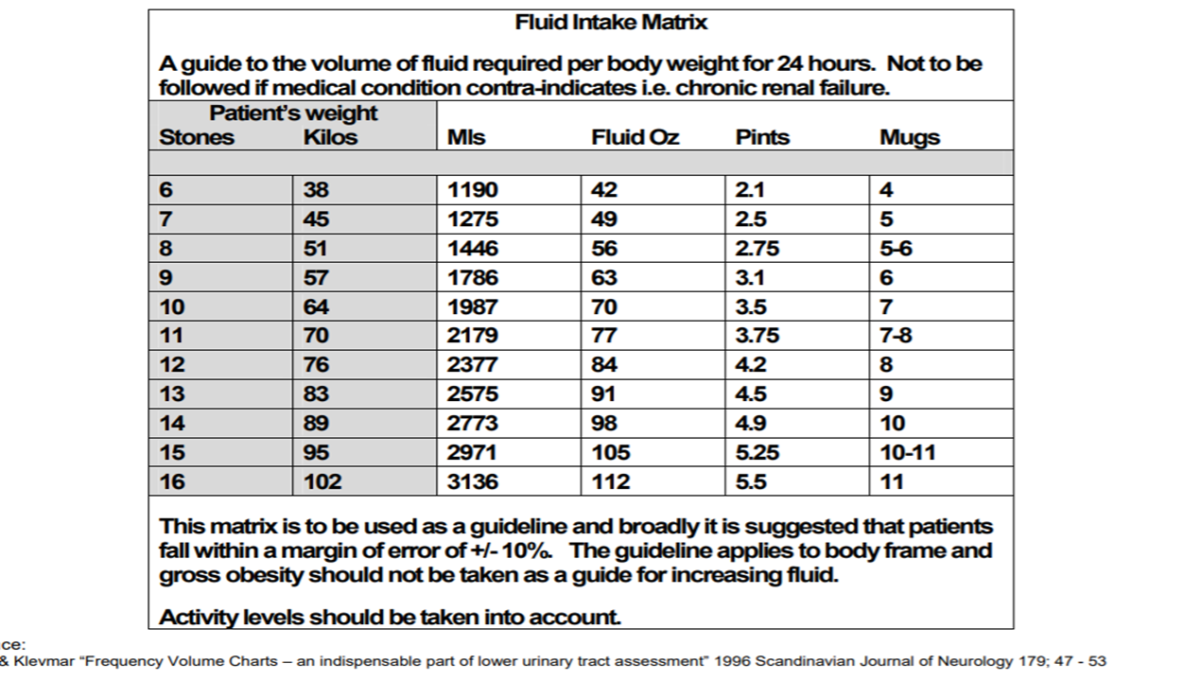
Stay Hydrated – see guide below based on an individual's weight…

Slide 39
Trial without catheter

Slide 40
Trial without Catheter (TWOC)
A TWOC involves removal of catheter for a trial period (usually 6 hours) to see if the patient can pass urine without it. The catheter is removed, and the patient is encouraged to drink as normal. Fluid input and urine output is then monitored/measured either by the patient or by the nurse. A bladder scan may be performed at the end of the trial period to see if there is any residual urine in the patient’s bladder.
If the patient is passing good amounts of urine normally then the TWOC has been successful, this may need confirmation using a post void bladder scan. However, if the patient is experiencing abdominal discomfort and there is a large amount of residual urine in the patient’s bladder on scanning, then re-catheterisation may be required.
There is evidence to show that utilising nurse led protocols for early assessment and removal of urinary catheters by nurses could achieve reductions in CAUTIs and improve patient health outcomes.
If a patient shows signs of a UTI, a MSU should be taken. If the MSU results are positive and confirmed within 48hrs of catheter removal this is a positive CAUTI.
If a patient has a failed TWOC, it is advised to re-catheterise and connect a catheter valve to encourage bladder training. The patient’s bowels should be re-assessed prior to the next TWOC attempt.
Nurse led HOUDINI.pdf
HOUDINI: make that urinary catheter disappear – nurse-led protocol - Debra Adams, Helen Bucior, Gina Day, Jo-Anne Rimmer, 2012

Slide 41
Clean Intermittent Catheterisation (CIC)
If a patient is unable to pass urine following removal of the urinary catheter, then the TWOC has failed. This may mean that re-catheterisation is necessary for the patient to empty their bladder; this can be facilitated using intermittent catheterisation.
Clean Intermittent Catheterisation (CIC) involves inserting a disposable catheter into the bladder to drain urine either into the toilet or clean receptacle designated for this (urinal or jug). Once the bladder is emptied then the catheter is removed. This is done regularly to prevent urinary retention and infections.
Using CIC can prevent the need for a long-term indwelling urinary catheter so minimising risks of acquiring a CAUTI.

Slide 42

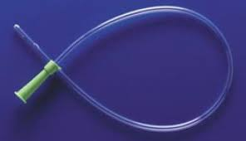
Clean Intermittent Catheterisation (CIC)
The catheters are single use (disposable), usually pre-lubricated and ready to use. Hands must be washed before and after the procedure to prevent contamination. Prior to CIC the patient’s genital area should also be cleaned either with soap and water or disposable wipes.
Patients can be taught how to self catheterise by a healthcare professional, such as a community nurse or continence specialist practitioner.

Slide 43
Troubleshooting catheters

Slide 44
Troubleshooting
Check that any tubing is not kinked, twisted or restricted by clothing or position of the patient
Make sure that tubing and catheter is not stretched or pulled tight as this might restrict urine flow. Use a securing aid such as a G-strap, leg bag straps or sleeve.
Check drainage bag is not full and is below level of bladder (especially if sitting or lying in bed). Use a drainage stand to secure bag to which will help prevent this.
Encourage patient to change position regularly and to move about if able.
Constipation can prevent a catheter from draining, so need to assess, treat and monitor. Encourage a healthy diet with plenty of fruit, veg and fibre. A digital rectal examination conducted by a qualified healthcare professional may be needed. Regular laxatives may be prescribed.
Make sure patient is drinking plenty of fluids – aim for 1.5- 2l per day (at least 8 cups/5 mugs)
Blockage may be caused by sediment (debris) blocking the catheter eyelets (holes) or around catheter tip – may need to consider frequency of catheter changes and use of catheter maintenance solutions if blockages occur frequently. This will be determined by the qualified healthcare professional responsible for the care and maintenance of the device.

Slide 45
When to escalate concerns

Slide 46
When to escalate concerns
Patients and carers should be advised to contact their healthcare professional, as outlined in their catheter passport, as soon as possible if the below symptoms are experienced:
Severe or persistent bladder spasms - similar to stomach cramps
Persistent haematuria or presence of clots in urine
Symptoms of a UTI – fever, chills, pain, foul smelling urine or presence of pus in urine
If an indwelling catheter falls out or is pulled out
Other symptoms may be present such as:
Low body temperature
Fast heart rate
Changes or problems with breathing
Vomiting
Headache
Skin discolouration
These may be potential signs of sepsis and medical advice/help should be immediately sought via NHS 111, Urgent Care Centre, or follow your local deteriorating patient/service user policy.

Slide 47
Useful Learning Resources
Fact Sheet on UTIs in Adults:
https://future.nhs.uk/A_M_R/view?objectId=1966857
Device related infection prevention practice (IPP):
https://future.nhs.uk/A_M_R/view?objectId=1966985
Urinary Catheterisation:
https://future.nhs.uk/A_M_R/view?objectId=1967017
Urinary Catheter Care:
https://future.nhs.uk/A_M_R/view?objectId=1966921

Slide 48

Thank you
Please contact us on
england.midland.ipc@nhs.net

