Slide 1

Intelligence to drive focus
(efficiencies, improved quality, gaps)

Slide 2
Variation in emergency admission rates

Slide 3
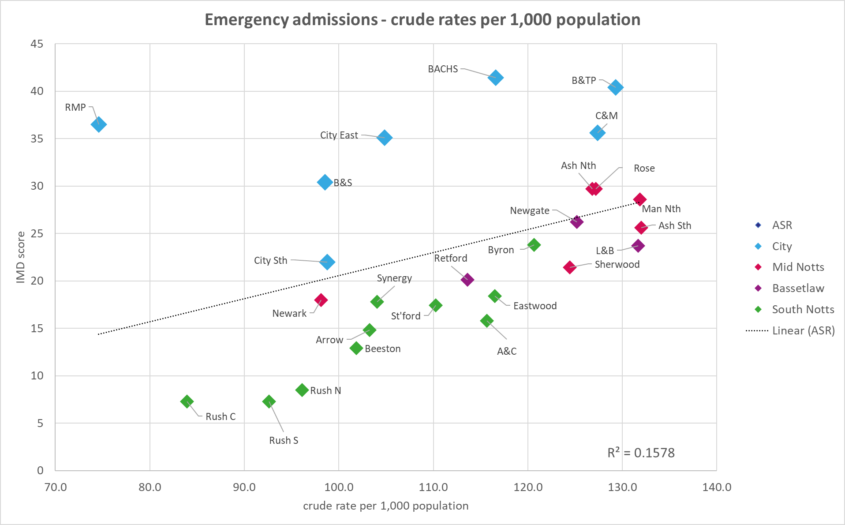
We might hypothesise that deprivation is a strong factor in driving higher emergency admission rates.
However, we can only see only a weak positive correlation (R²=0.16) between crude rates of emergency admissions and deprivation (IMD) when we analyse emergency admissions in 2019 (i.e. before the COVID-19 pandemic) for patients registered with a Nottingham and Nottinghamshire GP.

Slide 4
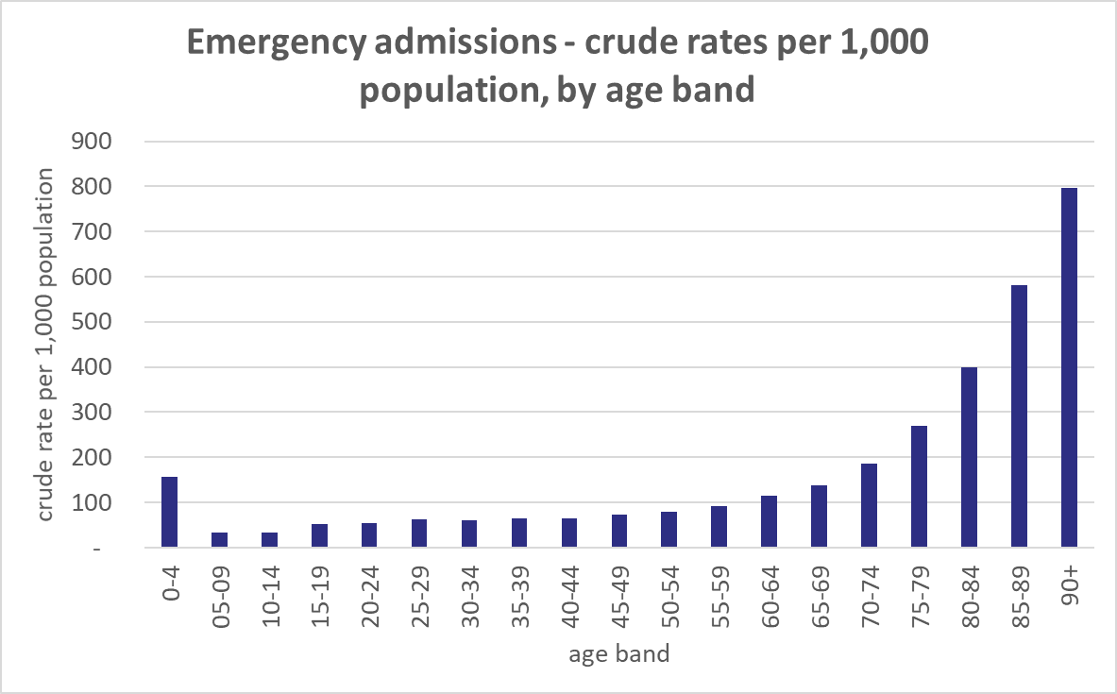
We can see age is also a very important factor to consider in understanding variation in emergency admissions:
admission rates for people aged 75-79 are 3.65 times higher than for the working age population;
this increases to 5.4x for people aged 80-84;
and 7.9x for people aged 85-89.
This suggests that we should adjust (or ‘standardise’) for age when we analyse variation.

Slide 5
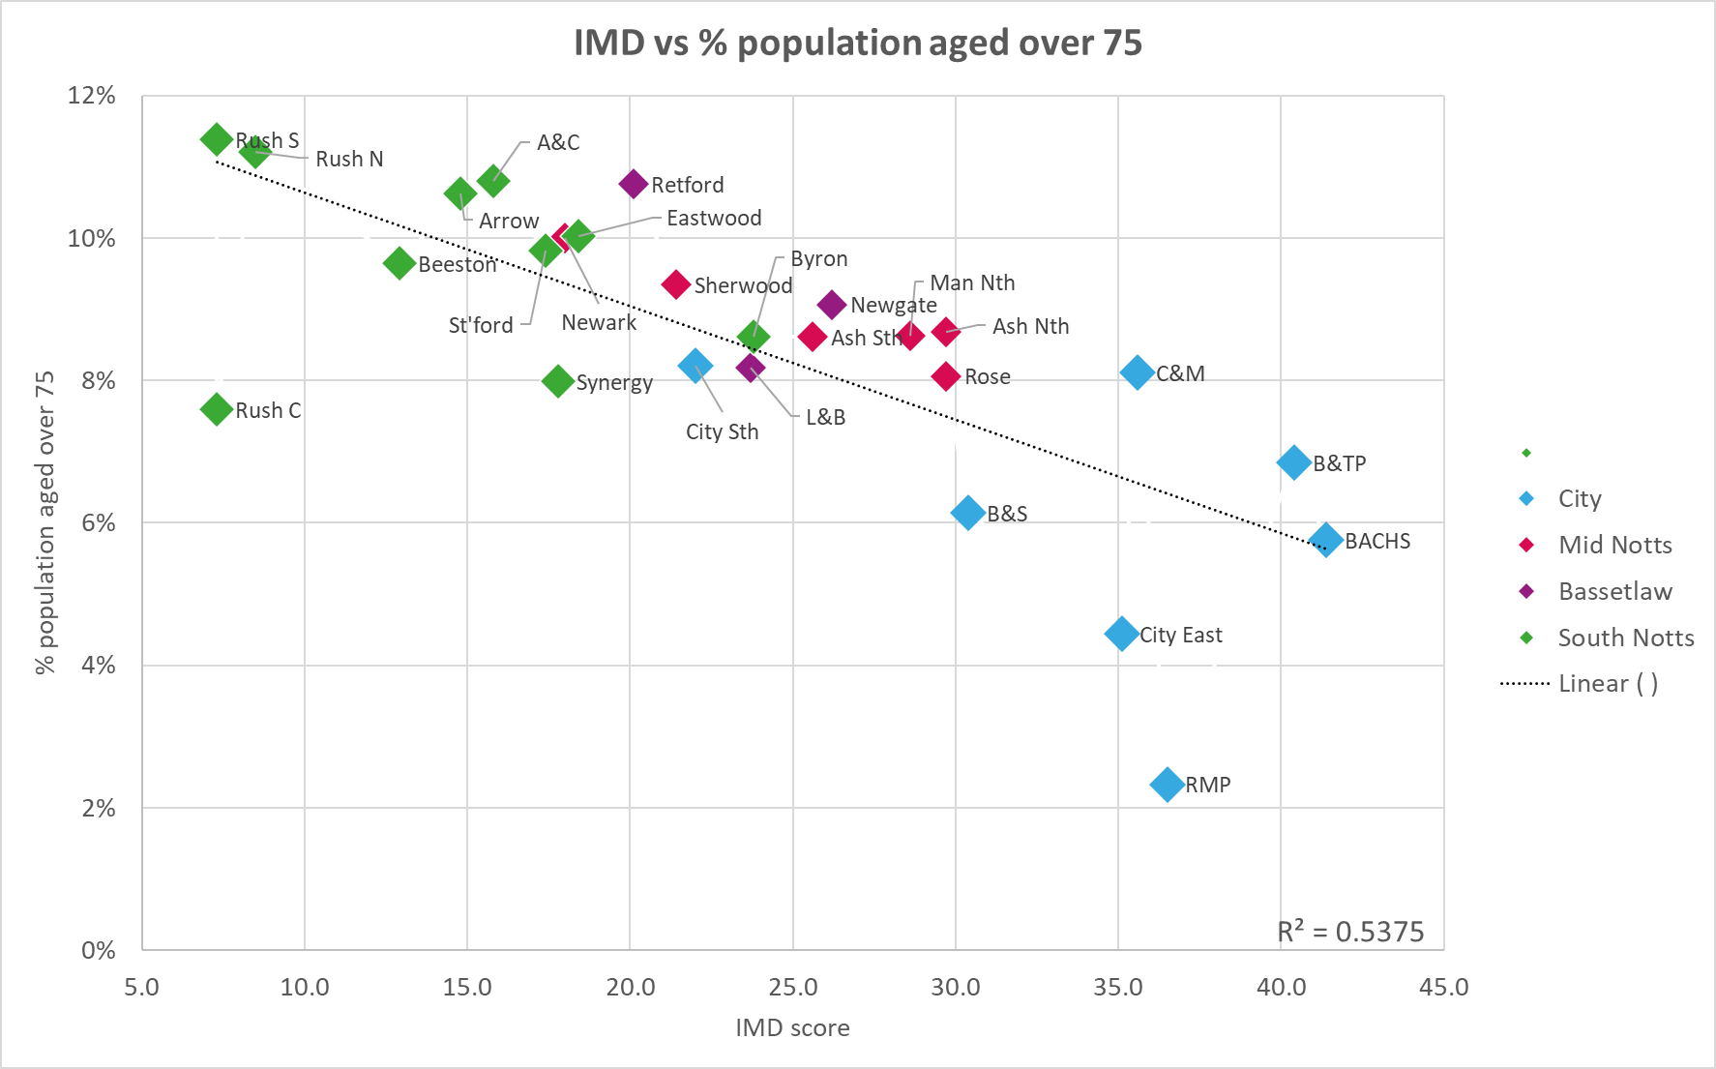
We can also see there is an inverse relationship between age and deprivation in Nottingham and Nottinghamshire ICS – generally the PCN neighbourhoods with the higher levels of deprivation have lower proportions of people aged over 75.
This means that more deprived neighbourhoods may have lower rates of emergency admissions because they have younger populations. We cannot change people’s age, but if we can standardise for age in the analysis, then the variation that remains may be modifiable in some way if we can identify interventions that reduce the need for emergency admissions, either by keeping people healthier so they do not develop the conditions associated with emergency admissions, or helping them manage their conditions better.

Slide 6
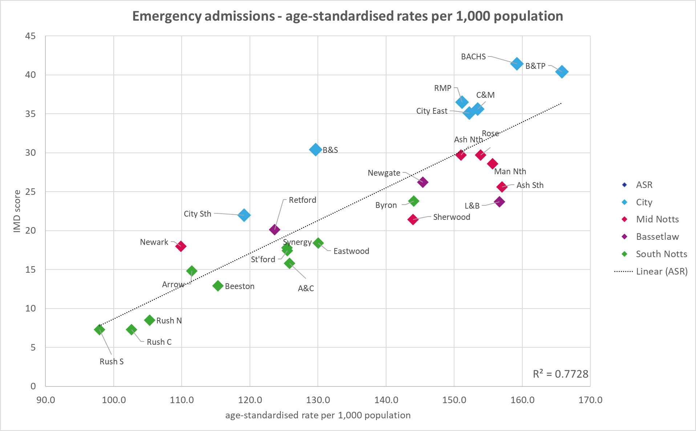
If we adjust for age and use age-standardised rates of emergency admissions, then we can see a strong positive correlation (R²=0.77) between higher deprivation levels and higher age-standardised emergency admission rates.
To take the two extremes, emergency admission rates for Bulwell & Top Valley and BACHS patients are 60-70% higher than those for patients in Rushcliffe South.

Slide 8
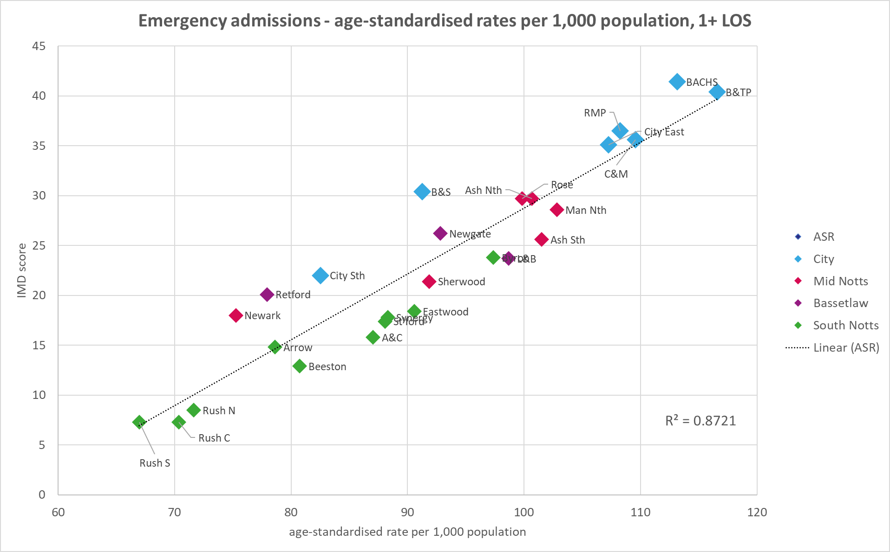
The correlation is even stronger if we exclude zero length of stay (SDEC) emergency activity; so the higher rates of activity we see in more deprived neighbourhoods are not driven by the less acute types of admission which do not require an overnight stay.

Slide 9
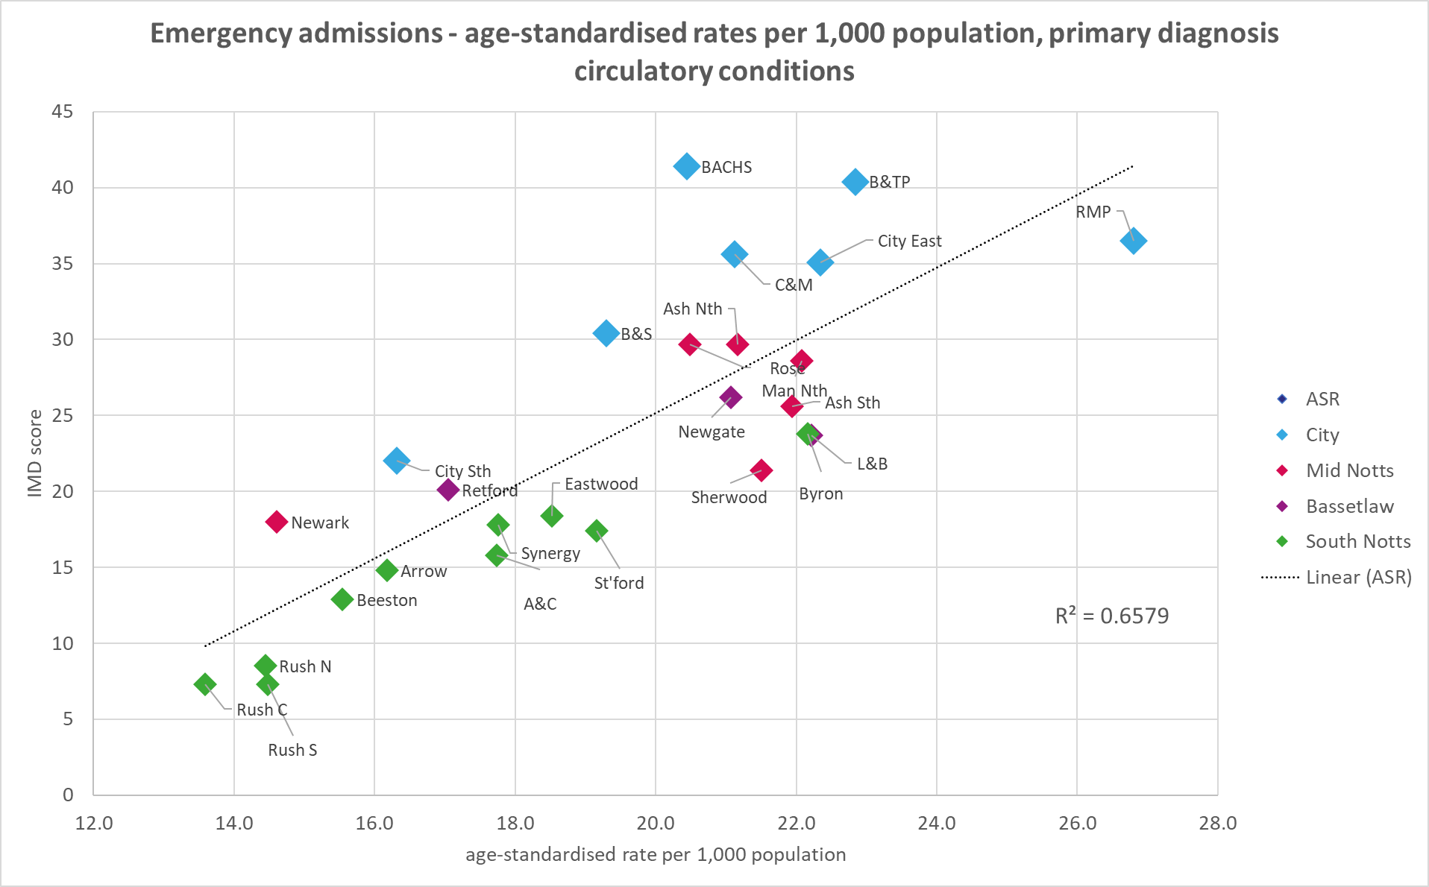
Circulatory
We see a moderate-to-strong positive correlation between deprivation and age-standardised emergency admission rates for circulatory conditions.

Slide 10
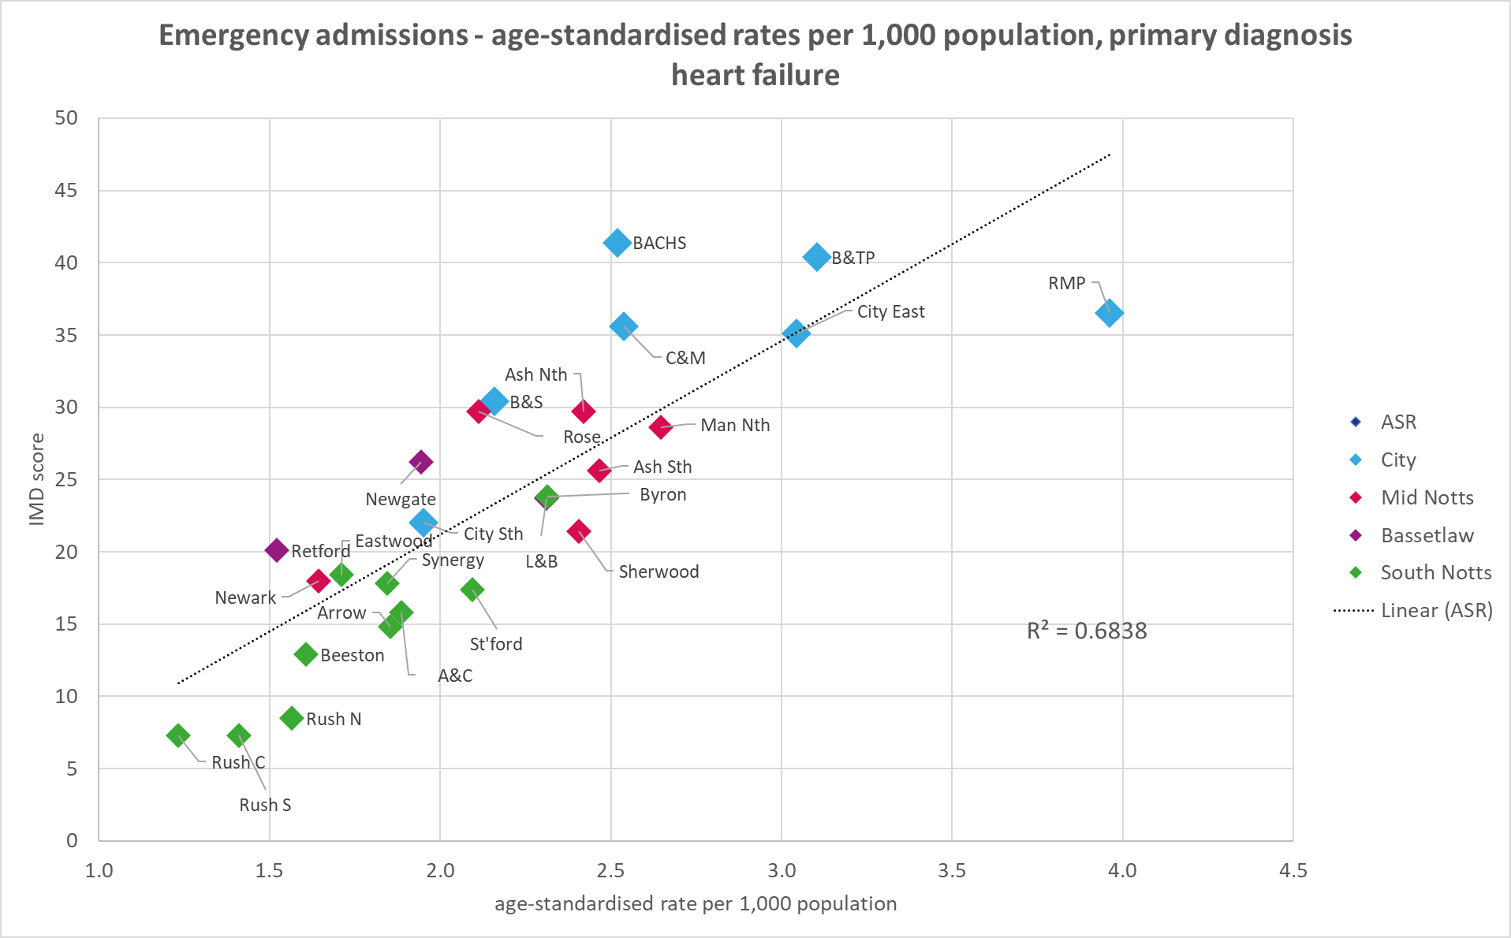
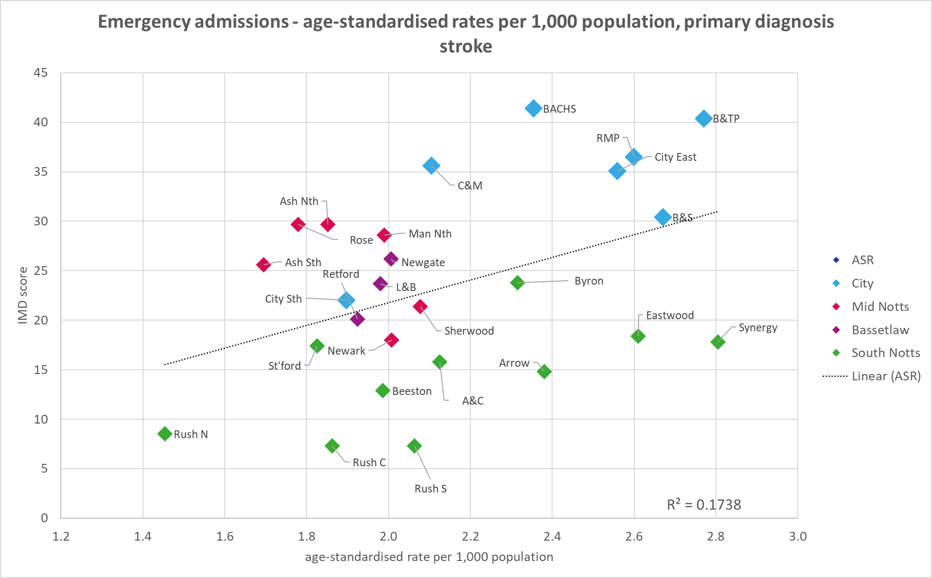
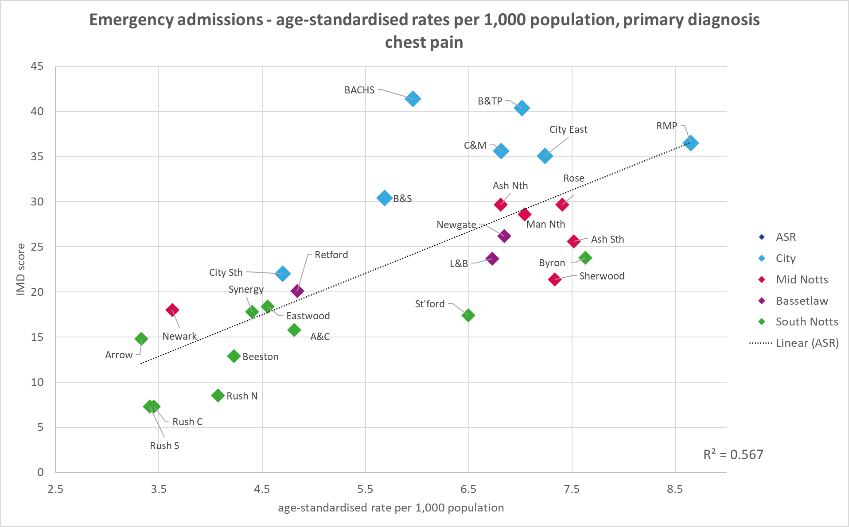
Circulatory - continued
Heart failure shows a strong positive correlation between deprivation and NEL rates with Radford and Mary Potter showing particularly high rates.
Chest pain shows a moderate positive correlation between deprivation and NEL rates. Again R&MP is the highest.
Stroke shows a low positive correlation between deprivation and NEL rates, with Synergy and Eastwood, both of which are less deprived, showing similar rates of activity to Bulwell & Top Valley, Bestwood and Sherwood and Radford & Mary Potter.

Slide 11
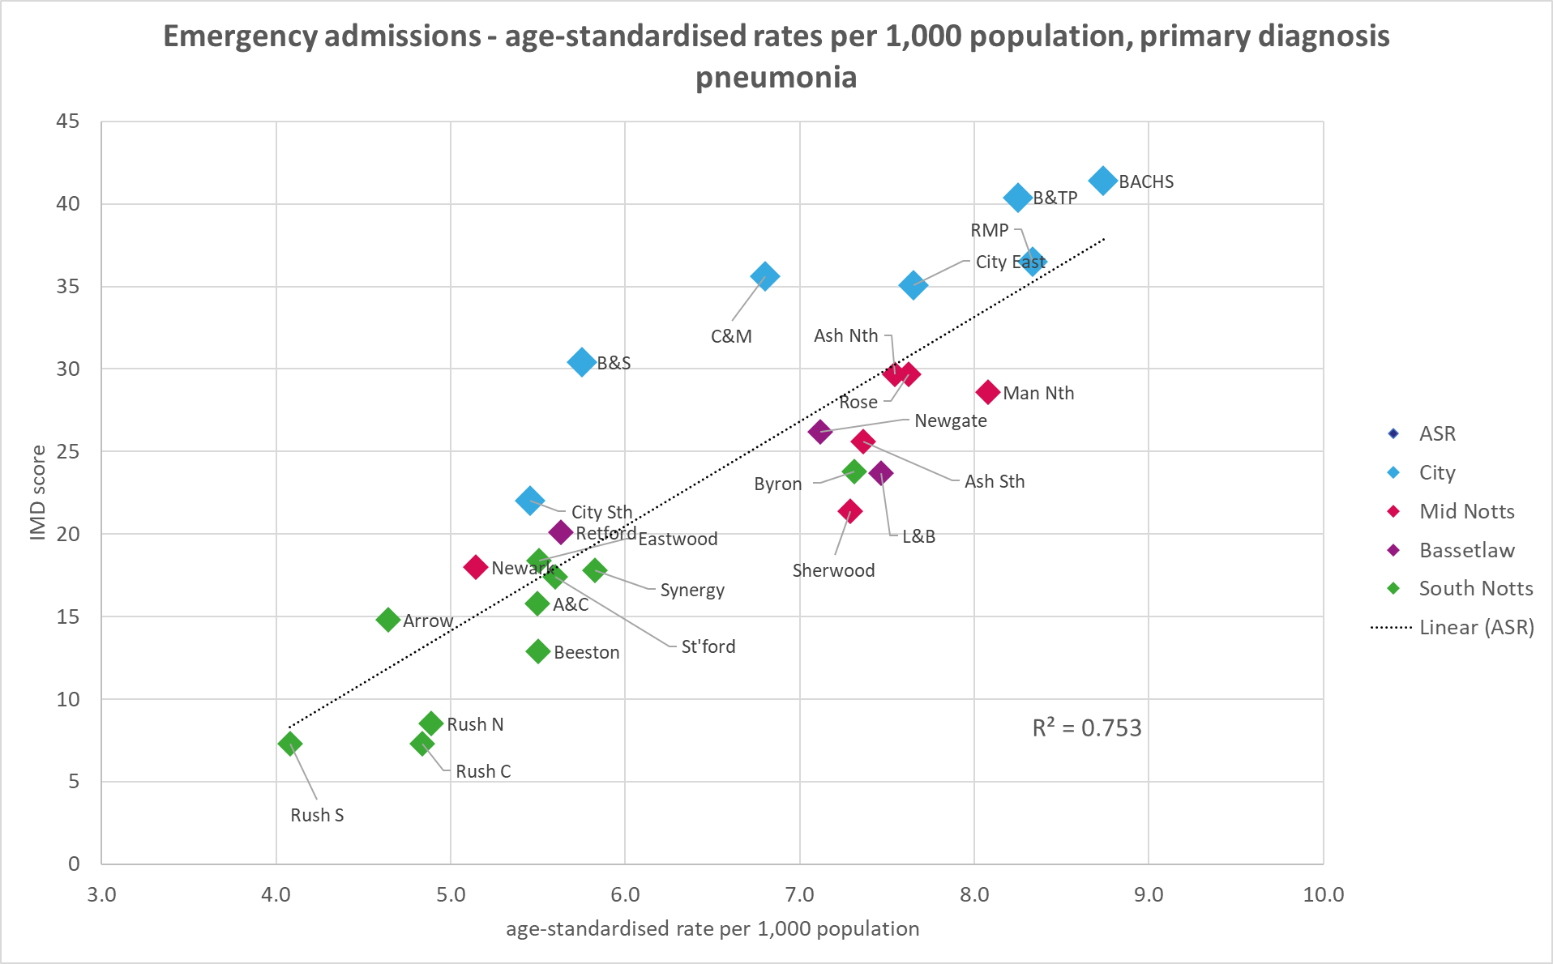
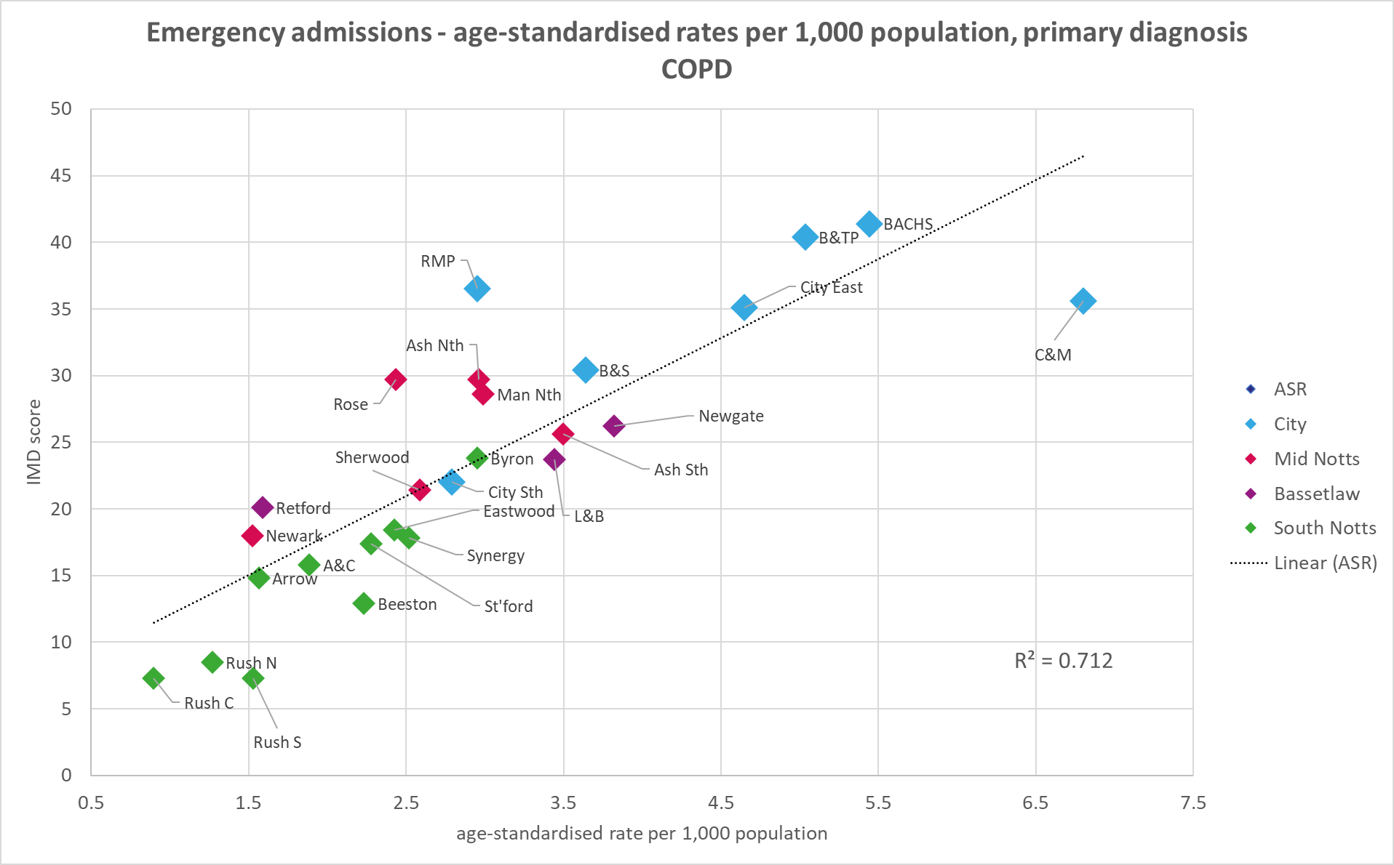
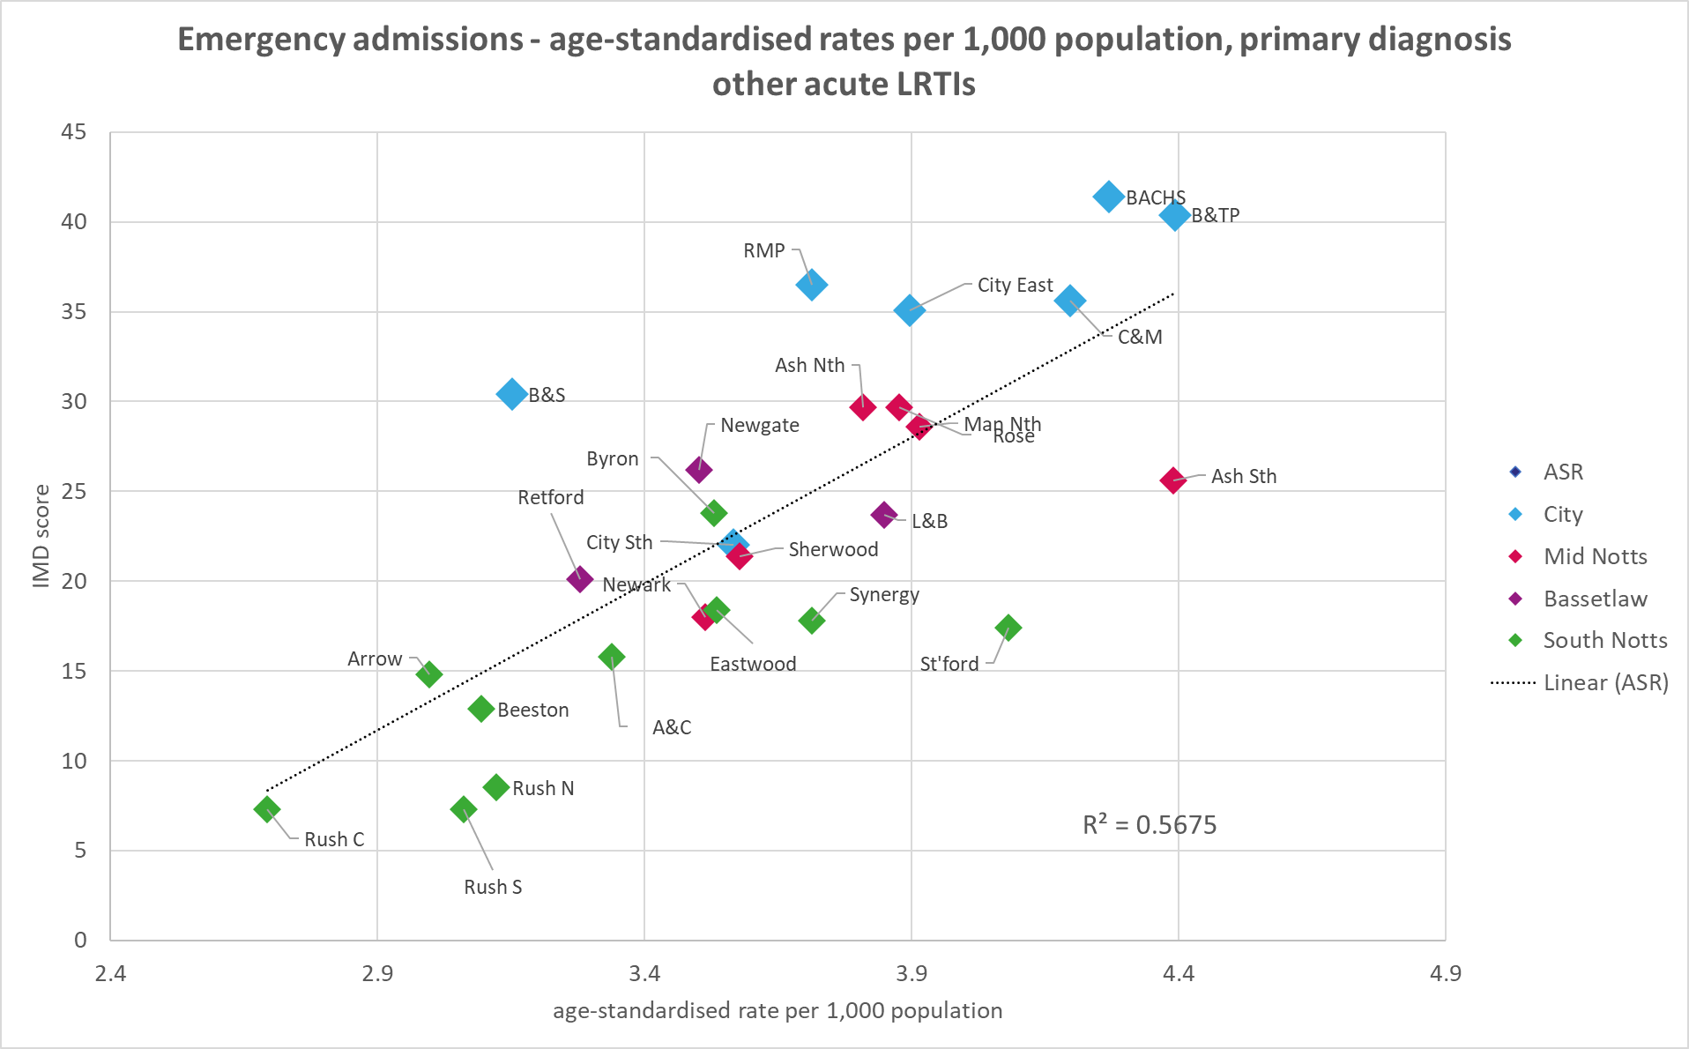
Respiratory
Respiratory conditions also show positive correlation between deprivation and age-adjusted NEL rates.
COPD shows a strong positive correlation between deprivation and NEL rates with Clifton & The Meadows showing the highest rates.
Pneumonia shows a strong positive correlation between deprivation and NEL rates, with the highest in BACHS, Radford & Mary Potter and Bulwell & Top Valley.
Acute lower respiratory tract infections show moderate positive correlation, with Bulwell & Top Valley and BACHS having the highest rates, along with Ashfield South, which is a bit of an outlier as is it only moderately deprived.

Slide 12
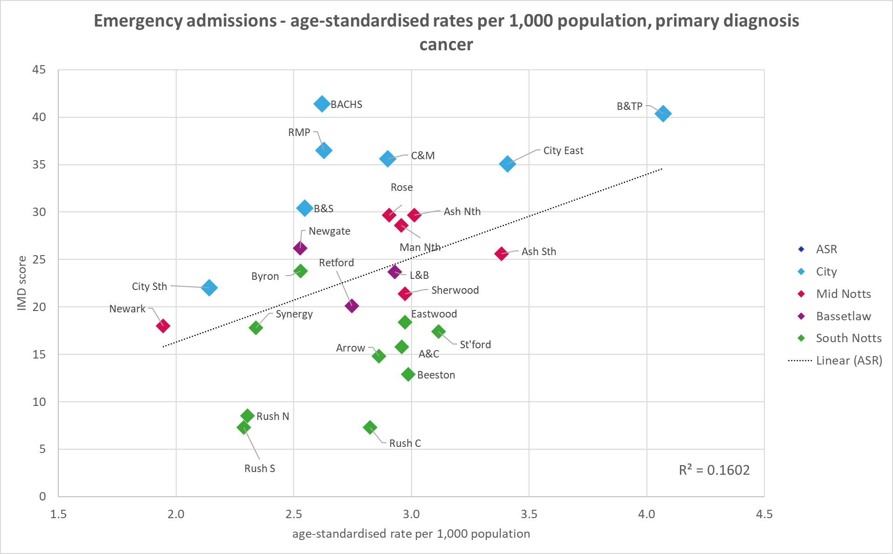
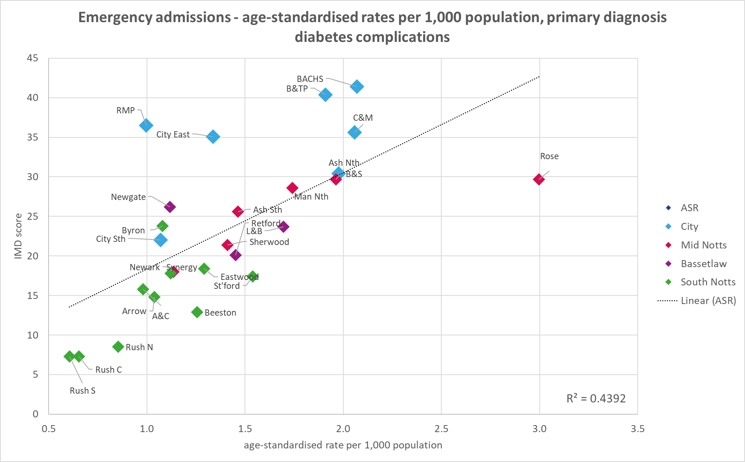
Cancer and Diabetes
There is a weak positive correlation between deprivation and emergency admissions for cancer.
This is similar to reported prevalence rates for cancer, which are also not higher locally in more deprived communities.
It would be interesting to understand if this is also seen in deaths from cancer, and/or to understand the variation for different types of cancer.
There is a moderate positive correlation between deprivation and emergency admissions for diabetes complications.
Rosewood is an outlier, with rates of admission 50% higher than the next highest neighbourhoods. Excluding Rosewood increases the R-squared value to 0.55.
Radford and Mary Potter and Nottingham City East are lower than expected given their levels of deprivation. Excluding these two neighbourhoods increases the R-squared value to 0.77 (strong correlation).

Slide 13
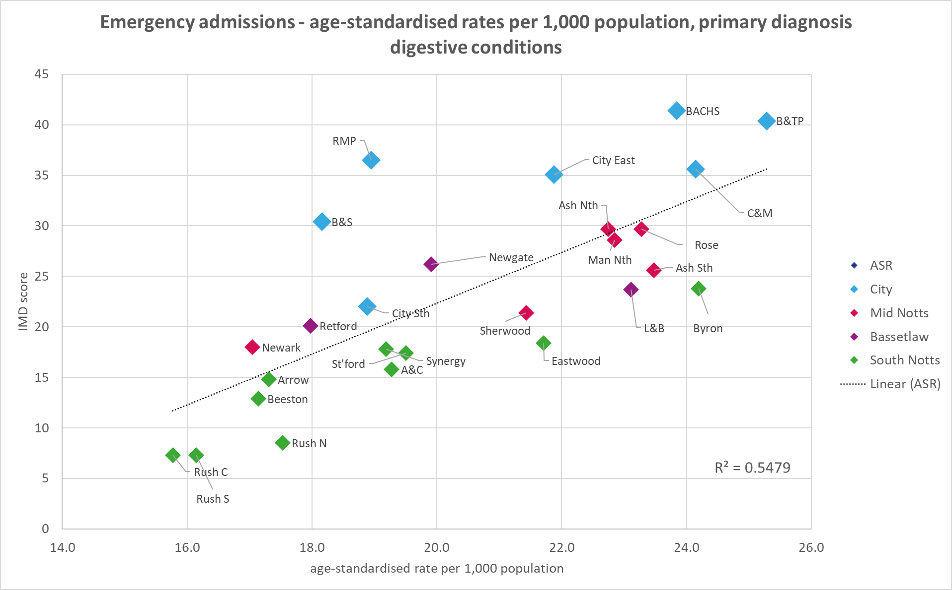
Digestive
There is moderate positive correlation between deprivation and emergency admissions for digestive system conditions.

Slide 14
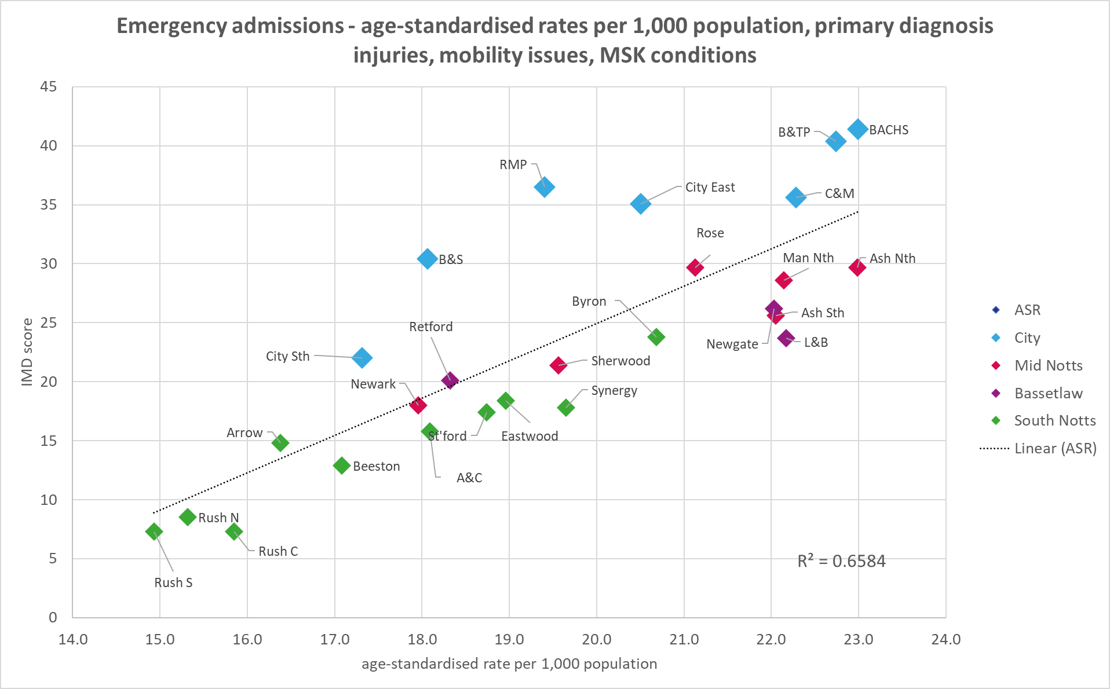
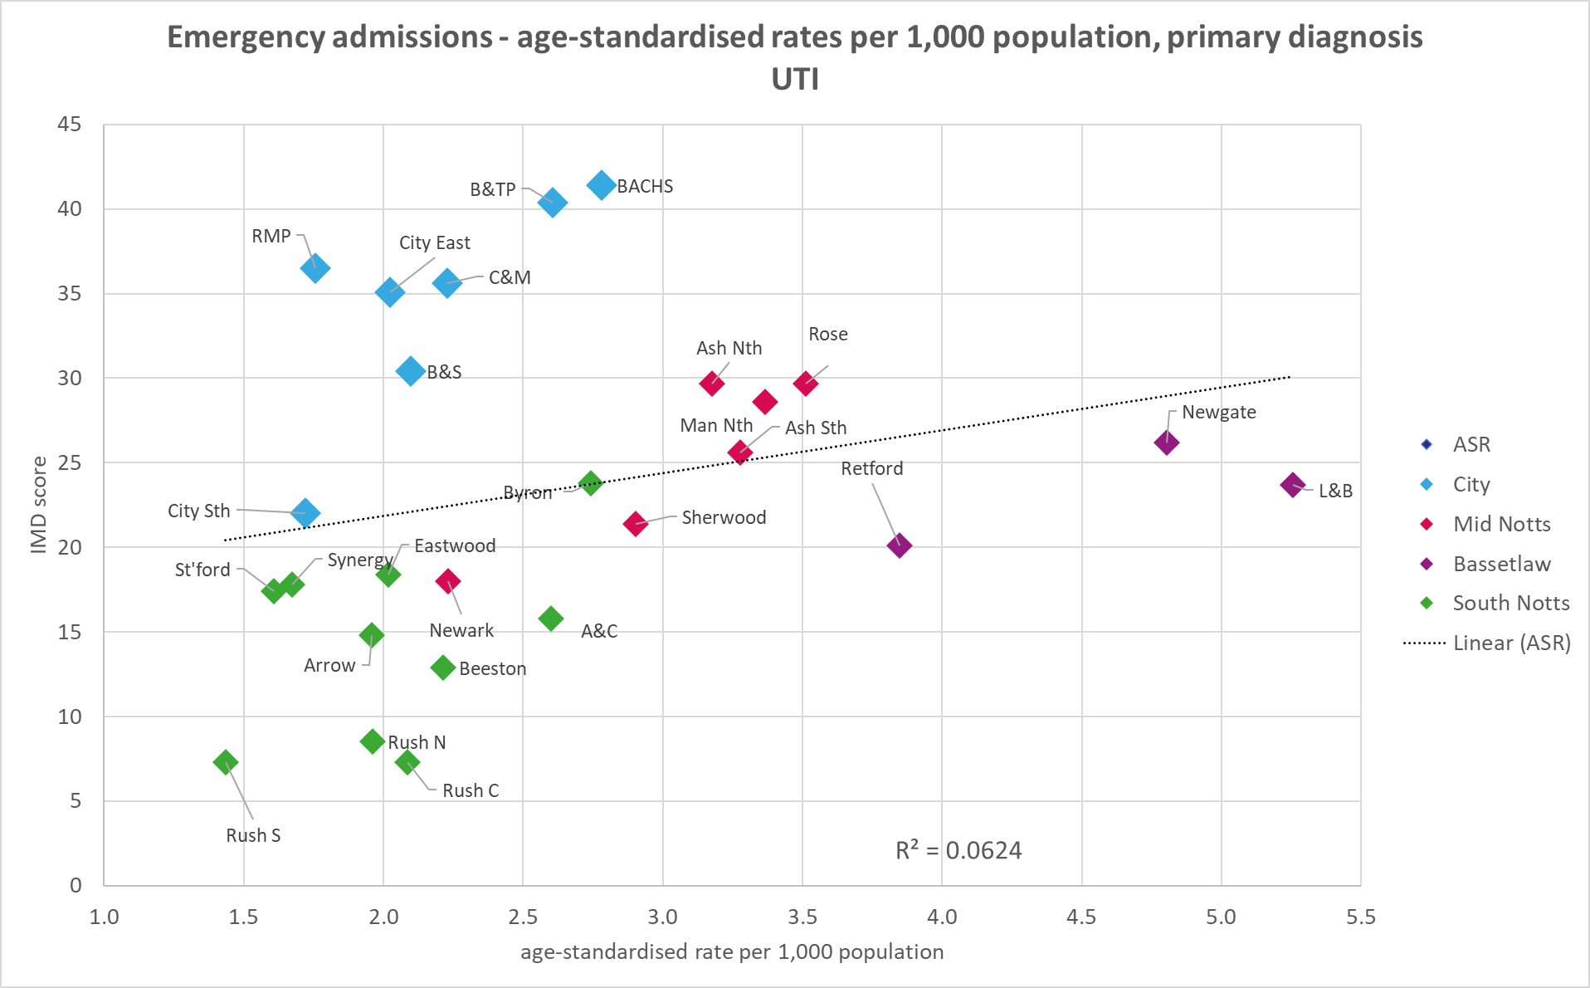
Injuries, mobility & MSK and Urinary tract infections
There is moderate-to-strong positive correlation between deprivation and emergency admissions for injuries, mobility issues and musculoskeletal conditions. This includes hip fractures and falls.
There is very weak positive correlation between deprivation and emergency admissions for urinary tract infections, with the three Bassetlaw neighbourhoods showing higher rates than all the other ICS neighbourhoods.

Slide 15
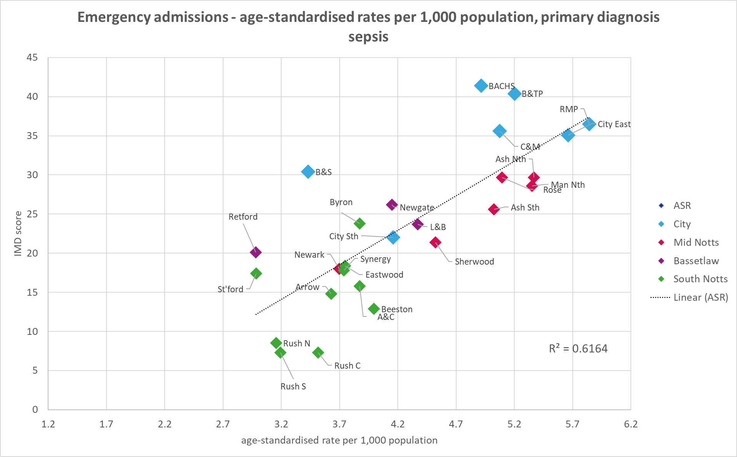
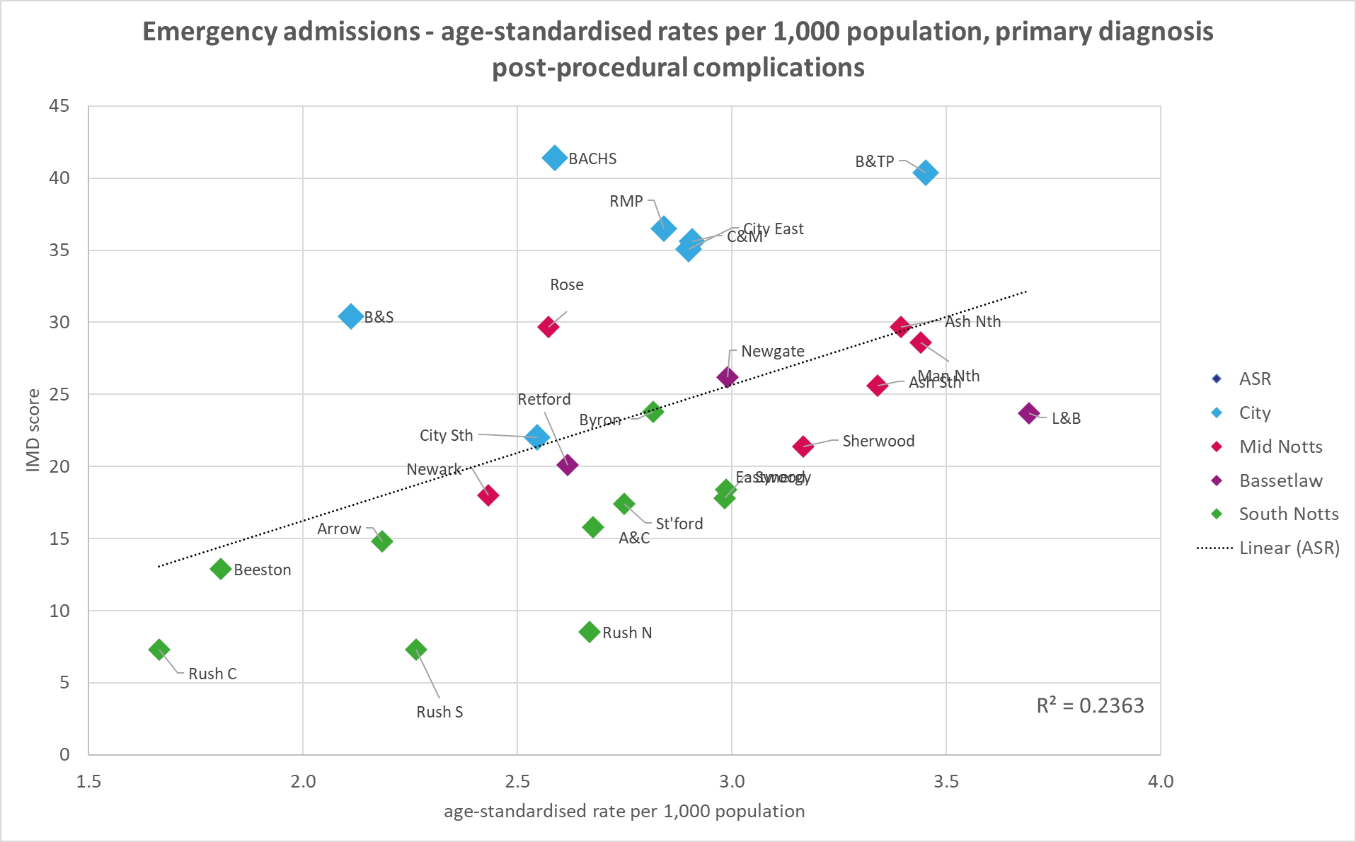
Sepsis and post-procedural complications
There is moderate-to-strong positive correlation between deprivation and emergency admissions for sepsis.
There is weak positive correlation between deprivation and emergency admissions for post-procedural complications.

