Slide 1
Elective Care Restoration –
Exploring Waiting List Inequalities
Combined Grant Thornton and SAIU analysis

Slide 2
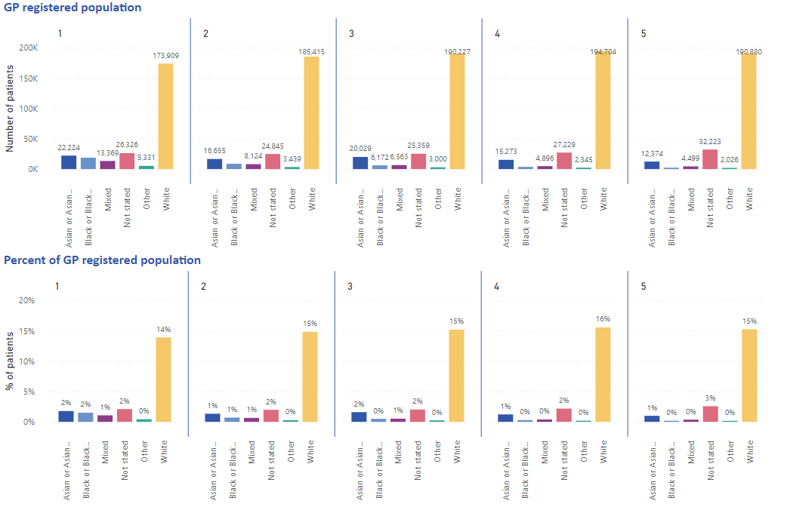
Ethnicity and deprivation breakdown of local population
GP data showing patient distribution across ethnic groups and deprivation quintiles.
There is a greater proportion of ethnic minorities in deprivation quintiles 1-3.
The White population is similarly distributed across all deprivation quintiles.
Data source: GPRCC population.

Slide 3
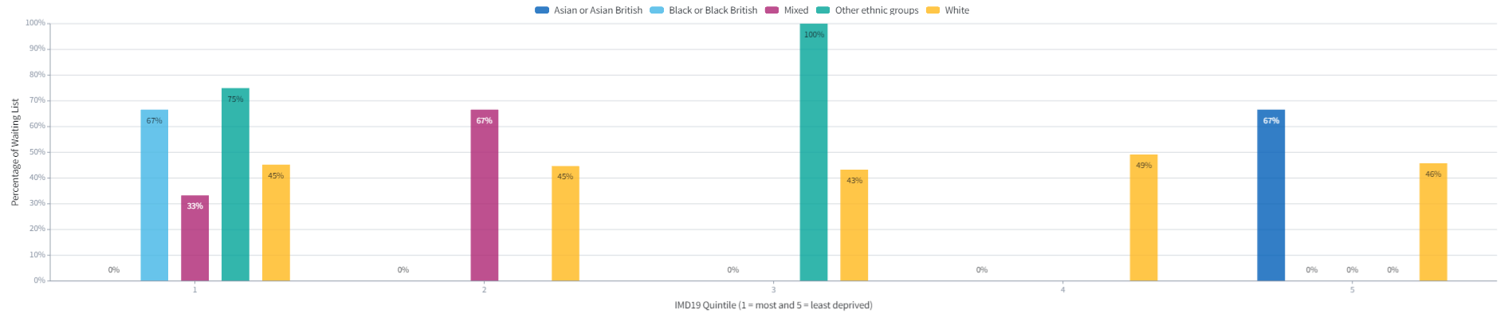
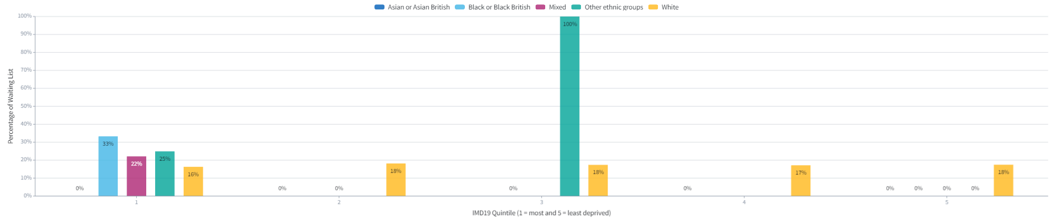
Trauma and orthopaedics patients waiting over 18 and 52 weeks – national data
Patients waiting over 18 weeks
These graphs display all T&O patients waiting over 18 and 52 weeks split by:
deprivation deciles 1-5 (1 being the most deprived);
And ethnicity (displayed by colour).
Patients waiting over 52 weeks
Source: The Foundry, Health Inequalities Workspace
Date: February 2022
Key Message:
Within the most deprived of society (IMD quintile of 1), there are patients of White, Black, Mixed and Other ethnicity waiting 18+ weeks for trauma and orthopaedics treatment. There are no patients of an Asian ethnicity. Within the least deprived group (IMD quintile of 5), however, 67% of Asian’s have been waiting 18+ weeks. This indicates a clear difference in the waiting list composition based on deprivation of the Asian community.
The percentage of White patients waiting 18+ and 52+ weeks remains consistent across all levels of deprivation. This is the only ethnicity to do so.
For Black/Black British, only the most deprived of this population are on the waiting list for trauma and orthopaedic surgery. This applies to the 18+ and 52+ week waiting list.

Slide 4
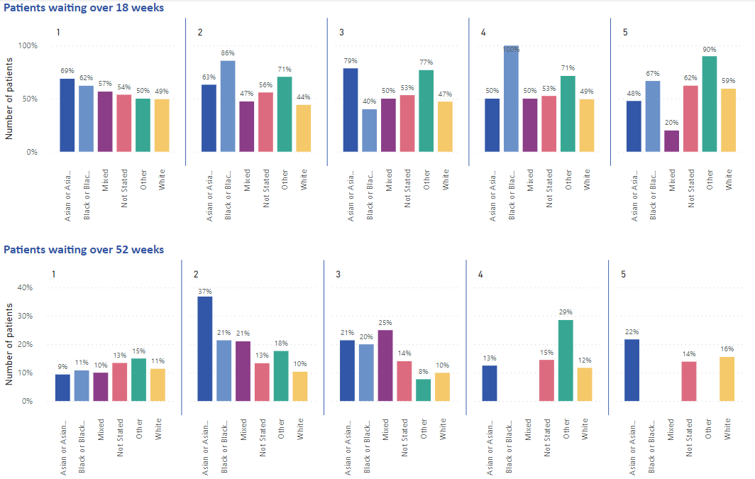
Trauma and orthopaedics patients waiting over 18 and 52 weeks – local data
Local waiting list data tells a different story to the national data – a greater percent of patients are waiting over 18 weeks than shown in the national data.
Local data shows that Asian or Asian British, Black or Black British and Other groups tend to have a greater proportion of patients waiting over 18 weeks compared to the White population across all deprivation quintiles.
In the White population those in low deprivation quintile (IMD 5) have a greater proportion of patients waiting longer (59% IMD 5 compared to 49% IMD 1)
Data source: NHIS ‘National Waiting Lists Open Pathways’ dataset, week ending February 27 2022.

Slide 5
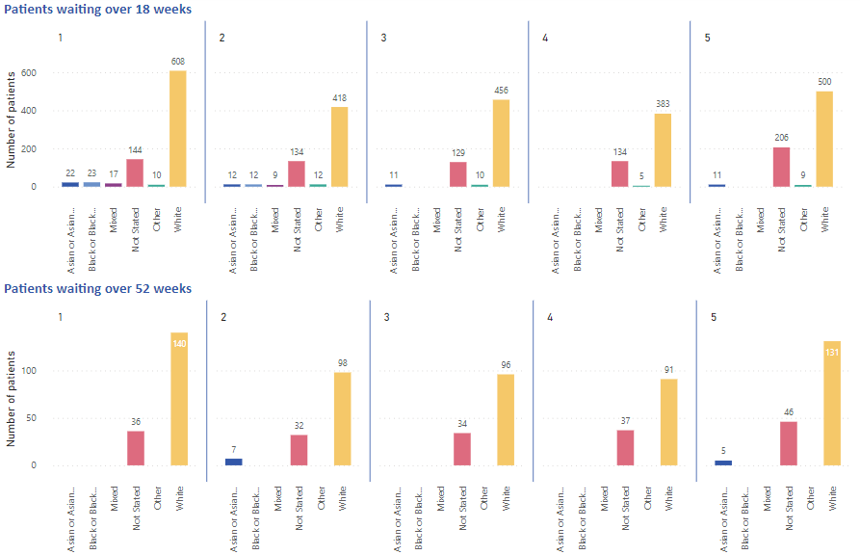
Trauma and orthopaedics patients waiting over 18 and 52 weeks – local data
Local waiting list data can be used to determine the patient denominators within each ethnic group and deprivation quintile.
The number of individuals waiting over 18 or 52 weeks in minority ethnic groups is much smaller than the White population.
This explains why some percentages appear very large for these groups (i.e. 100% of Black or Black British patients in deprivation quintile 3 waiting over 18 weeks is 2 individuals).
Note: numbers below 5 have been suppressed for information governance purposes.
Data source: NHIS ‘National Waiting Lists Open Pathways’ dataset, week ending February 27 2022.

Slide 6
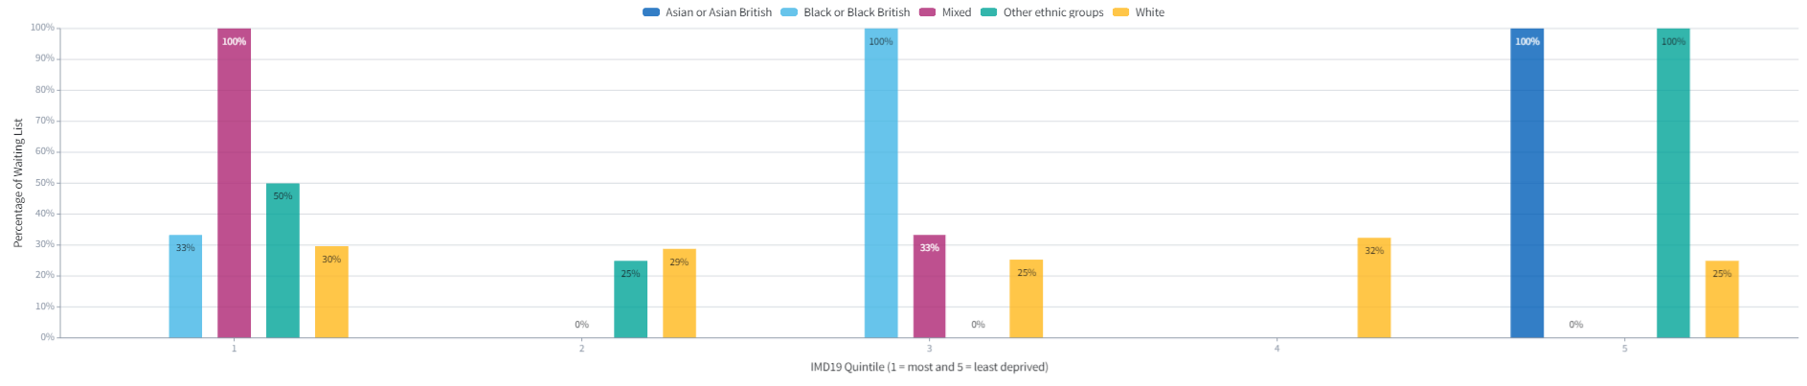
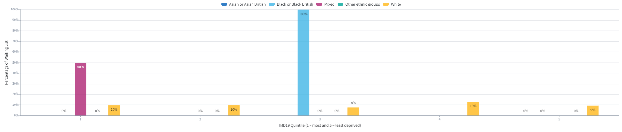
General surgery patients waiting over 18 and 52 weeks – national data
Patients waiting over 18 weeks
These graphs display all general surgery patients waiting over 18 and 52 weeks split by:
deprivation deciles 1-5 (1 being the most deprived);
And ethnicity (displayed by colour).
Patients waiting over 52 weeks
Source: The Foundry, Health Inequalities Workspace
Date: February 2022
Key Message:.
Within the most deprived of society (IMD quintile of 1), there are patients of White, Black, Mixed and Other ethnicity waiting 18+ weeks for trauma and orthopaedics treatment. There are no patients of an Asian ethnicity. Within the least deprived group (IMD quintile of 5), however, 100% of Asian’s have been waiting 18+ weeks. Consistent with the T&O waiting list, this indicates a clear difference in the waiting list composition based on deprivation of the Asian community.
The percentage of White patients waiting 18+ and 52+ weeks remains consistent across all levels of deprivation. This is the only ethnicity to do so.
For Black/Black British, 100% of the population within the mid-quintile (IMD 3) have been waiting 18+ and 52+ weeks.

Slide 7
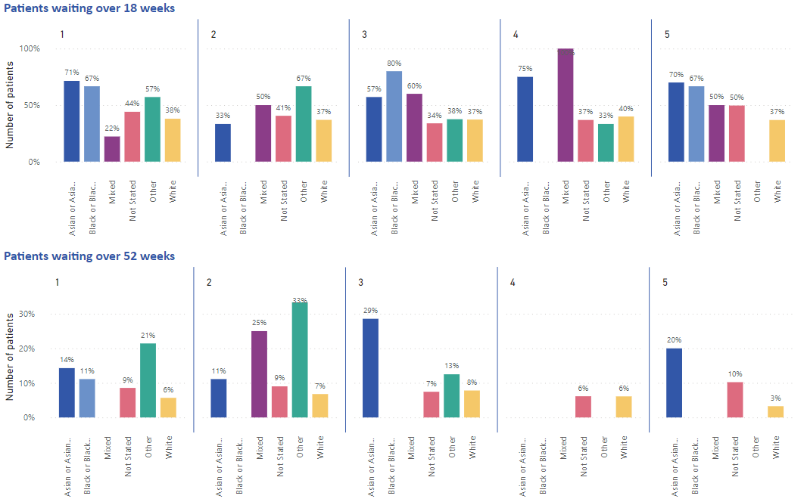
General surgery patients waiting over 18 and 52 weeks – local data
The general surgery waiting list shows a similar trend to T&O where Asian or Asian British, Black and Black British and Mixed patients have greater proportion of patients waiting over 18 weeks compared to White patients.
Within the White group there are few differences in the proportion of patients waiting for General Surgery over 18 weeks by deprivation quintile, but there is a difference in the number waiting over 52 weeks by deprivation quintile.
6-8% of White patients in IMD 1-4 wait over 52 weeks, only 3% of White patients in IMD 5 wait over 52 weeks.
Data source: NHIS ‘National Waiting Lists Open Pathways’ dataset, week ending February 27 2022.

Slide 8
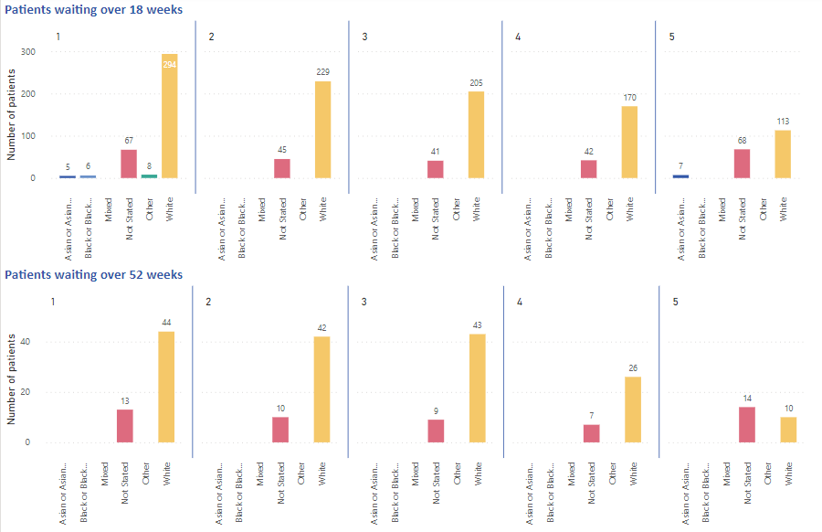
General surgery patients waiting over 18 and 52 weeks – local data
However the total number of patients waiting in the Minority Ethnic groups is much lower than the White group.
In the White population, there are twice as many people in IMD 1 waiting over 18 weeks for General Surgery compared to IMD 5, and four times as many people waiting over 52 weeks in IMD 1-3 compared to IMD 5.
Data source: NHIS ‘National Waiting Lists Open Pathways’ dataset, week ending February 27 2022.

Slide 9
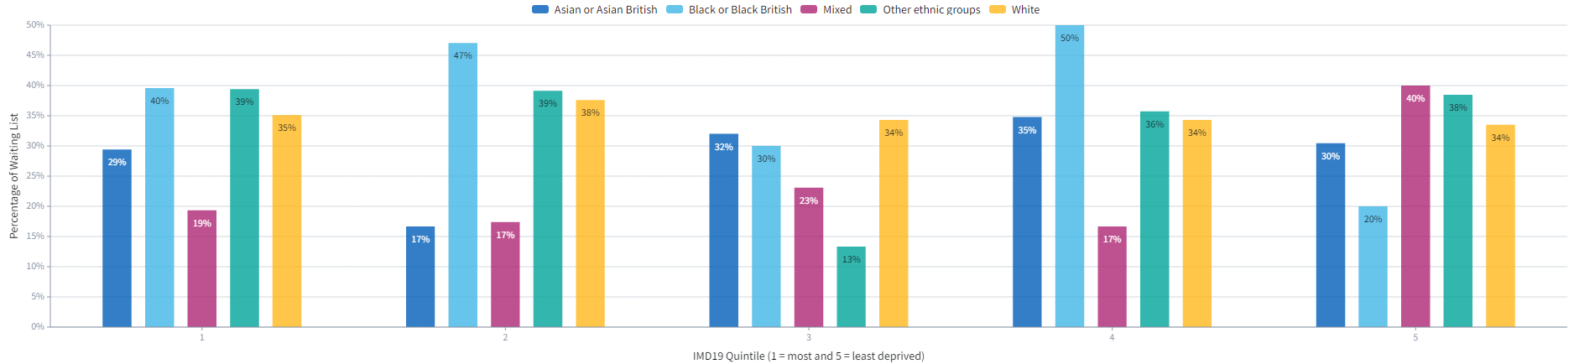
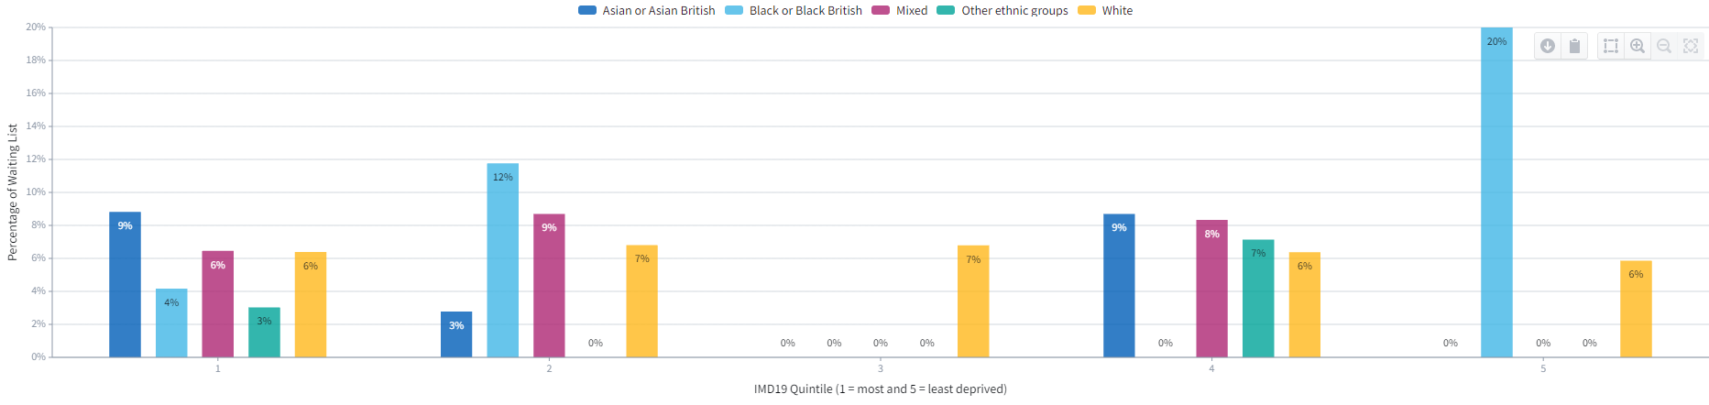
ENT patients waiting over 18 and 52 weeks – national data
Patients waiting over 18 weeks
These graphs display all ENT patients waiting over 18 and 52 weeks split by:
deprivation deciles 1-5 (1 being the most deprived);
And ethnicity (displayed by colour).
Patients waiting over 52 weeks
Source: The Foundry, Health Inequalities Workspace
Date: February 2022
Key Message:.
There are patients of all ethnicities, across all deprivation levels, who have been waiting 18+ weeks for ENT treatment.
Within the most deprived of society (IMD quintile of 1), those of a Black ethnicity have the highest percentage of individuals waiting 18+ weeks (40%). Within the lease deprived (IMD quintile of 5), those of a mixed ethnicity have the highest percentage (40%).
The percentage of White patients waiting 18+ and 52+ weeks remains consistent across all levels of deprivation. This is the only ethnicity to do so.
There are patients of all ethnicities, within an IMD quintile of 1, who have been waiting 52+ weeks. Within IMD quintiles 2-5, there is less representation across ethnic groups.

Slide 10
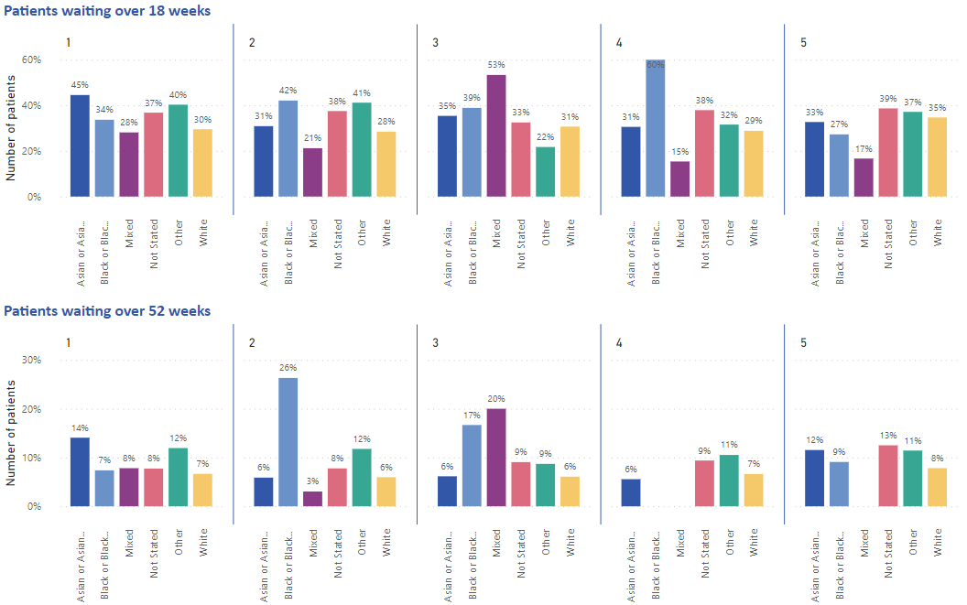
ENT patients waiting over 18 and 52 weeks – local data
Across deprivation quintiles there is a greater proportion of monitory ethnic patients waiting over 18 weeks compared to white patients.
In the Asian or Asian British population there is a greater proportion of patients waiting longer in more deprived areas than in less deprived areas.
Data source: NHIS ‘National Waiting Lists Open Pathways’ dataset, week ending February 27 2022.

Slide 11
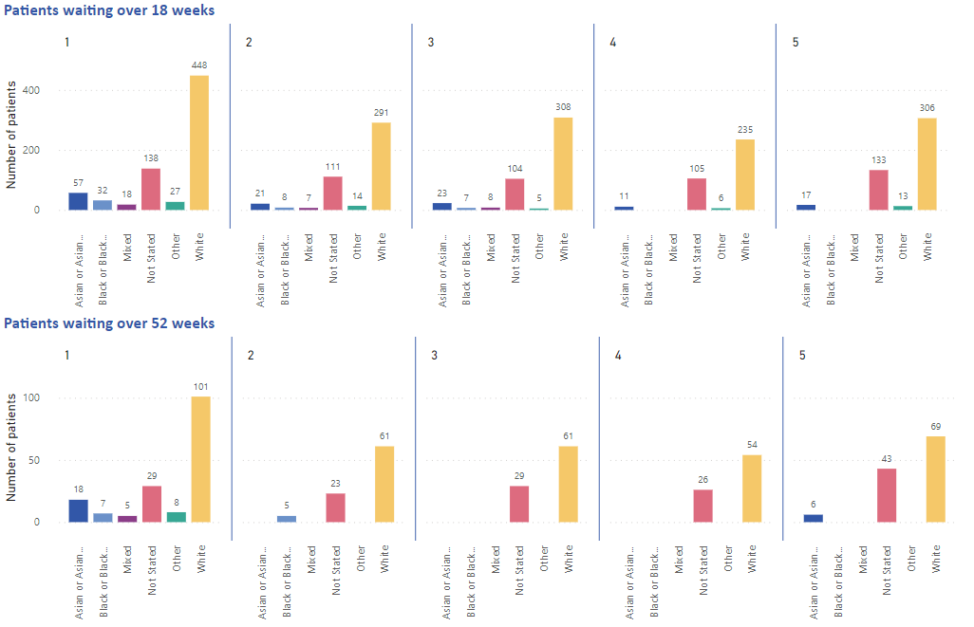
ENT patients waiting over 18 and 52 weeks – local data
Across all ethnic groups there appears to be a trend of greater number of people in more deprived areas (IMD 1) waiting longer compared to those in less deprived areas.
Data source: NHIS ‘National Waiting Lists Open Pathways’ dataset, week ending February 27 2022.

Slide 12
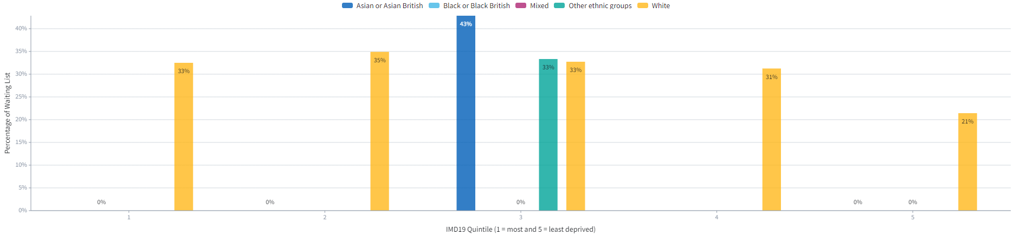
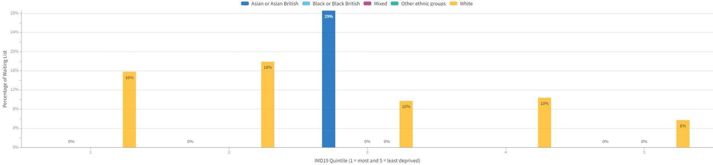
Urology patients waiting over 18 and 52 weeks – national data
Patients waiting over 18 weeks
These graphs display all urology patients waiting over 18 and 52 weeks split by:
deprivation deciles 1-5 (1 being the most deprived);
And ethnicity (displayed by colour).
Patients waiting over 52 weeks
Source: The Foundry, Health Inequalities Workspace
Date: February 2022
Key Message:.
White patients comprise the majority of those waiting 18+ and 52+ weeks for urology treatment. This applies to all deprivation levels.
Within IMD quintile 3, there is a significant spike in Asian patients who have been waiting 18+ weeks (43%) and 52+ (29%) weeks. There are no Asian patients across any other IMD quintiles.
There are no Black patients or those of a mixed ethnicity observed.

Slide 13
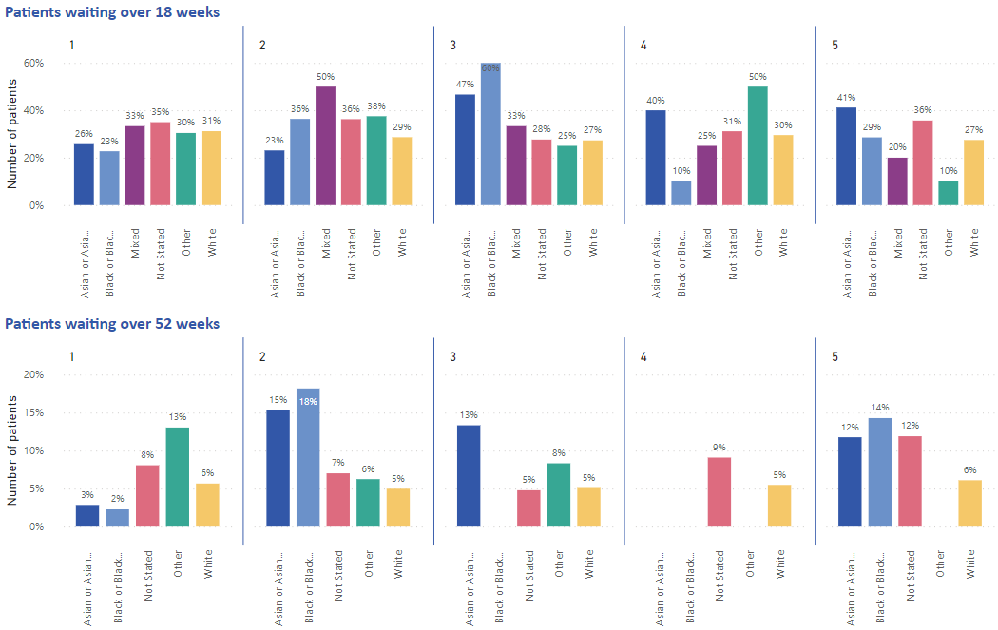
Urology patients waiting over 18 and 52 weeks – local data
In the White population the proportion of patients waiting over 18 or 52 weeks appears the same across deprivation quintiles.
There is some variation across minority ethnic groups but they proportion waiting over 18 weeks is similar to the White population in IMD 1,2,4 and 5.
Data source: NHIS ‘National Waiting Lists Open Pathways’ dataset, week ending February 27 2022.

Slide 14
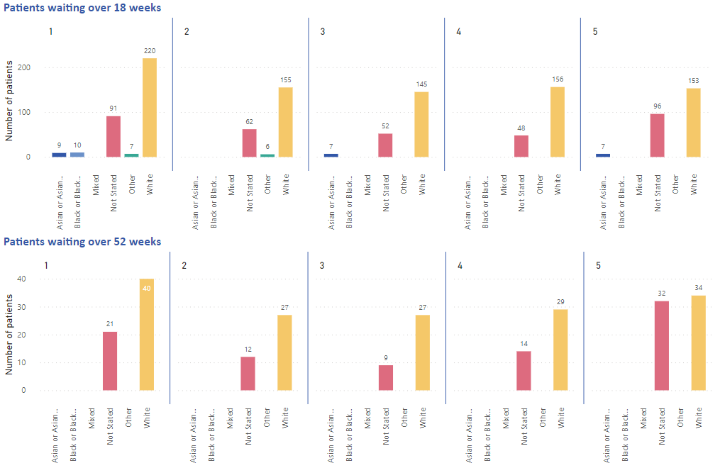
Urology patients waiting over 18 and 52 weeks – local data
The number of ethnic minority individuals waiting over 18 weeks on the urology waiting list is very small.
In the White population there doesn’t appear to be a great difference in across deprivation quintiles.
Data source: NHIS ‘National Waiting Lists Open Pathways’ dataset, week ending February 27 2022.

Slide 15
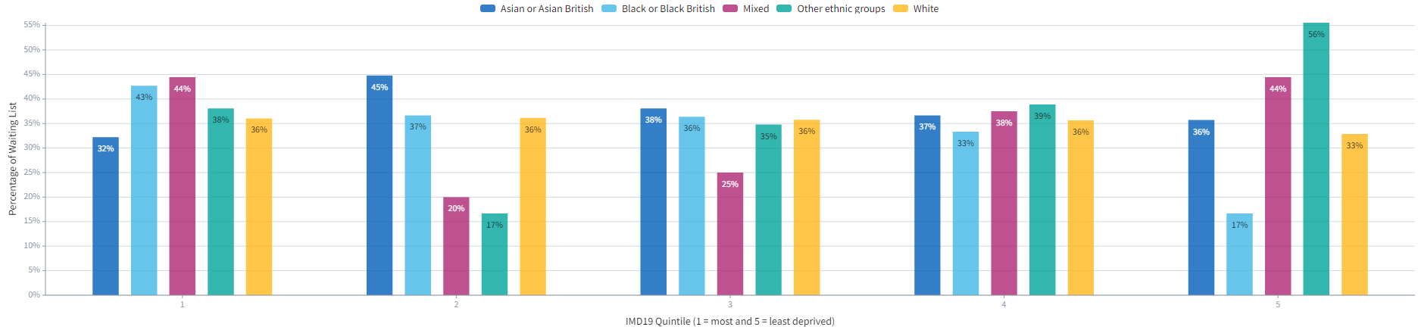
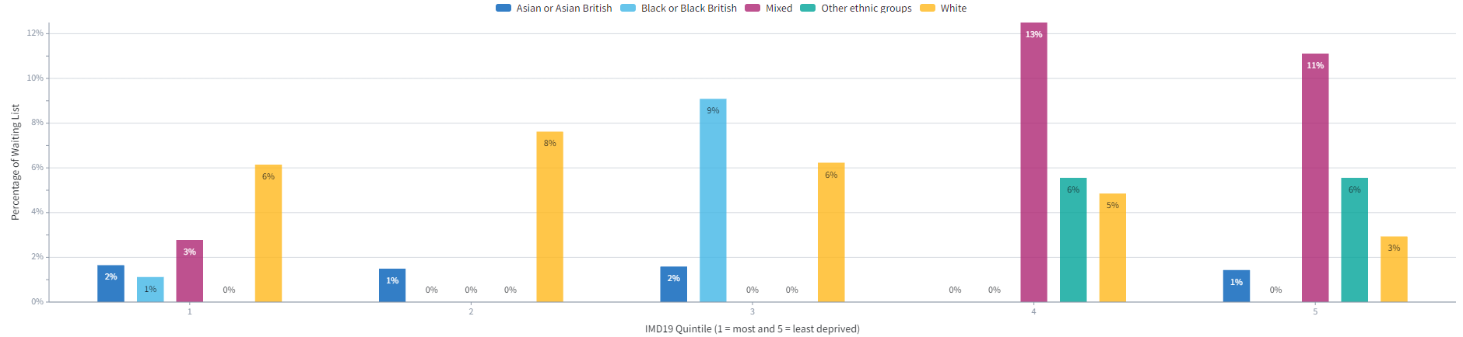
Ophthalmology patients waiting over 18 and 52 weeks
Patients waiting over 18 weeks
These graphs display all ophthalmology patients waiting over 18 and 52 weeks split by:
deprivation deciles 1-5 (1 being the most deprived);
And ethnicity (displayed by colour).
Patients waiting over 52 weeks
Source: The Foundry, Health Inequalities Workspace
Date: February 2022
Key Message:.
There are patients of all ethnicities, across all deprivation levels, who have been waiting 18+ weeks for ophthalmology treatment.
Within the most deprived of society (IMD quintile of 1), those of a mixed ethnicity have the highest percentage of individuals waiting 18+ weeks (44%). Within the lease deprived (IMD quintile of 5), those of an other ethnicity have the highest percentage (56%).
The percentage of White patients waiting 18+ and 52+ weeks remains consistent across all levels of deprivation. This is the only ethnicity to do so.
There is a greater proportion of patients of a mixed ethnicity who have been waiting 52+ weeks, within IMD quintiles 4-5, than any other ethnicity.

Slide 16
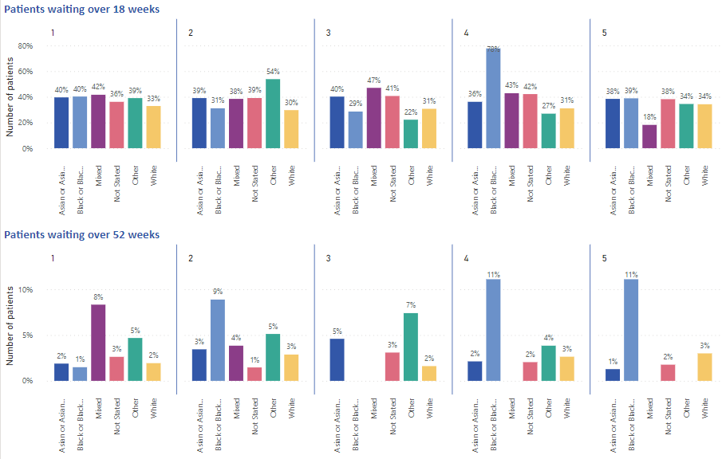
Ophthalmology patients waiting over 18 and 52 weeks – local data
The proportion of patients waiting over 18 weeks for ophthalmology is very similar across all ethnicity groups and deprivation quintiles.
Black or Black British patients in IMD 4 the exception, with 78% of patients waiting over 18 weeks (7 out of 9).
Data source: NHIS ‘National Waiting Lists Open Pathways’ dataset, week ending February 27 2022.

Slide 17
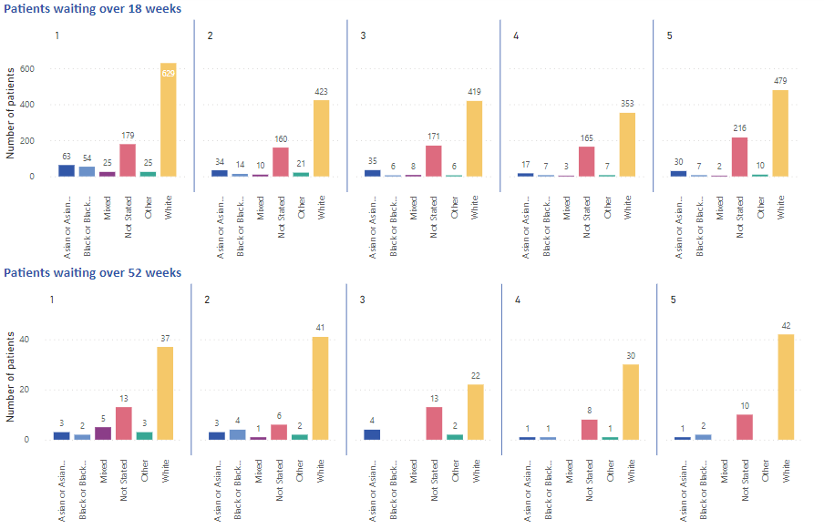
Ophthalmology patients waiting over 18 and 52 weeks – local data
The number of ethnic minority individuals waiting over 18 weeks on the urology waiting list is very small.
In the White population there doesn’t appear to be a great difference in across deprivation quintiles.
Data source: NHIS ‘National Waiting Lists Open Pathways’ dataset, week ending February 27 2022.

