Slide 1
Shared decision making – the new normal
A toolkit to deliver consistent good quality shared decision making across the ICS

Slide 2
FOREWORD - Shared Decision Making, what is the fuss all about?
Dr David Selwyn, Medical Director at Sherwood Forest Hospitals and Council Member of the Royal College of Anaesthetists and Director of the Centre for Perioperative Care.
First reported by Robert Veatch in 1972, shared decision making (SDM) is not new. However, it was not until the late 2000’s as patient autonomy developed, that SDM really started to be proposed as a pillar of ‘patient centeredness’ or informed consent. As the importance of unwarranted clinical variation has become recognised as a key component of patient satisfaction, patient outcome and clinical effectiveness, so the role of patients engaging in truly meaningful discussions of what they perceive the advantages and disadvantages of medical treatment options, has developed. Parallel to this is the recognition that the patient may perceive the risks and/or expectations, in a very different way to that of a clinicians. They may not be a right or wrong, just recognition that treatment choice is very personal, particularly to the person that is having the treatment.
But, what is the fuss all about? We have obtained informed consent for years and we all know the ramifications and implications of the Montgomery case! In fact, many of us state we are always use a SDM model. Except we don’t. Probably, even when we think we do.
The Choosing Wisely programme was launched in 2016 by the Academy of Medical Royal Colleges as a global initiative aimed at improving conversations between patients and clinicians. By having discussions that are informed by the clinician, but take what is important to the patient too, both sides can be supported to reach a better decision about care. This may help to avoid tests, treatments or procedures that are unlikely to be of benefit.
There is a growing evidence base that patient participation in discussions (that they fully understand) leads to improved (and better) outcomes, improves patient satisfaction and staff satisfaction. It facilitates self-management and self-care and reduces complication levels. It is also a useful strategy for tackling over diagnosis and overtreatment. Choosing Wisely UK encourages ever patient to ask 4 simple questions about their treatment:
What are the benefits?
What are the risks?
What are the alternatives?
What if I do nothing?
SDM is embedded in all components of the NHS restoration and recovery response to the Covid-19 pandemic, is in NICE guidance and has been championed by the Centre for Perioperative Care. It is high time that we had proper conversations with our patients and paid proper attention to their views.

Slide 3
Toolkit
Overview
Introduction
Who is it for?
Why are we doing it?
What is shared decision making?
Commissioned services
What good looks like?
Supportive systems and processes
Prepared public
Trained teams
Summary
Useful resources

Slide 4
Introduction
The aim of the toolkit is to ensure a consistent approach is applied to SDM across the system
to understand the benefits, how to implement it well and have better and personalised conversations, based on ‘What Matters to you’ with people using services.
As David states in the foreword, SDM is not new. Universal Personalised Care is front and centre in the NHS Long term plan. The introduction of the delivery plan, it talks about the case for change and creating a new relationship. It highlights that personalised care provides a foundation for the next 70 years of the NHS. As the World Health Organisation summarises:
The policy and legal drivers were in place prior to Covid, but post Covid the case for change is more compelling than ever. The timing is right. We all have a responsibility to achieve this real shift of relationships with the people we are here to serve. Genuine, good quality shared decision making will support the recovery and restoration of our services, particularly in elective services. The ICS leadership is asking us all to have ambition and determination as we have a real opportunity to deliver transformational change.

Slide 5
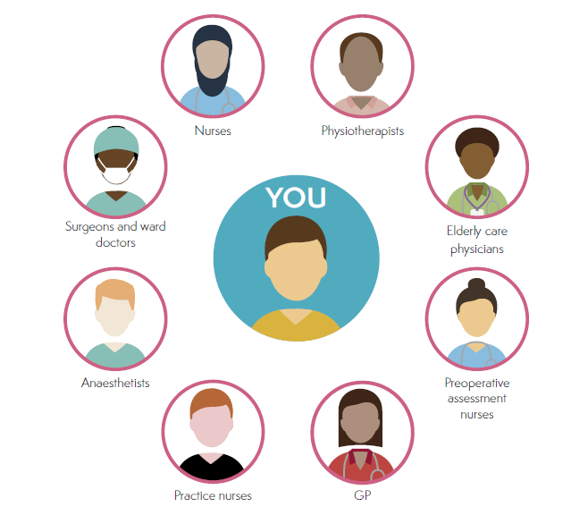
Who is the toolkit for?
Who is the toolkit for?
Shared decision making is relevant in any non-life threatening situation when a health or care decision needs to be made and a range of options (including doing nothing) is available.
This toolkit is for all healthcare professionals, health improvement personnel and engagement representatives to inform and educate them on Shared Decision Making in order to embed it in day to day clinical practice.
Shared Decision Making represents a cultural change in behaviour and this tool will aid and assist in changing an environment of medical paternalism to a more inclusive approach based on the 2012 Health Act Liberating the NHS.
‘No decision about me without me’.

Slide 6
Why we need to do it?

Slide 7
It is a LEGAL requirement
Health professionals must take “reasonable care to ensure that the patient is aware of any material risks involved in any recommended treatment and of any reasonable alternative or variant treatments”.
(Health and Social Care Act 2012, Medical Protection Society, 2015, Montogomery V Lanarkshire Health Board (Scotland) 2015 UK Supreme Court).
It is intrinsic in PROFESSIONAL CODES of conduct/standards. (General Medical Council, 2013; Nursing and Midwifery Council, 2018)
Increasingly, people want to be involved in making decisions about their own healthcare, and research has shown that, when they do so, they select LESS HOSPITAL CARE and report BETTER HOSPITAL EXPERIENCES.
Both individuals and clinicians tend to consistently OVERESTIMATE the benefits of treatments and UNDERESTIMATE the harms. SDM ensures that individuals are:
supported to make decisions based on their personal preferences
more likely to adhere to evidence-based treatment regimes
more likely to have improved outcomes and
less likely to regret the decisions that are made.
(Hoffman, 2017).
Although improvements have been made, Care Quality Commission (CQC) data identified 23% of people reported that doctors talked in front of them as if they were not there and 11% reported that they had not been involved in decisions about their care and treatment as much as they wanted to be.
(CQC, 2020).
There is still a significant perception gap between what patients want and what clinicians think patients want e.g. for breast cancer conditions 71% clinicians believe the top goal/concern is to keep the breast whereas this is only a priority for 7% of patients.
Sepucha et al. (2008). Pt Education and Counseling. 73:504-10

Slide 8
‘The silent misdiagnosis’
The responses from surveys suggests that clinicians could communicate better with people they see and treat. The message remains loud and clear that people want to receive more information and to have more involvement in their care. Furthermore, all the evidence available says treating patients as equals and really listening to their needs and desires and then responding to those needs ensures they start to feel involved.
Research also tells us that people who feel involved in decisions affecting their care who understand their condition have better outcomes, reducing the need for repeat appointments and hospital admissions.
PATIENTS’ PREFERENCES MATTER:
Stop the silent misdiagnosis, Al Mulley, Chris Trimble, Glyn Elwyn 2012
Patients:
unaware of all reasonable options and outcomes
Clinicians:
unaware of patients’ circumstances and
preferences
Uninformed decision = Decision regret
Uninformed demand on system =
unwarranted clinical variation

Slide 9
The Pathway train
Case Stories
2 older women in their 80s both with
Bowel cancer
Frail
Borderline functional independence
Cardiorespiratory disease
1 opted for the operation
1 made the decision not to have surgery
The destination is predetermined and everyone is doing their best. Each step leads to the next logical step on the pathway and the journey is often smooth.
But, do we:
make assumptions?
embed personalisation in our conversations?
“I have to ….”
This is what the older woman who decided not to have surgery said and felt. She didn’t realise she had a choice. She just wanted meals on wheels and to continue looking after her daughter who suffered from mental health problems. She got all the way to the end of the pathway train, because no-one had asked her
“what matters to you.”
“what matters to them and what is important to and for them?“
How do we ensure personalised conversations happen at every stop of the journey – what if you want to get off the train!

Slide 10
SDM is not an aspiration, it is a must do to achieve standards of care and informed consent
Decisions must be based on discussions with people, the evidence and their holistic needs at every step on the pathway.
We must treat the person, not just the disease.
The right management, at the right time, that is right for that person

Slide 11
What is shared decision making?

Slide 12
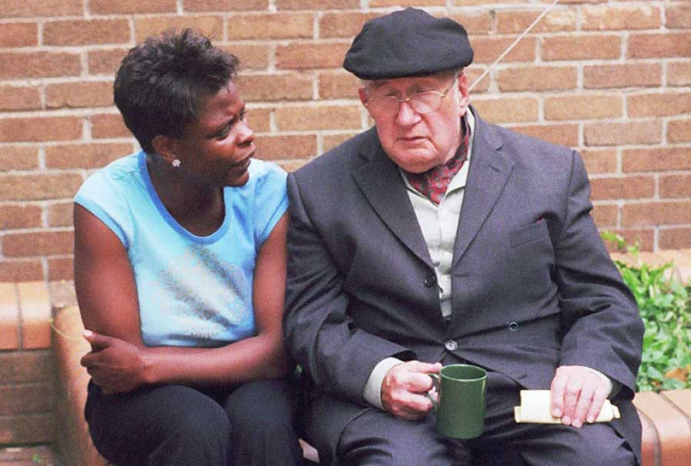
Having a personalised conversation
SDM is about having a good conversation that enables people to make a good decision.
It ensures the person is involved with the decision making process, to ensure the decision reached is a good decision.
SDM means that people are supported to:
understand the care, treatment and support options available and the risks, benefits and consequences of those options
make a good decision about a preferred course of action, based on reliable, evidence-based, good quality information and their personal preferences and with time allowed to consider all the options carefully.
Lay expertise is given the same value as clinical expertise, as it draws on the clinician's expertise and the persons own experiences to result in the best possible treatment and outcome for the person.
Watch this film Personalised Care in Nottinghamshire to find out about shared decision making on the MSK pathway.
=

Slide 13
It is a process in which clinicians and individuals work together to select tests, treatments, management or support packages, based on evidence and the individual’s informed preferences.
It ensures that individuals are supported to make decisions based on their personal preferences and are, therefore, more likely to adhere to evidence based treatment regimes, more likely to have improved outcomes and less likely to regret the decisions that are made.
By paying attention to individuals’ informed preferences we can support people to achieve outcomes that matter to them.
Aggregating the decisions of informed individuals to a population level means we can commission and provide services that informed people want and therefore allocate resources more effectively.
Following a process
Best evidence
Clinical expertise
Patient expertise
Individual patient preference
Clinicians
Together they make a decision
Equal
Partners
Patients

Slide 14
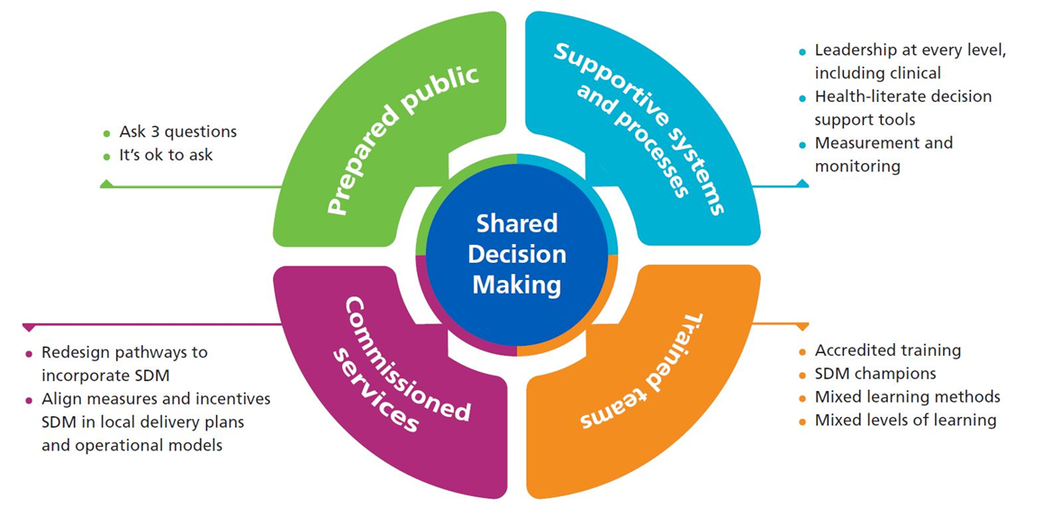
What good shared decision making looks like?
4 key foundations and enablers to embed SDM (NHSEI)
The next sections of the toolkit will guide you through how to implement the 4 foundations
https://www.england.nhs.uk/publication/shared-decision-making-summary-guide/

Slide 15
1. Supportive systems and processes

Slide 16
What your service needs to do
Understand where your service is now and define the priorities
NHSE/I has an SDM summary guide and an implementation checklist https://www.england.nhs.uk/publication/shared-decision-making-summary-guide/
Completing the checklist is a good place to start, as it will help gauge where you are now and what needs to be put in place to make progress across the 4 foundations. Clinicians leading this work in the MSK pathway in Nottinghamshire found this a very helpful starting point and a good way to measure progress. Review and map pathways, understand and record the key decision points = to highlight the key points to use SDM.
Ensure written information and conversations are health literate - see slide 16
There is a strong social gradient in the population, with lower levels of health literacy much more common among the socially and economically disadvantaged i.e. impacts on health inequalities. By addressing people’s level of health literacy when sharing decisions, in turn we can reduce health inequalities – a priority of the ICS and the NHS Long Term Plan.
SDM conversations can take place without decision support resources - there will never be a resource for every condition. However, when resources are used they should be health literate, designed in the format above and using the SMOG Readability formula https://readabilityformulas.com/smog-readability-formula.php ( created by G Harry McLaughlin in 1969).
for more information on health literacy and read more at the national health literacy toolkit
Use BRAN: Benefits, Risks, Alternatives, Do nothing format - see slide 17.
Use Decision Support Tools (DSTs)
Where possible, decision support tools should be developed and used at the key decision points to tailor clinical conversations; these tools should be readily available to clinical teams. NICE guidelines should be the primary resource for decision support tools as NICE routinely incorporates them into its guidance.

Slide 17
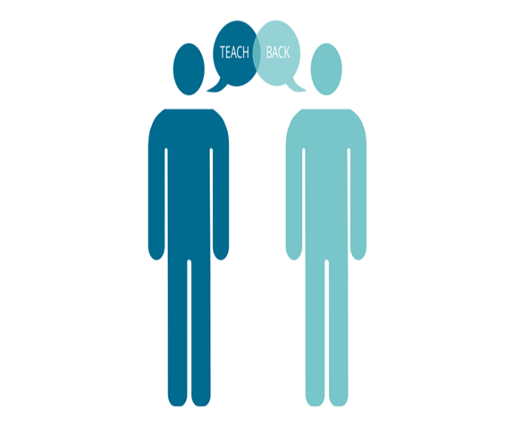
Health Literacy Techniques need to be used in SDM
It is an essential component of creating quality systems and processes, as it is a barrier to optimal SDM conversations. Clinicians need to tailor their consultations appropriately by using specific techniques, building on the national health literacy toolkit.
Because research has shown that between 43 – 61% of the English working age population do not understand health information they are given
(Institute of Health Equity/Public health England 2015).
WHY
It is not a test of the patient’s knowledge
A test of how well you have explained the concept
Should be used by everyone with everyone
Avoids use of ‘closed’ questions
Takes time to learn, requires practice
Can save time in the long run
A Person centred approach
Can improve patient safety and patient outcomes
To hear more about using the teach back method to promote health literacy watch this video of Graham Kramer, Clinical lead for Health Literacy with the Scottish Government.
https://www.youtube.com/watch?v=vFV3HNm6FQA&app=desktop
Use Teach – back
A health literacy technique
A way to confirm that you have explained to the patient what they need to know in a manner that the patient understands
national health literacy toolkit

Slide 18
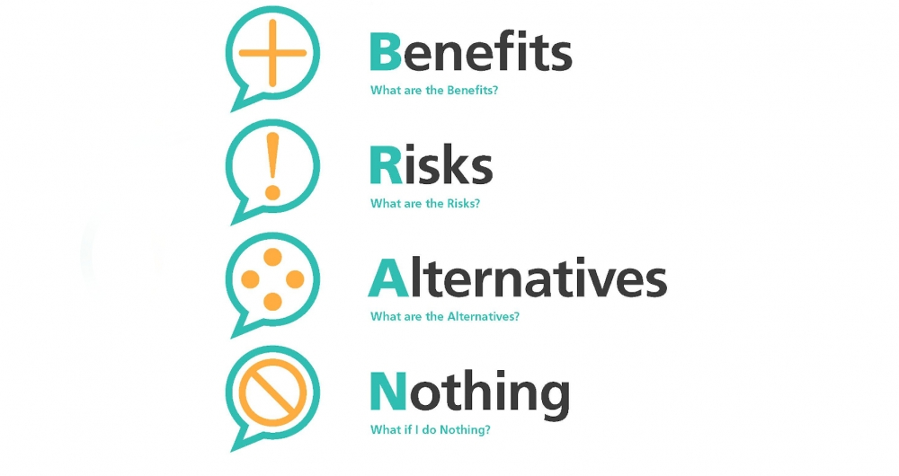
Use
BRAN
BRAN: Benefits; Risks; Alternatives and Do nothing.
Endorsed by the ICS as the tool that clinicians need to use, Choosing Wisely UK is the national arm of an international initiative in SDM and the Centre for Perioperative Care.
It is a great, yet simple tool and format to use to embed SDM within all clinical consultations.
Making the most of an appointment
Having a medical appointment can be daunting for patients, and perhaps more-so where decisions need to be made. Patients and clinicians should aim to get the most out of each appointment. Using a framework to support the process of making decisions, such as the one developed by Choosing Wisely UK, helps support conversations where decisions need to be made – both in preparation for an appointment and during the appointment.
Choosing Wisely UK

Slide 19
2.Prepared public

Slide 20
WHY?
People’s participation in shared decision making is an essential part of its success. However, for various reasons, we know that people can be reluctant to ask questions because they:
Don’t want to take up a busy health professional’s time.
Don’t want to appear “difficult”.
Are embarrassed to tell us they don’t understand for fear of appearing “stupid”.
Want their healthcare professional to tell them what to do.
How to achieve a change in the conversation?
By supporting, encouraging and giving people confidence to play as active a role as they wish in decisions about their care.
All services need to ensure that people are prepared to share decisions by preparing them for their healthcare appointment.
The insert has been fully co-produced with My Life Choices, a group of people who use Health and Care services who support personalised care, the Patient Information Forum and the Patients Association.

Slide 21
3. Trained teams

Slide 22
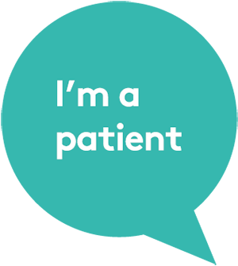
ICS Clinical Leaders are champions of shared decision making and have mandated it as an approach for the system to prioritise to achieve quality and improvement. They encourage and support:
The uptake of training opportunities, to ensure you, the workforce, have the skills to take part in SDM conversations.
Health and care staff to receive training to confidently take part in SDM conversations. The skills required involve training in motivational interviewing and health coaching approaches, alongside specific training in risk communication and in working with people at low levels of health literacy.
The workforce to be actively encouraged and supported to attend training by their line managers and senior managers. This is important as a barrier to the uptake of training is ‘unconscious incompetence’; in other words many clinicians do not understand that they might benefit from training. A further barrier is that ‘we are too busy’, ‘there is no time’.
Peer to peer support and mentoring, which can also be of great benefit . The ICS has created a list of SDM champions. They can support other service areas to adopt the approach with tips and ideas on what works, even better if, challenges and culture change - see useful resources section to connect with a local champion.
The use of shared decision making and shift in culture to partnership working to be included in workforce inductions; supervision and appraisals.
The SDMQ9 tool needs to be adopted as the measure to assess progress of the service, team and individual. It provides good levels of data for benchmarking.
What you need to do

Slide 23
There is a range of quality online resources, as a minimum the ICS expects:
The Personalised Care Institute https://www.personalisedcareinstitute.org.uk/
The Personalised Care Institute is a virtual organisation, accountable for setting the standards for evidence-based training in personalised care in England. It is a collaborative organisation with more than forty partners from across health and care, working together to develop, assure and deliver high quality personalised care training and provide the first ever personalised care training hub for all health and care staff to access the very latest in personalised care training and development.
E-learning for healthcare - E-learning for healthcare
As a minimum standard, the ICS expects that staff has SDM their induction and their personal development and it is identified within their clinical competencies. As such, as a minimum standard all clinicians need to complete the NHS Health Education England. It provides guidance on what SDM is and how to implement it in practice. It also provides resources to help health professionals learn the required skills. The e-learning sessions include films to illustrate examples of good and bad consultations and prompts, along with resources to aid health professionals with their work.
Minimum standard

Slide 24
Clinicians working at key clinical decision points and in specific roles need to be enabled to attend more in-depth face to face training, such as health coaching and motivational interviewing.
Motivational interviewing is a style of communication that uses a guiding/reflective style to engage with patients, clarify their strengths and aspirations, and utilise their own motivations for change, and promote independence of decision making. The ICS are offering free sessions this year which are run by Et al Training. What Et al say about the course:
‘If this is sounding a little flowery, in a nutshell, it saves your breath, your time and you are more effective when it comes to people making decisions about themselves. We all think we are brilliant communicators but come and find out how to keep your hands off other people's monkeys! This course evaluates as a stunning learning experience, where delegates leave knowing why they want to use MI, what MI is all about and the ability to start practicing some aspects of it as soon as they go home. There is laughter and fun with NO POWER POINT!!!’
Feedback from previous attendees is:
All rated it as excellent
“Very interesting and engaging session, found it very helpful and kept me gripped”
“The course was extremely well run and relevant to my current role”
“Loved today, ‘real’, not role play – great fun”
“Brilliant, amazing day, lots of useful ideas and loved the props”
“Excellent, useful the way it linked to SDM”
“Absolutely fabulous”
To book a course, email nnicb-nn.whatmatterstoyou@nhs.net
Advanced training – Motivational interviewing

Slide 25
4. Commissioned services

Slide 26
How to commission for SDM
Pathways
SDM should be built into points along a care pathway when a decision needs to be made. This is particularly relevant when people face ‘high value’ decisions where the choice can have a significant impact (positive or negative) on their lives.
2. Measuring the impact
To measure the extent of SDM, it needs to be recorded in the patient record on a providers systems as a searchable read code, which will be included in the monthly standard dashboard report.
This information alone will not create quality improvement. Commissioners and services need to collect information to measure the impact on the person and whether they perceived to have been involved in the decision. A validated measurement and monitoring of SDM should be used to ensure that it is taking place to a high standard. It helps facilitate improvement in the quality and number of SDM conversations between people and clinicians across the NHS, as well as help clinicians to improve their SDM skills or commissioners to assess whether SDM is taking place. As a minimum to get started to ensure consistency and provide comparisons, the ICS is endorsing the use of the SDM-Q-9.

Slide 27
Summary
We need to recognise that the way we communicate with people who use healthcare services can be difficult for them to understand. We can change our conversations with people to ensure they are truly at the heart of every decision made. Shifting from ‘What’s wrong with you’ to ‘What matters to you’
Shared decision making means working together to ensure people using our services:
Feel better engaged with their care.
Are clear on the options for the treatment they need
Choose treatments based on what helps them best meet their needs.
By helping people to understand their condition and treatment they are likely to have less decision regret and adhere to their decisions because they are preference based.

