Slide 1

Nottingham and Nottinghamshire Primary Care Strategy
2025-2030

Slide 2
Introduction
This strategy sets out our vision and roadmap for the future of Primary Care in Nottingham and Nottinghamshire over the next five years. It outlines our intention to accelerate the evolution of our four contractor groups of General Practice, Community Pharmacy, Community Optometry Services, and General Dental Services to meet the needs of local people. In doing so, this Primary Care Strategy will significantly contribute to the overall strategic ambition of our integrated care system to improve people’s life expectancy, support them to live healthier longer lives and reduce health inequality and inequity across our population.
It has been developed in the context of a dynamic environment, with rising patient demand, increasing complexity of needs, pressure for more efficient use of NHS resources, and a shifting workforce landscape. The ongoing review of local government architecture and emerging role of the East Midlands Combined County Authority will also continue to be highly influential in shaping transformational change across our system.
It is within this evolving context that our Primary Care Strategy reimagines our primary care landscape. It outlines the role that GP practices, community pharmacists, optometry and dental services will play within a more integrated health and care system that is characterized by the shift from treatment to prevention, analogue to digital, and hospital to community-based treatment. It describes our commitment to moving beyond traditional structures, using technology to enable proactive, personalised care, fostering collective accountability for population health at scale as well as locally, and organising services around communities that support three guiding strategic principles of promoting prevention, ensuring equity and delivering improvements through greater integration of service delivery.
This transformation will continue to rely on the dedication, expertise, and resilience of our primary care teams who remain critical to supporting the health and wellbeing of our population. Our Strategy is founded on their voices alongside that of our patients, people and communities, building on their perspectives of what needs to continue and evolve but also where we can do better for our population to improve outcomes.
This is a pivotal moment for our primary care providers — a time for us to radically redesign our primary care landscape and offer leadership in supporting our staff and teams, as well as our communities, to successfully transition into an exciting future.
Amanda Sullivan
Chief Executive
Nottingham and Nottinghamshire Integrated Care Board

Slide 3
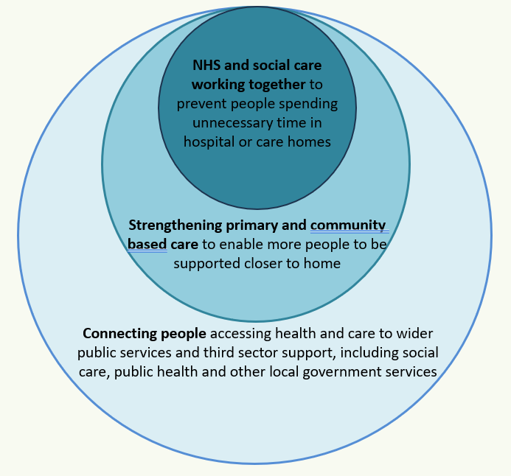
Our strategic priorities
Statutory partners across Nottingham and Nottinghamshire have come together to develop strategic priorities to improve the health and wellbeing of our local population. These priorities are outlined within our Integrated Care Strategy and supporting delivery plans (NHS Joint Forward Plan and Joint Health and Wellbeing Board Strategies). These can be found here:
Integrated Care Strategy - NHS Nottingham and Nottinghamshire ICS - NHS Nottingham and Nottinghamshire ICS
NHS Joint Forward Plan - NHS Nottingham and Nottinghamshire ICS - NHS Nottingham and Nottinghamshire ICS
Nottinghamshire Joint Health and Wellbeing Strategy 2022-2026
nottingham-city-joint-health-and-wellbeing-strategy-2022-25.pdf
One of our key transformational themes is the development of integrated neighbourhood working across our local communities. Below is a high level model of the way we will achieve this. It illustrates our intention over the next five years of moving more care out of traditional hospital based settings and into communities. Our ‘home first’ approach will be enabled through technology, and by accelerating health and care staff working together differently. This includes improved joint working focussed on hyper-local populations of approximately 100-150,000 and far greater focus on promoting ill health prevention, especially for those people with the most complex needs. Our primary care teams will play a critical role in this transformation. That’s why this Primary Care Strategy focusses on maintaining their resilience and ability to fully respond, and adapt to, this new vision for local health and care services.
Within our Integrated Care Strategy we have highlighted three key transformational priorities.
Accelerating our integration of health and care teams at Neighbourhood level
Promoting greater provider collaboration at Place and system level
Accelerating collaborative commissioning approaches and creating the conditions for success
Integrated Neighbourhood Health Model

Slide 4







Our Vision for primary Care
Our primary care services will be resilient and sustainable providing high quality care consistently for our population . It will be modernised through the delivery of three shifts: treatment to prevention, hospital to home, analogue to digital, and through effective workforce planning and development.
There will be greater consistency of the scope and quality of services, with less unwarranted variation where not based on assessed population need. Primary care outcomes will focus on reducing health inequalities through an ongoing focus on prevention and tackling inequity.
People will be supported to remain independent for as long as possible through proactive and personalised care planning. Primary care teams will target population cohorts using population health intelligence to employ evidence informed interventions.
There will be greater integration of the community-based workforce supported by shared training, development and retention initiatives, creating a more flexible and adaptive workforce acting as ‘one team’ irrespective of employing organization.
Primary care services will be locally accessible, via multiple routes, that meet the needs of the local neighbourhood population including access to self care and advice.
“A more resilient, efficient, and patient-centred primary care provider sector that meets the needs of our population both now and in the future”.
Primary care professionals will be full and active participants within Integrated neighbourhood health teams and Place based Partnerships across Nottingham and Nottinghamshire supporting the co-design and delivery of community based primary care interventions.
There will be greater public awareness of the opportunities of support including self care offered by primary care providers, with an expansion of services shifted into a community setting and out of an acute setting where safe and appropriate.

Slide 5

The actions we will take to turn vision into reality
2025/26
2026/27
2027/28
2028/29
2029/30
  Support our primary care teams to remain resilient.
  Implementation of Integrated Neighbourhood Health Model.
  Improve access to primary care services.
  Support primary care provider collaboration.
  Increase the scope of services provided by primary care providers.
  Improve our awareness of performance of contracts and reduce unwarranted variation.
  Tailored implement plans in place where needed (e.g. dentistry).
  Implement innovative ways of working and support more services to shift from acute into community settings.
  Ensure we have a better understanding of our challenges e.g. primary care workforce data.
  Increase public awareness of primary care services and self care opportunities.
  Mature Integrated Neighbourhood teams to include a wider range of patient cohorts and input from across health and care.
  Ensure consistency of ‘core’ community offer across the system with identification of warranted/unwarranted variation aligned with population needs.
  Promote workforce retention and training initiatives to embed a ‘one team’ approach.
  Embed more robust performance oversight arrangements of contract holders to ensure we maintain good governance and maximise contract adherence as well as supporting providers to improve.
  Review opportunity for primary care estates as part of One Public Estates approach in partnership with local authorities and NHS partners.
  Assess improving morale of primary care staff and promote their engagement in our transformation journey.
  Fully establish digital infrastructure to support same day/urgent and routine oversight of patients in order to manage demand.
  Ensure all practices/Primary Care Networks (PCN) delivering care within consistent model of service offer tailored to achieve improved outcomes and reduced health inequalities and inequity.
  Ensure routine appointments are provided within two weeks of request in the format of patient choice.
  Primary care teams fully exploiting AI and digital automation resulting in reduced administrative burden.
  Supported by shared infrastructure across providers and streamlined access routes.
  Fully established provider collaborative model operating across health and care providers, community and acute.
  Fully established integrated training and workforce development model.
  Full system coverage of enhanced pharmacy, dental and optometry services.
  Significant shift of resources, staff, and commissioning funding from acute into community-based services from 2025/2026 baseline.
  Urgent care provided by all primary care (all professions) as requested by patients within 48hrs based on clinical need.
  Significant reduction in tooth decay, oral cancer and poor oral hygiene across the system through increase in funded dental care activity.
  Ongoing focus on, and a consistent all system approach, to primary care as active participants in prevention through employment, education, training, activity, smoking cessation, vaccinations etc. resulting in reduced disease prevalence rates and improved outcomes.
  Reduced health inequalities and inequity
  Increase in healthier life expectancy.
  Improvement in primary care staff morale, retention and recruitment.
  Improvement in patient satisfaction with primary care service offer.

Slide 6


What will this mean for local people?
People will have improved access to their GP with flexible appointment models, which will include advice and guidance from specialists, on-line and face to face consultations. and virtual access.
People will be more aware of the community and voluntary services that are available locally to support them to stay well and independent.
People with complex chronic or multiple conditions will have greater access to integrated teams that understand their condition and promote continuity of care, building trusted relationships that better enable personalised care planning.
People will be able to have more treatments and consultations with support available, including specialist input, in a local community setting instead of going to hospital.
People will have access to wider primary care specialist services in the local community, for example specialist optometry services and community pharmacy services.
People will be able to have access to new technology that will enable them to book appointments online, and access digital support and advice. This will complement existing services offering face to face support to those who need it.
People will be more aware of the services and the role of Community Pharmacists, dentists and optometrists within their local community. Access to these services will be tailored to where the need is greatest.
People will be supported by care navigators who help people access the right care and support services at the right time acting as a guide through the health and social care system.
People will be more aware of what they can do to look after themselves to prevent themselves from becoming unwell and to lead healthier lifestyles.
People will be able to attend community pharmacy services across Nottingham and Nottinghamshire and receive a consultation for an increasing range of common conditions.
People will have opportunities to directly refer themselves into a growing range of diagnostic and treatment services.
People who have the most complex needs will have more active oversight by a dedicated team that are referred to as an Integrated Neighbourhood Team (INT). This team will be comprised of a wide array of community and specialist health and care professionals who will work together to provide more joined up responses to address the needs of the person.
People will be better informed on how to look after themselves and know where to seek further advice and support to enable them to remain independent and living in their own homes for longer.

Slide 7

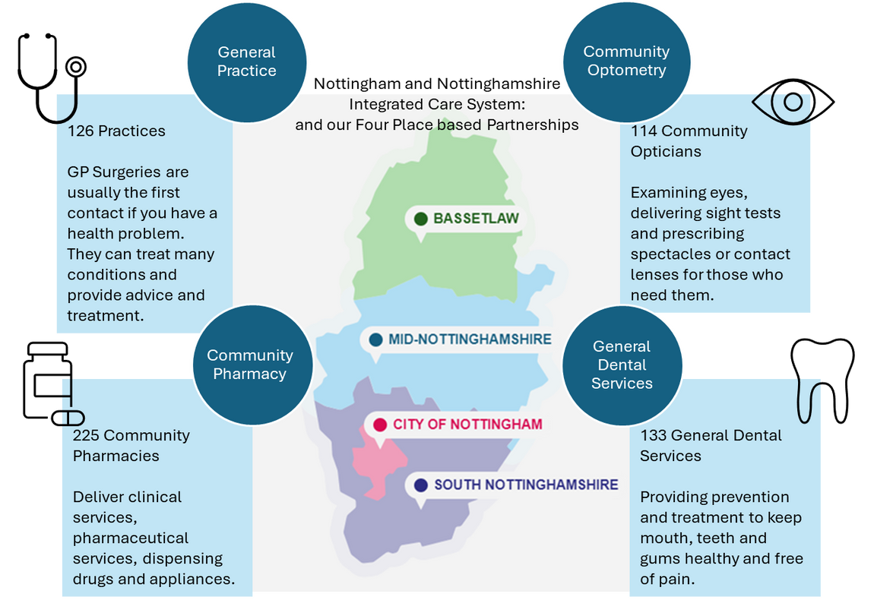
Our current primary care provider landscape
Primary care providers are often the first point of contact for people and provide the vast majority of NHS care to people. Primary care teams are critical to overall sustainability of the local NHS, offering advice, guidance and interventions that often avoid or delay more complex treatment within a hospital environment. As trusted care providers at the heart of their local communities, primary care teams also play a critical in our work to reduce health inequalities and inequity. We recognise that for this care to continue to meet the needs of people, the provision of primary care services must evolve rapidly over the next 5 years.

Slide 8












Building on what we have achieved
We recognise that primary care is the linchpin of the heath and care system and is central to transforming people's health and well-being outcomes and experience. All four contractor groups have a critical role in reducing inequalities, promoting equity and can also significantly reduce inefficient use of our public sector resources. Examples of where we already do this is outlined below.
Primary care supports over 1.3m people across Nottingham and Nottinghamshire.
Primary practices provided 7.8m GP appointments in 2024, an increase of 430,000 from 2023. 69% were face to face. 41% were same day requests.
Multi-Disciplinary Teams in place supporting people with multiple Long-Term Conditions.
Practice Nurse, GP Retention leads, and Clinical Ambassadors are supporting local retention and development initiatives. Retention programmes in place providing enhanced development for staff.
95% of Community Pharmacies are signed up to the Pharmacy First scheme providing 7 clinical pathways with 25,262 consultations taking place. 47,911 Blood Pressure checks and 4108 Contraception checks having been completed. (Aug 23- July 24).
We have 24 Primary Care Networks (PCNs) supporting local communities and providing extended services.
There are 133 General Dental Services providing dental care.
We are national leaders in the roll out of the NHS App. We had a 54% increase in use last year, making it easier for more patients to access their GP.
285,026 NHS Sight tests are completed per year (23/24).
112 GP practices are rated at Good or Outstanding by the Care Quality Commission (CQC).
95.2% of prescriptions are dispensed using the Electronic Prescription Service, 76.9% of patients have a nominated pharmacy.
87% of patients described their experience of using the community pharmacy as good. (GP Survey 2024).
GP Premises improved across Nottingham and Nottinghamshire enhancing the facilities for patients and opportunities for wider partnership working.
92% felt that they had confidence & trust in the healthcare professional with 91% being involved in the decisions about their care and treatment. (GP Survey 2024).
74% of patients rated a positive GP experience. (GP Survey 2024).

Slide 9
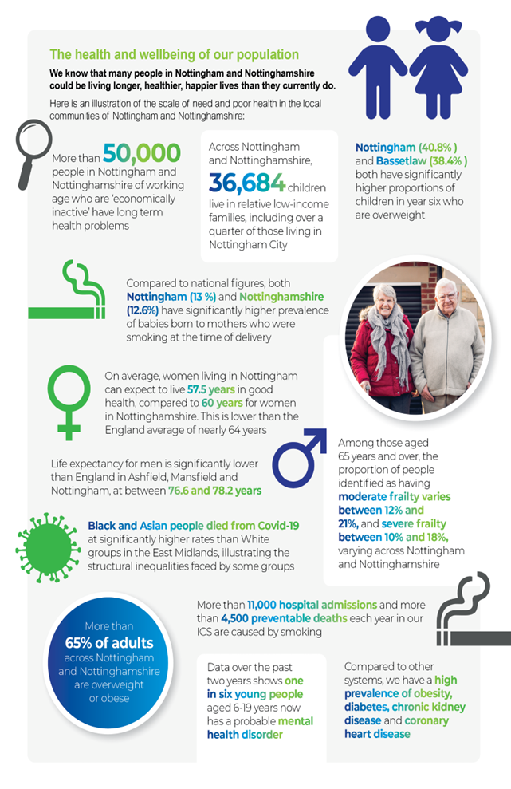
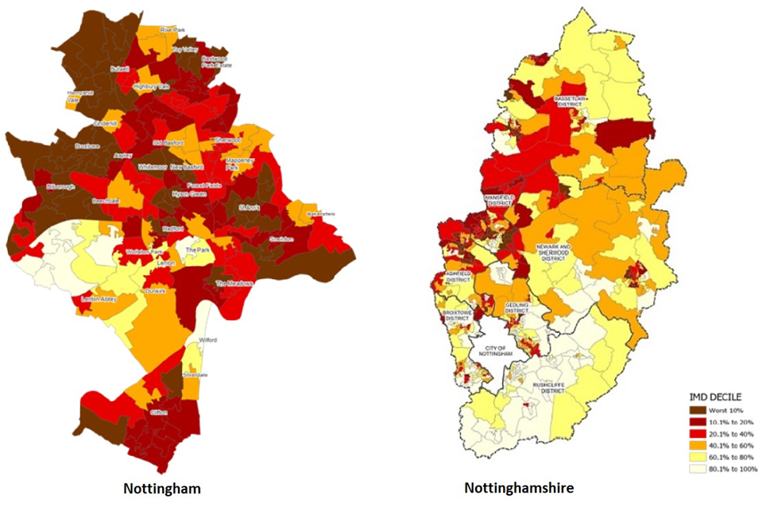
Our changing population also means we need to change how services are provided
A map of deprivation across our Integrated Care System
To help us understand better where and how we develop primary care services in order to improve population outcomes we need to understand what our population health need is. Key facts are:
People are dying earlier than they should be. Nottingham City, Ashfield and Mansfield have significantly higher rates of avoidable and preventable deaths than the England average (and double that in other areas of our ICS).
Inequalities and inequity are stark, reflecting levels of deprivation and social inequalities across our population.
Preventable alcohol and CVD deaths are getting worse. Our children are not as healthy as they should be, childhood obesity remains high. The number of people accessing some screening programmes is also lower than needed.

Slide 10
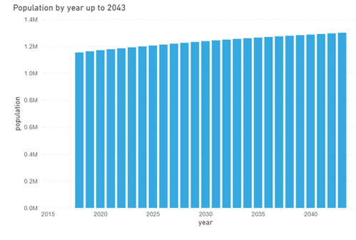
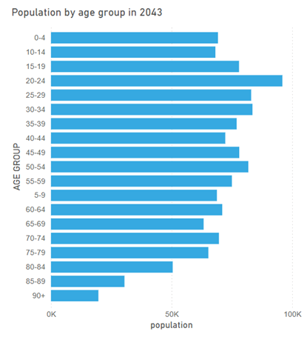
Understanding the impact of our changing population
Our population continues to increase, with people living longer in older age
Data from the SAIU Primary Care Network Dashboard

Slide 11
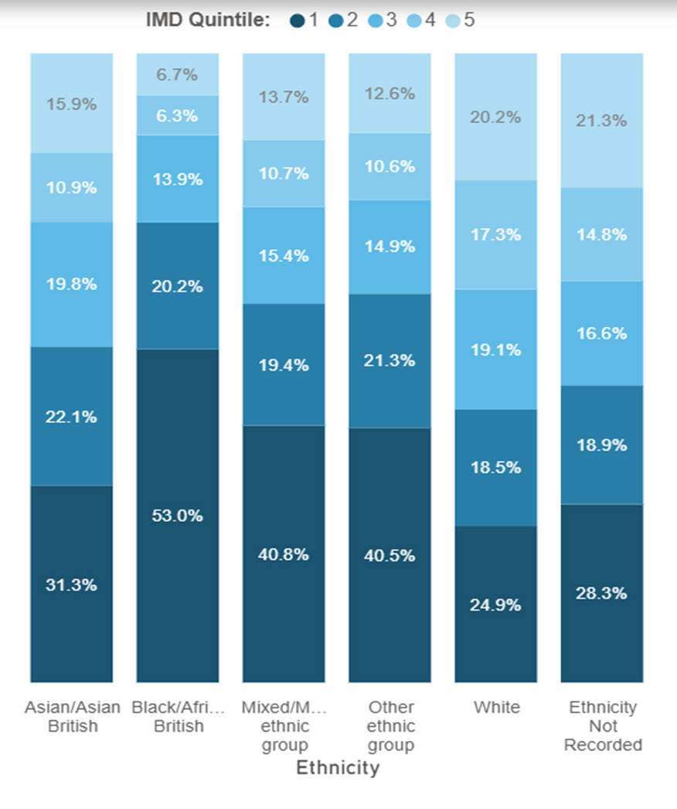
Understanding the impact of ethnicity and deprivation
Understanding ethnicity and deprivation across our community is also crucial for planning services and addressing health inequalities and inequity. Some ethnic groups face higher health risks and barriers to accessing care and ethnicity related factors can impact significantly on health outcomes.
Ethnicity | Key Notes
White/White British | Mortality from Cancer, dementia and Alzheimer's is higher in white groups
Asian/British South Asian | Those of South Asian heritage are more likely to develop high blood pressure, cardiovascular disease and diabetes.
Asian/British Chinese | Chinese people have relatively low uptake of health and social care services across the UK.
Black British/African/Caribbean/ Other | Women from black backgrounds are 4x more likely to die in childbirth than white women. Rates of hypertension and diabetes are also higher in black people and mortality rate from strokes and are more likely to have strokes at a younger age. This risk of developing certain cancers (e.g. prostate) can also be higher. Adult and Childhood obesity rates tend to be higher in black ethnicities
Mixed/Multiple Ethnic Groups (Asian/Black/British/ Other) | Those with a mixed ethnicity may still carry the risk factors in developing conditions from their heritage groups. Those from mixed groups have the lowest life expectancy than other ethnicities in the UK. Smoking rates in mixed groups also tends to be higher.
White Gypsy or Irish Traveller | Newark and Sherwood has a higher traveller population than the rest of the country with around 400 pitches in the district alone. The number of pitches across the ICS is set to increase by 193. Travellers are a marginalised group with some of the worse health outcomes, life expectancy 10-15 years lower than the rest of the population. Mental health problems and risk of suicide is higher in this population. Housing education, working conditions and poverty are also pressures for this population.
Other | This other group may represent people from a variety of lesser-known ethnicities who may find it harder to be catered for if they are not represented in the system.
This chart shows the link between ethnicity and deprivation in Nottingham and Nottinghamshire. 53% of the Black African/Caribbean population lives in the most deprived areas, compared to 25% of the White population.
To meet the diverse needs of our population and tackle health inequalities and inequity, we will prioritise locating primary care services where they are needed most. We will also continue to drive initiatives focused on preventing ill health, co-designing them with local communities to ensure they are culturally sensitive and make cost effective use of our resources.
Data from the SAIU Primary Care Network Dashboard and Census Data 2021

Slide 12
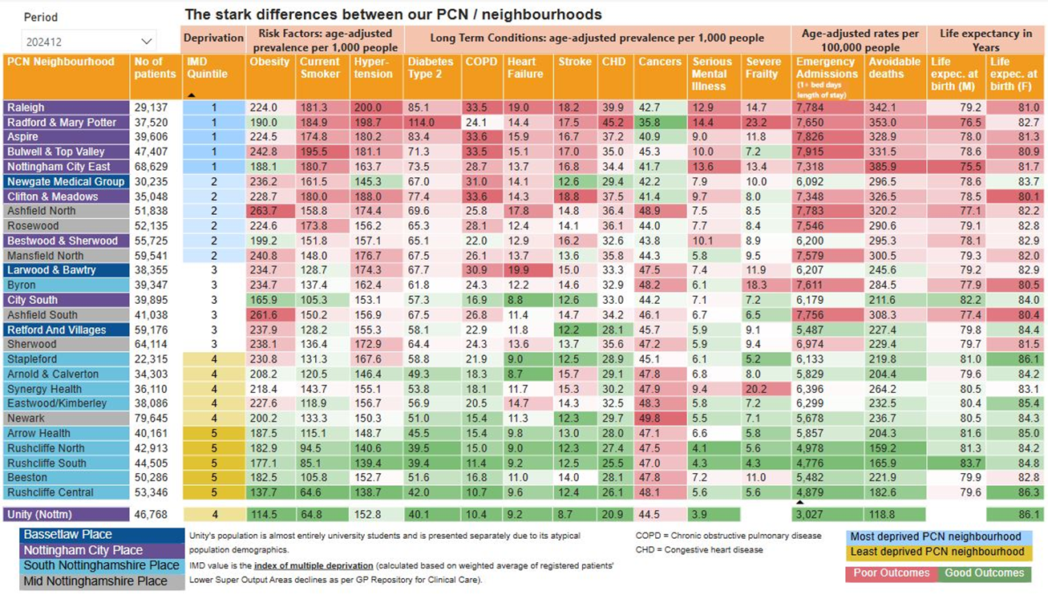
Understanding our health inequalities
The table opposite shows our ‘tartan rug’ of health inequalities and the need for us to drive equity across all Primary Care Networks (groupings of GP practices) in Nottingham and Nottinghamshire.
Our latest data on high level outcomes for our population show a worsening position, in line with what other areas of the country have seen. However, the latest data shows that the more detailed measures underneath these outcomes are moving in the right direction.
Healthy Life Expectancy
Life Expectancy
Health Inequalities
Baseline (2018-2020):
Females: 57.2 years Nottingham
60.0 Nottinghamshire
Males: 57.3 years Nottingham
62.4 years Nottinghamshire
Baseline (2018 - 2020):
Females: 81.0 years Nottingham
82.6 years Nottinghamshire
Males: 76.4 years Nottingham
79.5 years Nottinghamshire
Baseline (2018-20):
Females: 7.6 years Nottingham
7.7 years Nottinghamshire
Males: 8.4 years Nottingham
9.3 years Nottinghamshire
Latest (2021 - 2023)
Females: 56.8 years Nottingham
59.7 Nottinghamshire
Males: 57.2 years Nottingham
60.0 years Nottinghamshire
Latest (2021 - 2023):
Females: 80.6 years Nottingham
82.9 years Nottinghamshire
Males: 76.2 years Nottingham
78.9 years Nottinghamshire
Data for 2018-2020 are the latest available

Slide 13
Understanding the needs of local communities
General Practice
  Some rural areas require longer travel times to access services and struggle with access generally.
  Nottingham City, Ashfield, and Mansfield have significantly higher rates of avoidable and preventable deaths than the national average — in some cases, double that of other areas within our system.
  Rates of preventable deaths from alcohol-related conditions and cardiovascular disease (CVD) are worsening and continues to vary across communities.
  Childhood obesity remains high, and overall child health is below expected levels.
  Uptake of some screening programmes remains lower than needed with wide variation across our system.
  Challenges in accessing services persist for some populations.
Community Pharmacy
  Pharmacies are well-distributed across Nottingham and Nottinghamshire, with a concentration in areas of higher population density. However, we need to maintain resilience in areas of highest need.
  Most residents can access a pharmacy within 15–20 minutes by car (outside of rush hour), and within 20–30 minutes by public transport.
  In Nottingham City, most residents can access a pharmacy within a 20-minute walk.
  Pharmacies offer a good range of enhanced services, but public awareness of these services is low and we don’t have a consistent offer across communities.
Community Optometry Services
  Community optometry services are generally well-distributed, though rural residents may need to travel further.
  Cost concerns often lead some people to delay important eye tests.
  Inequalities in eye health are linked to socioeconomic status, ethnicity, geography, and healthcare access.
  Black, Asian, and minority ethnic groups are at greater risk for conditions such as glaucoma and diabetic retinopathy.
  Research suggests that almost half of those living with sight loss come from economically disadvantaged households.
  General Dental Services
  People from disadvantaged backgrounds experience higher levels of oral disease and lower treatment rates.
  Groups at greatest risk include young children, those living in deprivation, people needing care support, smokers, heavy drinkers, inclusion health groups, individuals with chronic conditions, looked-after children, vulnerable families, and older adults.
  Vulnerable groups such as travellers, those in contact with the justice system, looked-after children, and people experiencing homelessness have poorer oral health and face significant barriers to care.
  Limited data exist on oral health disparities across protected characteristics (e.g., ethnicity, religion, sexual orientation, disability), but evidence shows that oral health burdens are highest among the most vulnerable and disadvantaged.

Slide 14
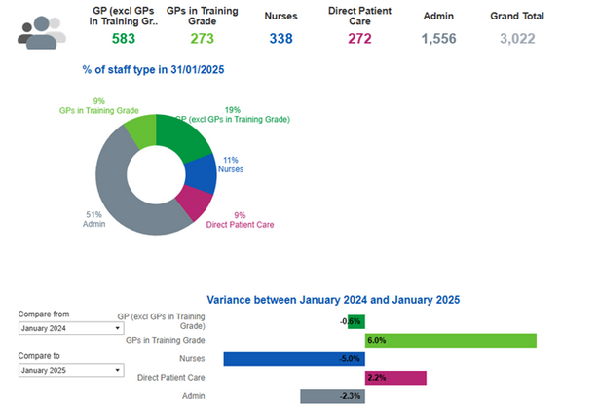
Our Primary Care Workforce:
General Practice and Community Optometry
General Practice Workforce
We have seen a shift in the GP workforce moving from being a partner to salaried employment, impacting on the current partnership model which has traditionally provided extensive discretionary effort. Working with local leaders, we are working to identify opportunities to support alternative models for the future. This includes supporting general practice teams to work together more collaboratively to deliver primary medical services as well as work across health and care organisations within integrated neighbourhood teams.
PCN Additional Roles Reimbursement Staff roles have remained stable through the year, with a slight increase as the ‘new GP’ role commenced in October 24. This reflects the shift in staff mix at a practice level with fewer GPs but more staff with different skills such as clinical pharmacists, care coordinators, physician associates.
The greatest reduction in staff has been among Practice Nurses. Our Practice Nurse leads across the system have developed a workforce plan that will support, develop, encourage involvement and drive best practice across our system which will support retention and encourage opportunities.
Age profiling of the profession indicates a high portion of the workforce aged 55+ years that could leave the profession within the next 5 years. This means supporting the ongoing retention of more experienced staff will be important – as will supporting existing staff to remain flexible and adaptive to new working environments/ways of working. There are therefore opportunities across our system to promote staff working across traditional working boundaries, especially from acute into community. This will be facilitated by shared learning, recruitment and training initiatives.
To meet the changing needs of people and address health inequalities and inequity we need to develop a more flexible and integrated primary care workforce. We want to bring providers together, across our health and care provider sectors, to work more collaboratively at a community level. We want them to consider opportunities for sharing their staff, estates and information to enable this to happen. To facilitate this, we will improve our data about our primary care workforce to better understand our skills and capacity gaps. Below is a snapshot of what we currently know.
Community Optometry Workforce
The NHS General Ophthalmic Services Statistics for England 2019 provides analysis based on headcount at a Midlands demographic. This data has not been validated.
There is no local data available for Nottingham and Nottinghamshire. During 2025/6 we will seek to improve data completeness and quality in respect to our optometry workforce.

Slide 15
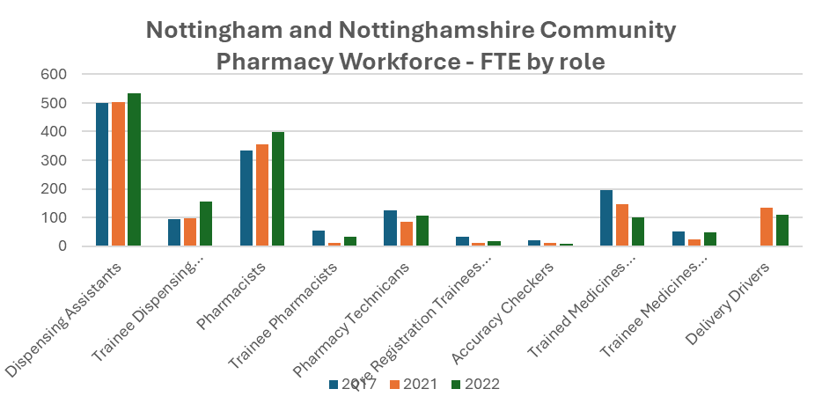
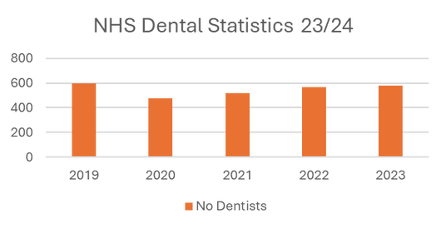
Our Primary Care Workforce:
General Dental Services and Community Pharmacy
Community Pharmacy Workforce
The data for our community workforce is taken from the annual NHS England Community Pharmacy workforce survey (2023).
The pharmacy sector is in a period of great transformation.
Between 2017-2022 the pharmacist workforce remained positive within Nottingham and Nottinghamshire, however, there has been a significant impact on the introduction of the Primary Care Network Additional roles position resulting in a shift of professionals moving from community pharmacy into general practice. This has resulted in vacancies and additional pressures being experienced within Community Pharmacy.
Nottingham and Nottinghamshire has seen a decrease of Pharmacy technicians between 2017-2022 at a time when recent changes to legislation around the roles and responsibilities of pharmacy technicians have relaxed and allowed technicians to act more independently. This development will improve access for patients but will require additional training and supervision support.
Expansion of the role for Pharmacy Independent Prescribers is also taking place increasing the potential for further growth in the role of community pharmacy in supporting patient care in the future.
The supply of Designated Prescribing Practitioners (DPPs) continues to be a challenge with Nottingham and Nottinghamshire struggling to meet the required support.
General Dental Services Workforce
The NHS Dental Statistics for England, 2023/24 provides analysis on workforce and headcount across Nottingham and Nottinghamshire. The accuracy of the data has not been locally validated.
The data suggests a slight increase of dentists between 2021-2023.
80.1% (81.9% England average) of the dentists provide General Dental Services activity. 7.9% provide Personal Dental Services, with 11.9% providing a mix of general and personal services.
13% of dentists are 55 years or over which presents a moderate risk of a decline in future capacity without workforce planning/retention considerations.

Slide 16
What Primary Care Providers say about local services
General Practice
  Demand on General Practice continues to rise. GPs and teams are simply seeing more people than ever.
  Continuity of care is not consistently available to patients.
  Workforce retention continues to be a challenge.
  Unsustainable workloads is resulting in burnout.
  The clinical model does not intervene early enough, there needs to be a stronger focus on prevention.
  Finances within General Practice are challenging resulting in Practice Contracts being handed back.
  The partnership model is challenged as a result of increasing numbers of GPs becoming salaried.
  Resources for GP practices are not equitably distributed on the basis of patient need.
  Bureaucratic paperwork takes time away from clinical practice.
  Shift of work from secondary care to primary care impacting on additional workload and no resources to follow.
Community Pharmacy
  Workforce recruitment and retention issues as a result of ARRS model destabilising usual model of community pharmacy workforce.
  Skill mix and funding challenges as an impact of move from prescription to service delivery model.
  Regulations can present challenges to effective working.
  National medicine supply shortages is impacting on relationships with patients and GP practices.
  Financial problems are resulting in pharmacy closures.
  As more people manage their own medication at home, it is expected they will require greater support from community pharmacies.
  Primary Care Networks can involve Community Pharmacy more to maximise opportunities for patient care.
Community Optometry
  Pressing need to streamline pathways so that they work in harmony with clearly defined roles for all providers.
  Underutilisation of Optometrists in Primary Care. Optometrists are not yet recognised or engaged as the first point of contact for eye health issues, despite their expertise.
  There is insufficient engagement and collaboration between/across Primary Care providers, even those working in close proximity.
  The increasing prevalence of age-related conditions is creating a greater need for domiciliary services to cater to people’s need.
  Poor communication between primary care, patients, and hospital eye services (HES) is hindering the effectiveness of low vision management, highlighting the need for a more structured and transparent pathway.
A series of workshops highlighted the challenges that are being experienced across our Primary Care providers.
General Dental Services
  Access to NHS Dentistry remains a challenge.
  Commissioning of services has remained unchanged and not responsive to patient need.
  Our population continues to access urgent dental services but often demand is heightened due to lack of access to routine care.
  Children continue to experience high levels of oral disease.
  Consistent engagement is lacking across general dental services and patients.
  Increase of oral cancer that means people are having poorer outcomes.
  Workforce challenges are unknown due to lack of data.

Slide 17
What local people and professionals say about primary care services
Key messages that have informed our Strategy:
We have listened to people over the past twelve months. This engagement has comprised:
Review of patient survey data
Engagement forums
Direct patient feedback from Primary Care
Patient perceptions and wider national feedback.
We have also listened to primary care professionals in a variety of forums:
Primary Care Strategy workshops
Direct communication with primary care professionals
Conversations with colleagues working within primary care
System and partner meetings.
We have also considered a range of policy and guidance publications including:
Fuller Stocktake
NHS Long Term Plan
NHS Planning Guidance
NHS Integrated Neighbourhood Health Model Guidance
Primary Care Recovery Plan
Community Pharmacy Contractual Framework 2019-2024
Community Pharmacy Services & specifications
Pharmacy Needs Assessment
Dental Recovery Plan
Oral Health Needs Assessments
Guidance from professional bodies.
People want better access to primary care services using the form that best suits them e.g. face to face, telephone or virtual, and to be locally available.
People want services to feel more joined up so that professionals involved in their care have access to information about them that reduces the need to re-tell their story.
People want more support to remain independent and stay healthier for longer.
People want more information about which service or professional will best meet their needs at any time in their treatment journey.
People want consistency of provision and not a postcode lottery of care.
Professionals want to support continuity of care, building and maintaining relationships so that care needs might be better met.
Professionals want support to train, recruit and retain staff so that we maintain resilience of local primary care teams, especially in GP practices.
Professionals want more say in the design and delivery of transformation of local services, especially in relation to prevention and shifting services from hospital to community settings.
Professionals want support in managing demand and using data and intelligence so that they can focus on supporting people who would benefit from their expertise the most.
Professionals want to offer more services in fit for purpose environments supported by the most up to date technology.

Slide 18
Moving forward – delivering our vision
A strong, sustainable healthcare system depends on vibrant primary care, rooted in local communities and delivering holistic, patient-centred support across the population. Based on the feedback we have received, and on the data we have about local population needs today and into the future, we think its time to reshape and lead a new era in the delivery of community based primary care services in Nottingham and Nottinghamshire. The transformation of primary care will be intimately connected with the wider transformation of our provider community as part of our integrated health model. We have worked closely with our communities, primary care teams, and system partners to co-design this shared vision for the future — our strategy is therefore shaped by the voices and experiences of those delivering and receiving care as well as our commitment to deliver national primary care operational standards.
By 2030, we intend to achieve:
“A more resilient, efficient, and patient-centred primary care provider sector that meets the needs of our population both now and in the future”.
To secure this vision we have identified three transformational themes. These are: creating resilient and sustainable services, improving quality and outcomes, and enhancing partnership working and integration. These transformational themes will be achieved through six delivery priorities and associated delivery plans. These will be robustly monitored to ensure we secure the future we are committed to. Supporting the delivery of these transformational themes will also be work to promote one public estate, digital and IT maturity, and joint workforce planning.
Our delivery priorities acting as the building blocks for sustainable transformation of our primary care services
Promote secondary and tertiary prevention through proactive and personalised care planning leading to more cost-effective targeting of resources and improved outcomes.
Maintain and promote primary care resilience and sustainability through extension of community services, new funding models, and the promotion of a unified voice for primary care.
Improve access to primary care services reflecting national delivery commitments as well as local population preferences and needs in order to address health inequalities and reduce inequity.
Delivery of the Integrated Neighbourhood Health Model supporting primary care to undertakes proactive case finding and long term condition and complex case management. This will support a ‘home first’ approach and comprise reactive, responsive and crisis care over time for all ages, including physical and mental health needs.
Promote active engagement and collaboration of primary care providers as part of the transformation of our provider landscape.
Increase public awareness of local support offers within their communities and promote opportunities for self care and management of conditions.

Slide 19
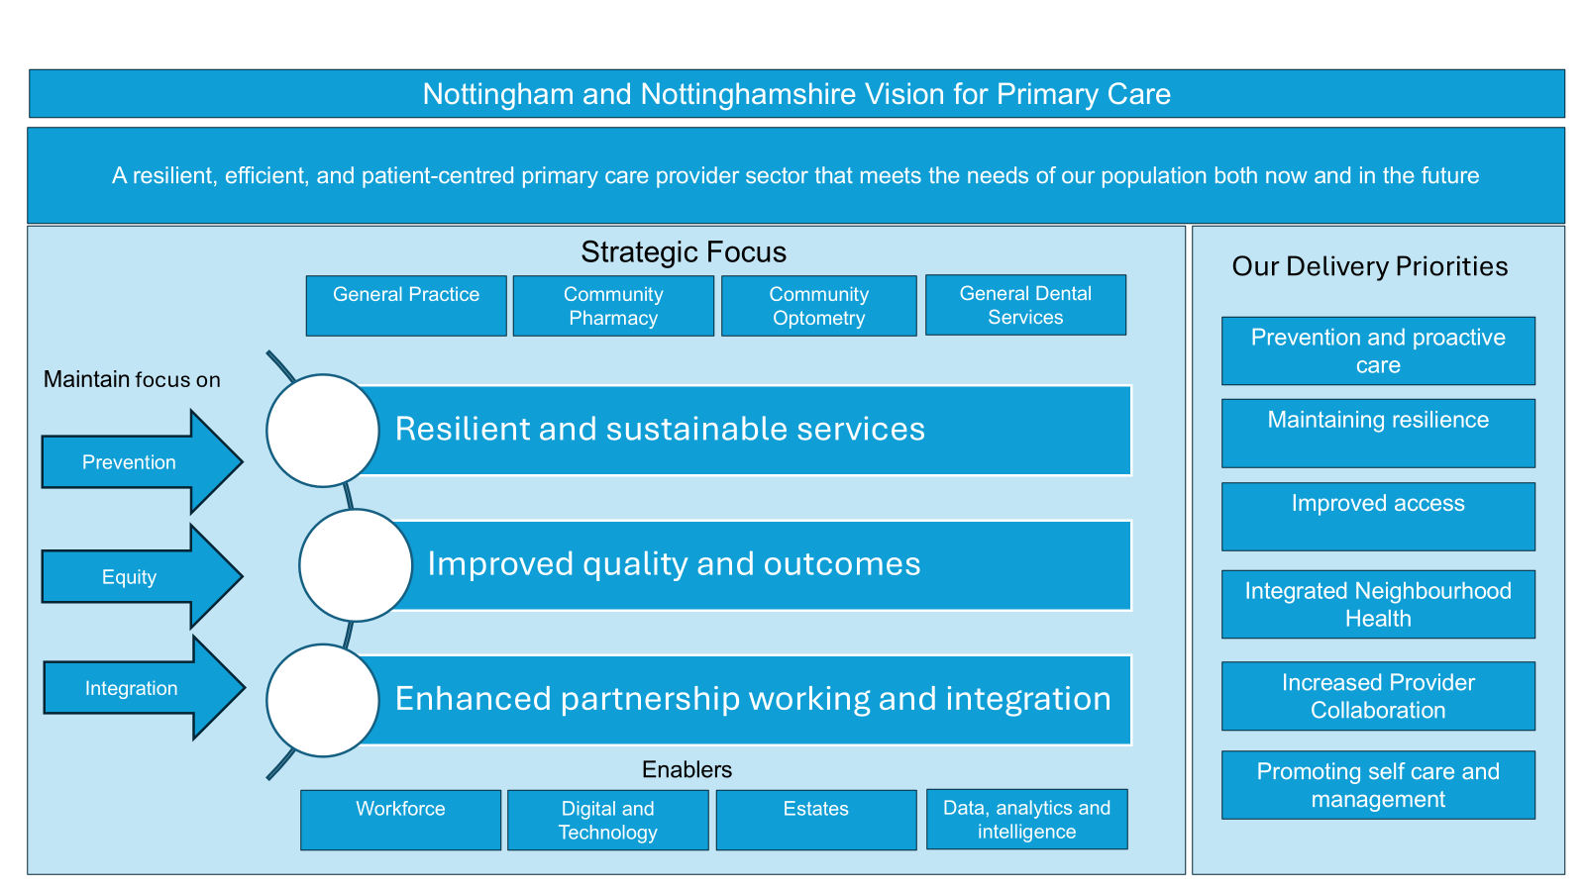
Marking our vision a reality: Our Plan on a Page

Slide 20
Delivery Plan 2025/6 – Prevention and Proactive Care
Prevention and proactive care
Maintaining Resilience
Improved access
Delivery of Integrated Neighbourhood Health Teams
Increased Provider Collaboration
Promoting self care and management
Key Actions | Timeline | Success measures
Model of multi-disciplinary discussion of complex cases systematically implemented within primary medical services as part of integrated neighbourhood health model. | Q1-4 | Conduct of MDTs in line with best practice guidance across all Integrated Neighbourhood Teams (March 2026) Increase in completion of personalised care plans for people identified as frail (trajectories within Frailty Programme) Increase in recording of RESPECT forms for people on End of Life register (trajectories within Frailty Programme) Increase in recorded Clinical Frailty Scores (trajectories in Frailty Programme.
Care navigation service in place supporting complex case identification and management. | Q1-2 | Care navigation service procured and mobilised (June 2025).
Increase use of population health management approaches to support case finding, care planning and management for people with high volume/high complex long term conditions (CVD, CHD, respiratory, diabetes, cancer, mental health). | Q1 | Provision of patients via e-Healthscope for GP practice review identifying patients most likely to benefit from further intervention or where gaps in care. Lists to also identify predictive risk of emergency admission (June 2025).
Increase the number of people registered with the NHS App. | Q1-4 | N&N ICS to have the highest rate of NHS App registration in England (March 2026).
Increase in hypertension case finding supporting prevention of exacerbation of illness. | Q1-4 | 1% monthly increase throughout 2025/6.
Increase in Structured Medication Reviews (SMRs) for patients identified as frail/with polypharmacy needs. | Q1-4 | Delivery of agreed trajectory (Frailty Programme/Medicines Optimisation Programme).
Increase in the number of new discharge medicine consultations to reduce readmissions. | Q1-4 | Increase 1% month on month during 2025/6 (March 2026).
Integration of Dental & Medical Needs - ensure that vulnerable people receive support with keeping their mouth clean. | Q1-4 | Work across system to support the importance of (1) brushing their teeth if they need help with personal care and (2) access to toothbrush and toothpaste if they can’t afford to buy them, through collaborative and partnership working.

Slide 21
Delivery Plan 2025/6 – Maintaining Resilience
Prevention and proactive care
Maintaining Resilience
Improved access
Delivery of Integrated Neighbourhood Health Teams
Increased Provider Collaboration
Promoting self care and management
Key Actions | Timeline | Success Measures
Promote full utilisation of ARRS funding across N&N ICS to develop local skill mix. | Q1-4 | 100% expenditure of available ARRS allocation (March 2026). Increase in ARRS appointments via GPAD (March 2026).
Implementation of Make Every Contact Count training across all new employees in primary care as part of induction. | Q1-4 | Inclusion of MECC training and awareness in induction programmes for primary care medical services (September 2025). Inclusion of MECC training and awareness in induction programmes for dentistry, community pharmacy and optometry (March 2026).
Awareness raising and training to support use of National Specialist Pharmacy Service Supply Tool enabling clinicians to be better informed of supply issues and actions. | Q2 | Training completed across all practices (June 2025).
Support for clinical leadership development and inclusion in transformational change initiatives. | Q1-4 | Review of clinical leadership requirements across Place based Partnerships and Neighbourhood Teams (Q1 2025). Review of Phoenix Programme supporting clinical leadership, retention, training and recruitment (Q1 2025). Continuation of our senior clinical leadership group in engagement of service/transformational change (2025/6).
Align the development of shared estates and workforce plans with the implementation of the Integrated Neighbourhood Health Model, bringing health and care professionals together to develop a ‘one team’ approach. Primary Care Estates Plans to be reviewed in light of development of same day/urgent Hub and spoke models, clinical delivery models, administrative and training needs and availability of NHS capital investment. | Q1-4 | Develop maturity plans for INTs as they evolve during 2025/6. Estates and Workforce Plans to be completed by December 2025. INT Estates Plans and Workforce Plans to be aligned to GP practice plans, system infrastructure/One Public Estates Plans and Workforce Strategy.

Slide 22
Delivery Plan 2025/6 – Improved Access
Prevention and proactive care
Maintaining Resilience
Improved access
Delivery of Integrated Neighbourhood Health Teams
Increased Provider Collaboration
Promoting self care and management
Key Actions | Timeline | Success Measures
Improve 14-day GP access through continued delivery of the Action Plan including promotion of best practice appointment coding. | Q1 Q2 | N&N ICB performance achieve national target (85%) or above from March 2025 Assertive in-reach programme implemented for practices with lower achievement levels to review and revise coding as appropriate (Q1) Subject to the above, achievement of min 87.6% (from July 2025)
Work with community pharmacy to increase service offer to patients across N&N; prioritisation within areas of highest deprivation. | Q1-4 | Increase in community pharmacists providing Pharmacy First service in most deprived areas (September 2025) across Nottingham and Nottinghamshire (March 2026). Min 1% monthly increase in community pharmacists providing blood pressure monitoring and contraception services (from Q4 2025/6)
Review and optimise Community Pharmacy Bank Holiday Rota to ensure equitable service access across Nottingham and Nottinghamshire. | Q3 | Revised rota in place (December 2025)
Implementation of Primary Care Access Recovery Plan (PCARP). | Q1-4 | By March 2026: Min 80% of practices having more than 40% of registrations using national on-line registration service Min 80% practices implementing Modern General Practice Models (achieving 3 criteria or more) Improvement in overall Friends and Family Test assessment, submission rate and survey completion rate Min 80% of practice compliance with website national guidance Increase of on-line consultation/triage appointments recorded in GPAD

Slide 23
Delivery Plan 2025/6 – Improved Access Continued
Prevention and proactive care
Maintaining Resilience
Improved access
Delivery of Integrated Neighbourhood Health Teams
Increased Provider Collaboration
Promoting self care and management
Key Actions | Timeline | Success Measures
Develop community-based pathways for wet age-related macular degeneration (AMD) and eye casualty follow-ups. | Q2-4 | Confirmed revised pathways mobilised (March-April 2026).
Exploration of opportunity for increased role of optometrists in preventative healthcare and early disease detection and treatment in a community setting. | Q1-4 | Confirmed preferred options (June 2025) and revised pathways mobilised (March 2026).
Develop an Eye Health Needs Assessment to identify main priorities for improving eye health, reducing preventable sight loss and reducing inequalities. | Q1-4 | Eye Health Needs Assessment completed (December 2025). Implementation Plan developed (February 2026). Mobilisation (March 2026).
Implementation of the Electronic Eye Referral System allowing more appropriate referrals to specialist input. | Q1-4 | Electronic Eye Referral system fully operational (March 2026).
Implementation of the Dental Recovery Plan supporting increased access, urgent care provision and commissioned services. | Q1-4 | Plan deliverables completed in accordance with agreed timelines (June 2025). Deliver 24,360 unscheduled care appointments (March 26). Expand commissioning and delivery of UDAs each quarter, commissioning mandatory services to areas of highest need (March 2026). Recommission urgent dental care services (March 2026). Expand flexible commissioning through the annual cycle to utilise flexibility within the dental regulations to maximise opportunities to improve dental service provision. (March 2026). Recommission urgent dental care services by (March 2026).
Implementation of a national community pharmacy independent pathfinder service. | Q3 | Four independent prescribers within Community Pharmacy Independent Pathfinder Programme (December 2025). Minimum of six by March 2026.
Implementation of a Pharmacy Sustainability Dashboard to optimise pharmacy delivery options for people | Q4 | Pharmacy Sustainability Dashboard established (March 2026).

Slide 24
Delivery Plan 2025/6 – Delivery of Integrated Neighbourhood Teams
Prevention and proactive care
Maintaining Resilience
Improved access
Delivery of Integrated Neighbourhood Teams
Increased Provider Collaboration
Promoting self care and management
Key Actions | Timeline | Success Measures
Implementation of Integrated Neighbourhood Health model. | Q1-4 | Phase 1: Minimum of 4 INTs – June 2025 Phase 2: Minimum of 8 INTs – September 2025 Phase 3: Minimum of 10 INTs – December 2025
Integrated Neighbourhood Health Teams to focus on people with severe or moderate frailty (including with long term conditions), children and young people (CYP) and people experiencing severe multiple disadvantage (SMD). Specific/hyper focussed cohorts defined within the Frailty Programme based on greatest opportunity for population impact and secondary and tertiary prevention. | Q1-4 | Phase 1INTs: Frailty pathway implemented (June 2025) CYP pathway implemented (September 2025) SMD pathway implemented (December 2025) Phase 2 INTs: Frailty pathway implemented (September 2025) CYP pathway implemented (December 2025) SMD pathway implemented (March 2026) Phase 3 INTs: Frailty pathway implemented (December 2025) CYP pathway implemented (March 2026) SMD pathway implemented (June 2026)

Slide 25
Delivery Plan 2025/6 – Increased Provider Collaboration
Prevention and Proactive care
Improved workforce integration, retention and training
Improved access
Delivery of Integrated Neighbourhood Health Teams
Increased Provider Collaboration
Promoting self care and management
Key Actions | Timeline | Success measures
Develop a single GP Collaborative to create a unified voice for general practice. | Q1-2 | Agreed concordat across all practices (September 2025).
Develop enhanced service proposal/GP Improvement Programme to incentivise GP engagement in Integrated Neighbourhood Health Model and accelerate proactive case finding and management. | Q1-3 | Options appraisal completed Agreed Enhanced Service Offer mobilised across N&N (June 2025). Performance oversight of delivery commenced (September 2025).
Dissemination of data packs for practices/Primary Care Networks to support awareness of variation in outcomes to support joint working and learning across practices and identification of opportunities for proactive support to practices by the ICB (PMS Performance Group). | Q1-4 | Implementation of pro-active practice visits to support practices to address unwarranted variation in outcomes (March 2025).
Exploration of opportunities for shared infrastructure across primary medical care services e.g. same day/urgent care, access Hub and Spoke model. | Q1-4 | Identification of opportunities and early mobilisation (March 2026).
Expansion of ‘at scale’ working models for delivery of primary medical services. | Q4 | Review of opportunities for delivery of commissioning ‘at scale’.
Involve Pharmacy, Optometry and Dentistry across all Place Based Partnerships. | Q1-2 | Involve and enhance awareness of Pharmacy, Optometry and Dentistry within Place Based Partnerships (July 2025).
Ensure that we address the needs of the whole population, by considering oral health in the services that support our vulnerable groups. Specifically ensure that vulnerable people receive routine and urgent dental care, as part of their overall care (may involve signposting to services or referral into services such as the Community Dental Service. | Q1 | Agreed process Plan (June) 2025 mobilised by (December 2025).
Confirm approach to develop Dental Strategy One Vision across NHS and Local Authorities. | Q4 | One vision across the system to support commissioning and oral health needs and prevention March 2026. Implementation plan (June 26), Mobilisation (September 2026).
Primary / Secondary care interface enhanced to incorporate Pharmacy, Optometry and Dental Services. | Q2 | PODS active participation within primary / secondary care interface meeting supporting wider working (September 2025).

Slide 26
Delivery Plan 2025/6 – Promoting self care and management
Prevention and Proactive care
Improved workforce integration, retention and training
Improved access
Delivery of Integrated Neighbourhood Health Teams
Increased Provider Collaboration
Promoting self care and management
Key Actions | Timeline | Success measures
Communications campaign to increase public awareness of pharmacy, optometry, dental expertise and services; prioritisation within areas of highest deprivation. Comms to also promote self-care and management and awareness of self-referral pathways. Importance of prevention in managing health and wellbeing (e.g. eye tests reduce risk of falls). | Q1-4 | Completed multi-media comms campaign (December 2025). Increase in public and professional awareness of optometry’s expended role beyond vision correction (sample survey December 2025) Increase in public and professional awareness of oral health and preventative care and self-referral pathways (sample survey December 2025). Increase in referrals through self-referral (March 2026).
Communications campaign to promote patient ordering of repeat medications allowing 3 – 5 days, supporting hub and spoke model of delivery. | Q3 | Increase in pharmacy on-line prescription requests and reduction in emergency prescriptions issued (December 2026).

Slide 27
Delivering our vision
Our approach to delivery is based on working in partnership across primary care. It recognises the need to work together as a system of good practice and shared solutions and provides an opportunity to collectively shape and influence transformational change.
To successfully deliver the aims and ambitions set out in the document the Primary Care Transformation Group will oversee and support the delivery of our agreed actions as outlined in our delivery Plans. The group will have a system-wide approach to oversight and governance and our partners who have supported its development will all have a key role in supporting its delivery.
NHS Nottingham and Nottinghamshire ICB would like to take this opportunity to thank everyone who has been involved in the development of this strategy and your ongoing support in its implementation for the benefit of the population we serve.

