Slide 1
Floor Mapping
For Falls Prevention
Falls Awareness Week 2024

Slide 2
Content
What is floor mapping ?
Types of floor mapping
How can floor mapping help to prevent falls?
How to complete floor mapping
Opportunity to complete a falls cross together online

Slide 3
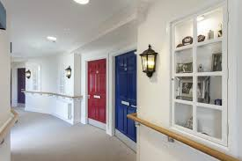
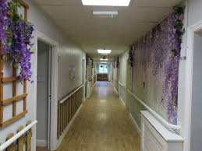
Care homes by nature have long corridors, lots of corners and floors, which mean unwitnessed falls can be a common occurrence
Understanding the place, the time and the frequency of falls provides insight into the cause.
Once the cause is known change can be implemented to reduce the risk of future falls.
Floor mapping for falls prevention aims to provide oversight of an entire floor or care home on where , when and who is falling.
It aims to ensure that at a glance any team member can see who has fallen where and at what time.
This provides important information which
can help to prevent future falls.

Slide 4
4 Falls 1/10/23,4/10/23,18/10/24,30/10/24
13.00, 11.00,18.00
Floor mapping may include a diagram of the floor of a home . By law, all homes will already have these plans as part of their fire safety regulations.
Over a one- month period staff record each floor on the diagram
A tally or change the number each time . The date and time of the fall can also be added.
Completing a falls map in this way can provide key information regarding when and where falls are most likely to happen .
A diagram such as this may also highlight specific residents who are experiencing high falls rates.
1 Fall 10/10/23
13.00
5 Falls
22/10/23,23/10/24,23/10/23,24/10/23/24,25/10/24
21.00,21.30,01.00,04.00,05.00
3 Falls
12/10/23,17/10/23,22/10/23
13.00, 13.15, 13.22

Slide 5
Case Studies
Highlighted at home round
Occurred in room over lunchtime , most staff in dining room , reduced supervision Staff member used mobile desk to have eyeline sight of resident over lunchtime
Falls Risk Assessment Plan updated
A
Four falls but all experienced by different residents
No pattern regarding time of day
Following review of flooring noted change of colour and texture
All residents who feel had dementia
Flooring updated
Falls risk assessment updated
Cases highlighted for discussion at home round
Office
B
C
Three falls all in dining room
Three different residents
Timing indicates this is just after lunch when staff are helping residents to move from the dinning room to the living room
Housekeeping staff and kitchen staff supported with supervising residents in the dinning room after lunch
D
Five falls , single resident
All occurring in room overnight
Map clearly shows this is occurring in room furthest from the office
Resident was supported to move rooms

Slide 6
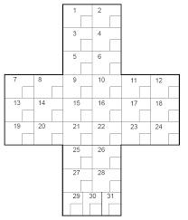
1
2
Falls Safety Cross
Near Miss
Reduced transfer ability
Reduced Mobility
0
1
1
Falls assessment plan updated to include new risk factors identified
Case brought to home round
3
4
0
0
5
6
0
1
No Falls
7
8
9
10
11
12
No action required this month
0
1
0
0
2
1
13
14
15
16
17
18
0
0
0
3
0
1
Newly admitted resident with a falls history , but no falls since being at the home.
Falls assessment with 7 days of admission
Falls history taken from family and resident which informed completion of falls risk assessment
19
20
21
22
23
24
0
2
0
2
0
1
25
26
0
0
Fall
Falls Risk assessment and care plan updated
Case discussed at home roud
Review completed by care home team
Care home utilised post falls guidelines for care homes
27
28
0
0
29
30
0
0

