Slide 1
Falls Huddle Training
Falls Awareness Week 2024

Slide 2
A falls huddle is a structured conversation that happens
after a fall.
1. What did we do well ?
Emphasis on:
Psychological safety
Conversation feeling like a safe space
No blame culture
Team ownership “ A fall is our shared problem”
Important to start with what we did well
Consider language used
= Compassionate Leadership
2. What did not go well ?
4. What are our actions going forwards?
Falls Huddle
3. What have we learnt from this fall?
Every fall can teach us something
Backed by patient safety science ad research

Slide 3
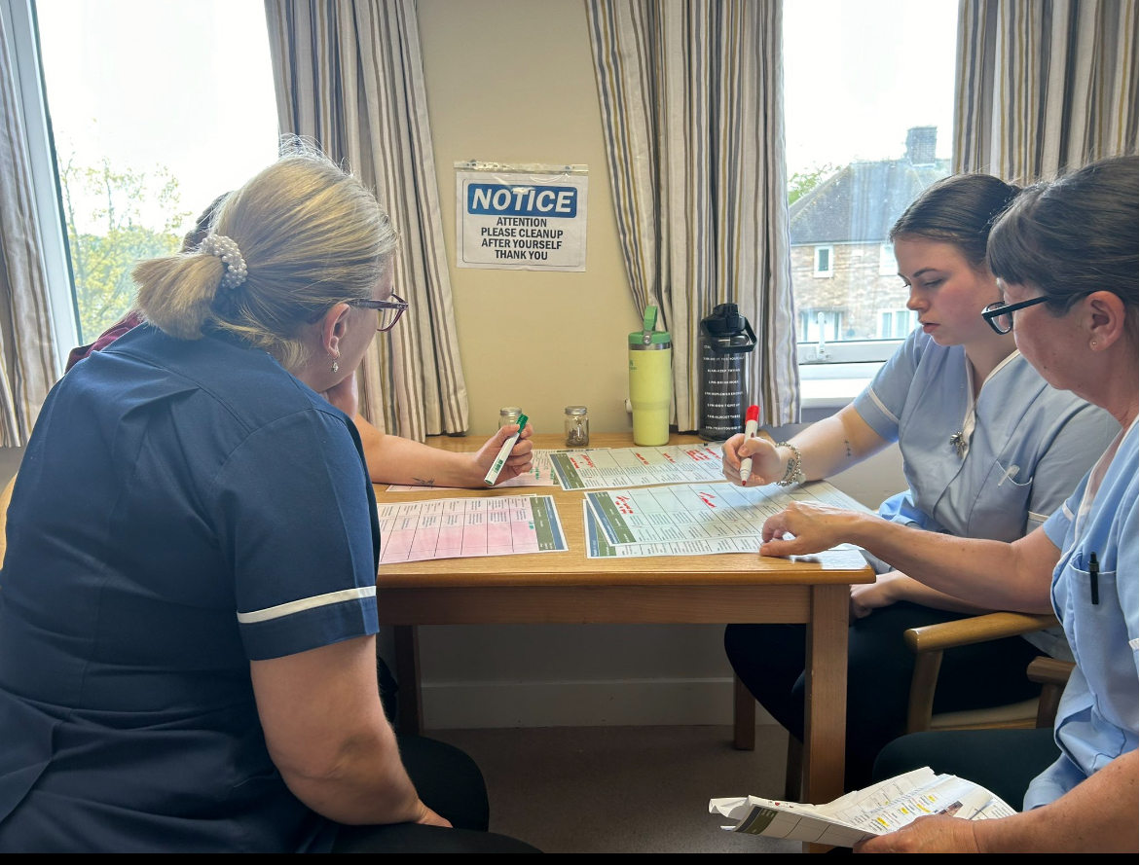
A falls huddle should include all persons involved in and witnessed to the fall.
Most effective as soon after the event as possible.
Can be done at a later date.
Needs to have some structure with open questions.

Slide 5
There needs to be a method by which findings are recorded and acted upon
How do we take forward the actions identified ?
How will we check these have been actioned?
How will we ensure these actions are clear to all staff members?
How will we evidence this ?

Slide 6
Case Study

Slide 7
What went well ?

Slide 8
What did not go well?

Slide 9
What have we learnt from this fall ?

Slide 10
What are the actions
following this falls huddle ?

