Slide 1
Dementia & Falls in Care Homes
Falls Awareness Week 2024

Slide 2
Content
Better understanding of different types of dementia and their presentations
Explore the links between dementia and falls
Consider person centred approach to falls prevention for this cohort of residents
Opportunity to share best practice

Slide 3
Falls and Dementia
People with dementia are four to five times more likely to fall than older people who do not have cognitive impairment.
For those who fall, the risk of sustaining a fracture is three times higher than for cognitively well people.
Also, those who fall are five times more likely to be hospitalized or live in a long-term care setting than older adults with dementia who do not fall.
People with Parkinson’s disease, vascular and Lewy body dementia are more prone to mobility disturbances. (Fiona Shaw, 2003)

Slide 5
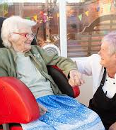
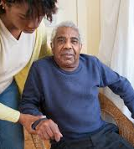
Falls and dementia
People with a cognitive impairment like dementia are at greater risk of falling and sustaining a serious injury. This is linked to some of the symptoms of dementia, such as difficulties with:
Judgment and insight
Sensory perception such as sight, sound, touch
Mobility and coordination
Communicating their needs (eg difficulty explaining that they need help to get out of bed)
Interpretation of their environment, causing illusions and misperceptions e.g., depth, light intensity, colour, pattern, temperature
Retention of information: loss of memory, difficulty with new learning or relearning ,
Initiation of tasks, leading to immobility

Slide 6
Alzheimer's Disease
75% of all dementia
Slow onset , with a steady decline
Memory loss especially with names and
recent events
Word finding difficulties
As the disease progresses :
Greater memory loss
Impaired visuospatial skills
Language difficulties
Impaired functioning of daily activities
How may Alzheimer's lead to falls ?
May be unable to verbalise pain
Difficulties judging how far away furniture is – Example: when sitting on a chair
Altered routines when getting dressed
Example : Putting on shoes before trousers
Forgetting Socks and Slippers
Bumping into things or other people
Unable to judge how close together furniture is
How things look when rotated
Navigation

Slide 7
Case Study
Margaret “Mo”
3year history of Alzheimer's
In early days of disease Mo lived at home and her daughter oved in with her to care for her
Main symptoms at this time was word finding difficulties
Memory loss – but could still recall memories from when her children were at school and when she was working in her mum and dads' shop
As disease progressed Mo had difficulties at home and several falls
Moved into a care home in December 2023
Remains independently mobile with zimmer frame
Falls history
2 falls occurred in the dining room when mobilising between 2 chairs – getting trapped with zimmer frame.
2 falls in doorway of bedroom - lifting frame over threshold.
Falls thought to be due to visual-spacial issues
Plan
Highlighted for discussion at home round
Seen by dementia outreach and had a review of her holistic care plan
Extra supervision given for Mo during lunchtime
Regular chair and table with extra space created
Moved to a room closer to the office – doorway within eyeline sight

Slide 8
Vascular Dementia
20 – 30% of all dementias
Occurs when blood supply to the brain is compromised by arterial disease
Can be a sudden onset or a gradual onset
Memory loss and symptoms of arterial disease
Such as Diabetes , High blood pressure , Circulatory issues
Depression , Anxiety
Lack of interest or motivation
History of smoking – very common
30% of vascular dementia caused by a stroke
How may Vascular Dementia lead to falls?
Forgetting to ask for help
Example : Getting up without waiting for assistance
Blurred vision , dizziness – due to high bP
Example : Loss of balance
Depression/ Lack of interest leading to reduced movement and sitting for long periods
Example : Muscle weakness – knees giving way
Increased fear of falling due to heightened anxiety
Example :
Stroke

Slide 9
Case Study
Jane worked her whole life as a nurse for the NHS. After retiring she continued to provide care and support to others regularly volunteering at the hospice along the road from her home.
Two years ago, Jane experienced a stroke which has led to mild weakness along her right arm and leg and vascular dementia. This led to her moving into a care home.
The vascular dementia meant that Jane forgets to ask for help and will often get up and forget her walking frame. Wanting to help others Jane often gets up and attempts to provide care to other residents causing numerous falls. Due ot the right sided weakness experienced by the stroke Janes right knee also gives way sometimes leading to falls.
Falls History
4 falls
3 unwitnessed in other residents' rooms during day
1 witnessed – right knee gave way whilst mobilising without walking frame
Plan
Referred to dementia outreach for support and advice.
Moved room to area of home which is not as busy – less buzzers going off
Sensor matt in situ
Signage placed on table in room reminding Jane to use her walking frame
ACTION Falls checklist completed

Slide 10
Lewy Body Dementia
Approximately 10 – 15% of all dementias
Lewy bodies are small proteins that form in the brain
Often proteins form in the cerebral cortex which is responsible for memory , speech and movement.
Can present very similarly to Parkinson's disease.
Symptoms include visual hallucinations, marked fluctuations in conscious awareness, disturbed sleep or nightmares, trembling in limbs, shuffling when walking , reduced facial expressions.
How may Lewy Body Dementia cause falls?
Visual hallucinations or aggression causing sudden movements and a loss of balance
Shuffling steps meaning a person will be prone to trips
Nightmares causing broken sleep leading to disorientation and fatigue

Slide 11
Case Study
John worked for 40 years as a chemical engineer. During his working life he worked on oil rigs during the gulf war and often witnessed shell attacks and worked in war zones.
During retirement John started to lose his memory and began to experience visual hallucinations. Often these came in the form of children crying or men shouting. This caused John to become agitated sometimes and occasionally aggressive. This is often when falls occurred as John would get up and walk around trying to understand where the shouting was coming from.
John also mobilises with a shuffling gait and has a tremor noted in standing .
John often experienced nightmares causing broken sleep and fatigue
Falls History
4 falls all unwitnessed
Each time John found to be confused and hallucinating
The falls also coincided with a previous poor night's sleep
Plan
Care home team highlighted case at home round and John was referred to a community geriatrician for review. This review was able ot take place at Johns home. John was given medication to help reduce hallucinations and for him to sleep better . This reduced fatigue and meant that John was more rested and settled during the day.
John has experienced no further falls

Slide 12
Frontotemporal Dementia
2 – 10% of all dementias
Affects front art of the brain which is responsible for planning , emotion, motivation and language
Affects younger age group
Disinhibited and socially inappropriate behaviours
Impaired judgement
Lack of interest and motivation
How may frontotemporal dementia cause falls?
Unable to understand risks to self , leading to risky behaviours.
Becoming very distressed causing reduced insight into falls risks.
Lack of motivation – leading to long periods of time sitting or sleeping – causing physical weakness.

Slide 13
Case Study
Bill a retired headmaster began experiencing some word finding difficulties 18 months prior to retiring. This progressed and began to include episodes of loss of memory. Bills wife also noticed some change in personality and noticed Bill would sometimes become upset at inappropriate times . To begin with Bill and his wife felt he may be depressed and coming to terms with retirement and change of routine, but as the disease progressed Bill also began to show some signs of inappropriate behaviour towards his wife and a general lack of interest in life .
Bill was supported to live at home with a personal assistant for several years but when his wife started to struggle to support him at home he moved into a care home.
Bill remains very mobile but some reduction in strength and balance. Often puts himself at risk of a fall due to having little insight into common falls risks.
Falls History
1 fall in bedroom unwitnessed
Bill reports to have been standing on his bed to reach for something on top of his wardrobes and fell sideways off the bed
Plan
Room moved closer to office and in line of sight of staff member overnight.
Bed moved to be placed against wall reducing risk of fall from bed.
Items stored on top of wardrobe moved
Signage used in room to remind Bill to press call bell or ask for help.

Slide 14
Communication
How the caregiver communicates with the person they are assisting is an important factor in reducing the risk of falls for people with dementia.
Remember to obtain the person’s attention: reduce distractions and gain eye contact
Watch for non-verbal cues from the person to help understand their actions and reactions
Be mindful of your approach: remain calm and watch your facial expression and gestures
Give thought to how instructions are given: use short, simple sentences; suggest one step at a time; use cue; allow time; encourage the person

Slide 15
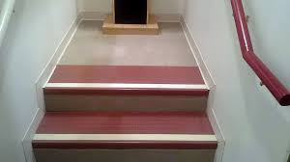
Visual Contrast
Use obvious contrast in colour to define objects from the background.
Use solid colours with no pattern to decrease confusion.
Avoid black surfaces, which may be misinterpreted as being a black hole. Suggestions: Use a contrasting ,coloured rubber mat or decals on bottom of the tub.
Place a contrasting, coloured towel or apply contrasting coloured tape on the edge of the tub.
Use a non-slip contrasting bath matt.
Install a contrasting colour toilet seat.
Install darker handrails on light coloured walls.
Use a contrasting colour doorsill.
Apply bright, non-slip tape on the edge of each step or on the bottom and the top stair.
Paint walls a light colour and baseboards a darker tone.
Have darker floors and lighter coloured furniture.

Slide 16
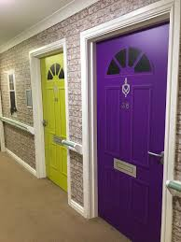
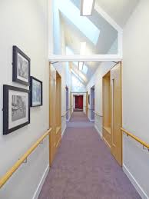
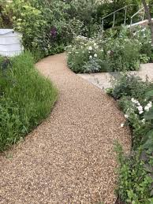
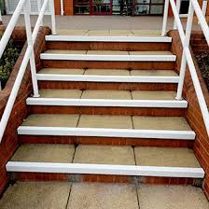
Environmental Considerations
Indoors
Keep corridors clear of clutter
Keep surfaces level, dry and non-slip
Remove scatter cushions or rugs .
Replace uneven, damaged flooring
Avoid polishing floors.
Ensure door thresholds are level with floor
Clean up spills immediately.
Remove light, unstable or low pieces of furniture.
Keep furnishings in consistent places.
Outdoors
Keep pathways level, in good repair, free of clutter and clear of ice and snow.
Paint step edges a contrasting colour.
Enhance Accessibility
Keep important items in consistent, visible, easy-to-reach places.

Slide 17
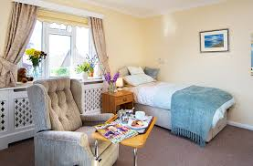
Bedroom Considerations
Use a firm mattress.
Ensure height of bed is optimised for residents needs
Label cupboards with the name of the contents
Keep mobility aids close by.
Have important items by the bedside.
Consider purchasing a fall alert device
Keep room clear of clutter
Ensure commodes are placed with back to a wall
Consider placing bed next to a wall
Consider high risk fallers and locating rooms as close to the office as possible
Encourage residents to spend time in communal areas
Consider how to reduce noise level
Avoid sudden noises

Slide 18
Any actions taken to reduce falls should be clearly documented in the residents personalised falls prevention plan
Consider how this plan will be updated and communicated to all staff members
Ensure a detailed falls history s taken following every fall and that the history is studied for patterns and clues which could help to prevent a future fall.

Slide 19
Pease consider taking part in the online React To Falls Training which will provide generalized falls prevention and management training
This is free and evidence based
https://reactto.co.uk/react-to-falls

