Slide 1
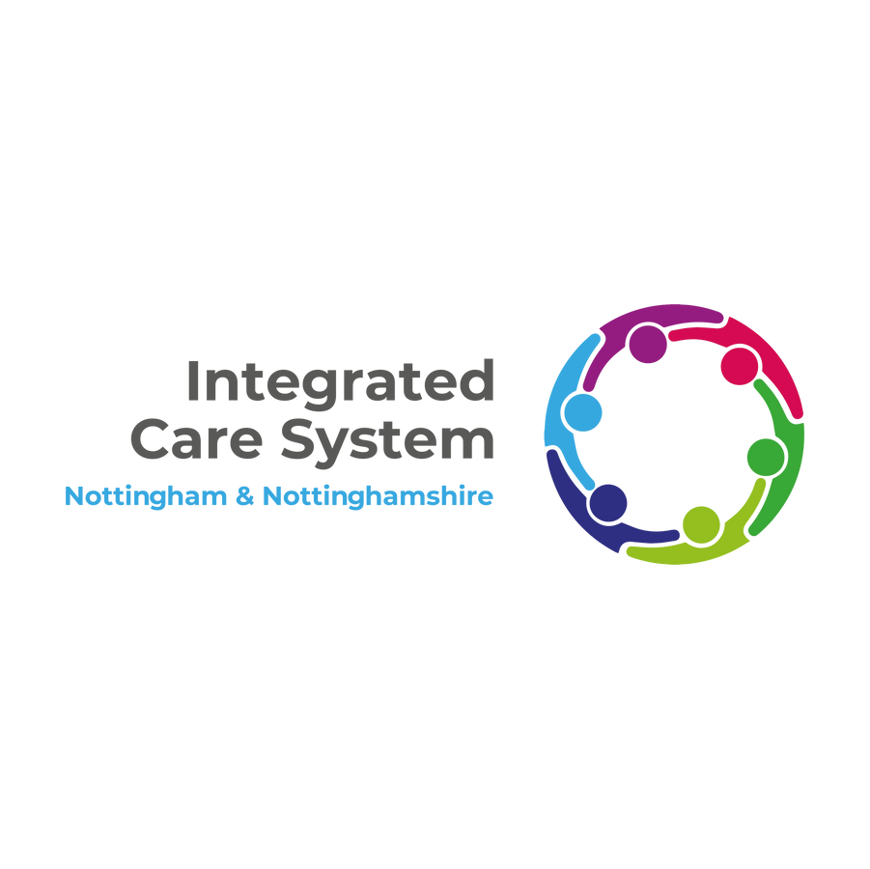

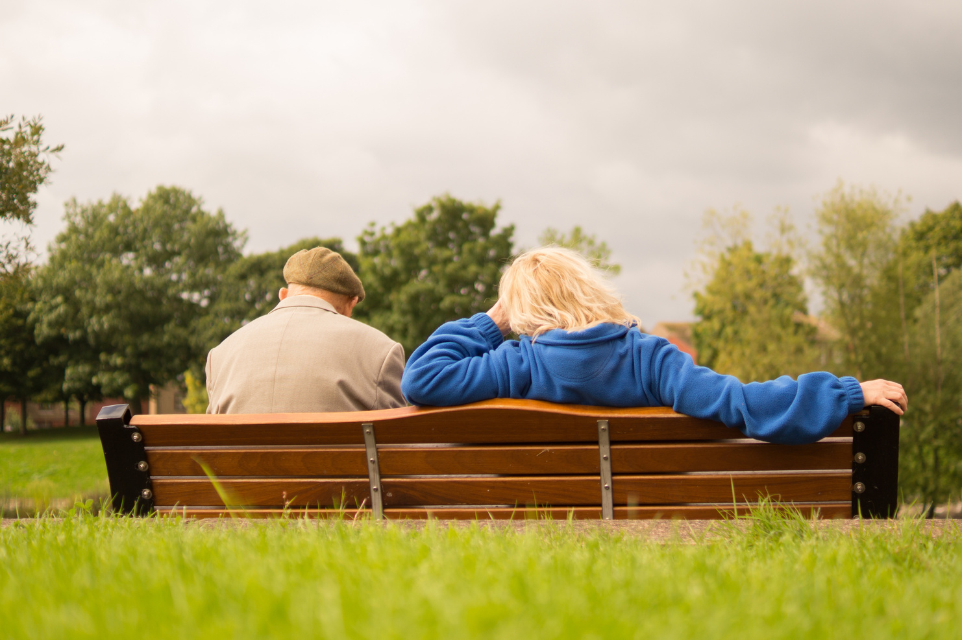
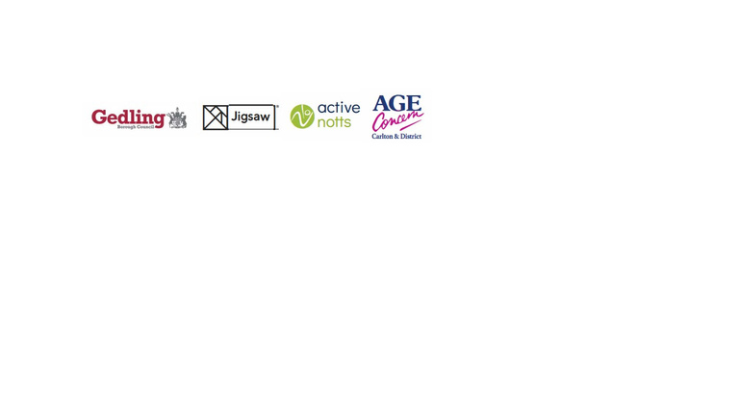

COPRODUCTION
Case study
TALK. LISTEN. CREATE. INSPIRE. CONNECT
Age Friendly Carlton
Aim of the project: Re-launch Age Friendly Carlton.
Area: Carlton in Gedling Borough
Who was involved: Carlton residents, Age Concern, Active Notts, Jigsaw & Gedling Borough Council.
Learning area: Co-creation of resources & the impact of coproduction on the people taking part.
  To know where the toilets and benches were.
  Local shops to be welcoming & friendly.
Contents:
  Scope of this work
  The emotional impact of this coproduction approach
Age Friendly Carlton...
This will take you 10 mins to read.
Based on what people told us, the focus for the relaunch of Age Friendly Carlton scheme became highlighting:
  Businesses who pledged to be welcoming and patient; assist with shopping where required, and go the extra mile in supporting older adults.
  The location of benches, public toilets, car parks & defibrillators in Carlton.
Local residents had the idea for including this information in a ‘bench map’.
About the project...
After the Covid-19 pandemic, Age Concern wanted to relaunch their Age Friendly Carlton scheme.
To understand how to make Carlton a safe & friendly space, focus groups were held with local residents, in community venues, to understand the enablers & barriers to people getting out and about.
We found out...
What we did...
To have the confidence to go out more, local residents said they needed:
Alongside local residents, we walked around Carlton to find the benches, toilets, defibrillators and carparks.
123-456-7890
www.reallygreatsite.com
Case study Series Two - The Emotional Impact of Coproduction July - September 2024
hello@reallygreatsity.com

Slide 2
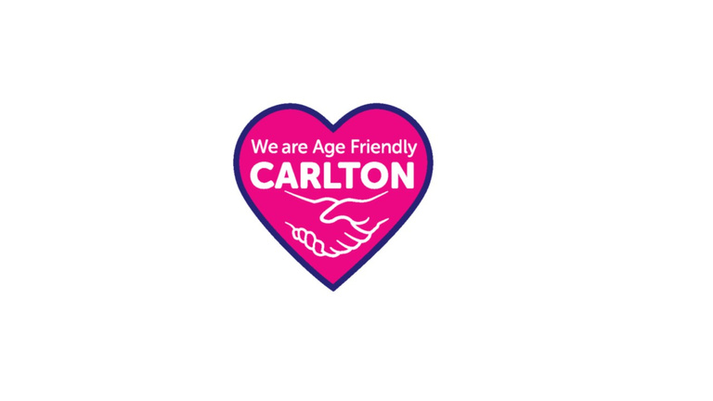

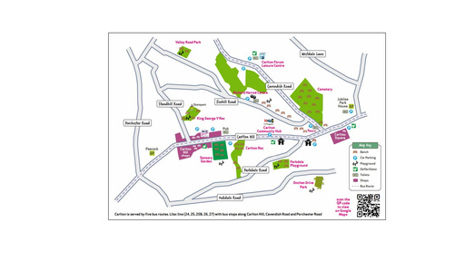
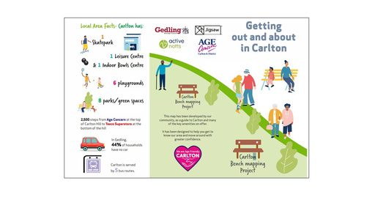
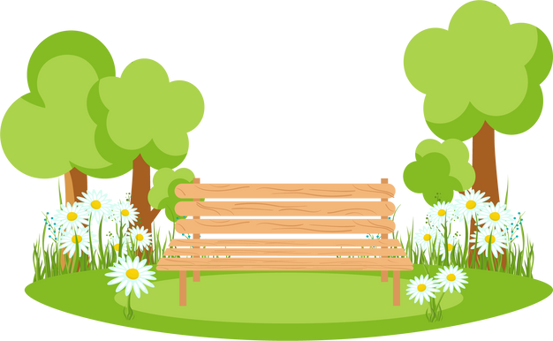
And we set up an online form for people to submit WHAT3WORDS locations of amenities.
The information we collected was plotted on Google maps and sense checked with local residents.
Once everyone was happy that the information was accurate, a the Carlton Bench Map was printed & distributed to:
  Local community venues
  Housing schemes
  Library
  GP surgeries
  Community partners, such as Social Prescribing Link Workers and Community Physiotherapists.
It was also made available online, via the Active Notts website.
We also co-created an Age Friendly Carlton logo, for shops to display, to show that they provided a friendly & welcoming space.
33 businesses signed up and are proudly displaying the bright pink, co-designed ‘We are Age Friendly Carlton’ logo.
Next steps...
Residents are now co-designing a ‘6 short walks in Carlton’ leaflet and working out how to support each other walking on these routes.
Top Tips....
  Don’t go in with a prepared solution. Let the solution evolve from the discussions with residents.
  Invest time in building trusted relationships.
  Find out what matters to the individual.
  Let the project evolve organically.
“I get out of breath easily and it’s really good to know where I can sit down and have a rest”
Judith, Lived Experience Expert
Case study Series Two - The Emotional Impact of Coproduction July - September 2024

Slide 3
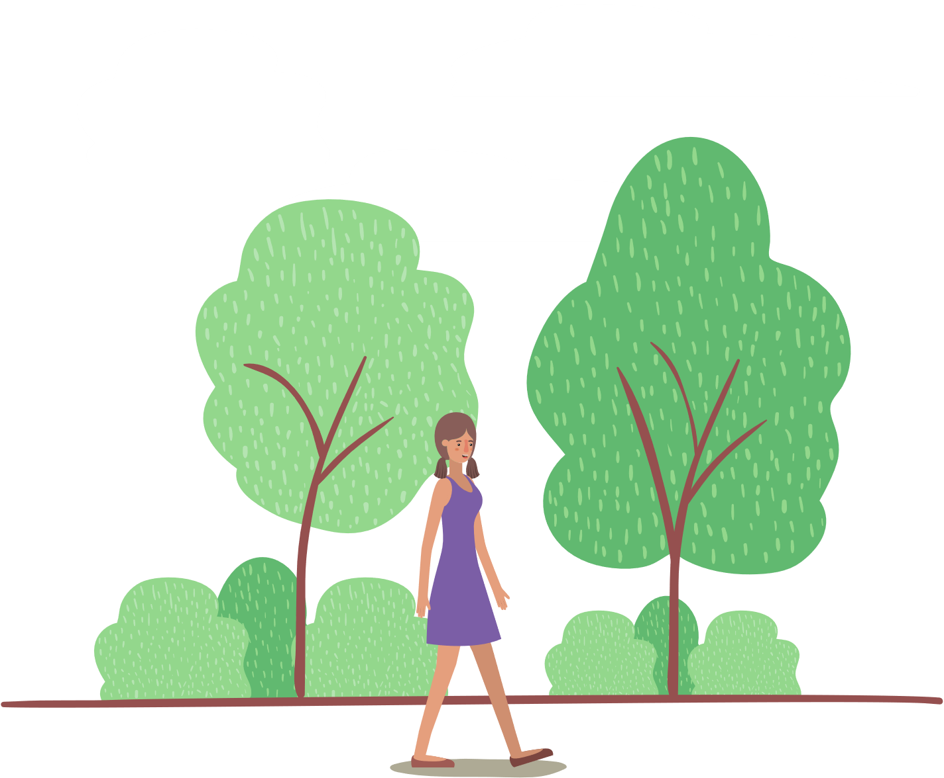
In focus: the emotional impact of coproduction
Sara Davies, Carlton Community Connector told us that:
“Walking a mile in the shoes of the people you’re trying to support really helps you to understand and appreciate the challenges and barriers they face.
This project has improved the relationship between local community partners, which has led to a collaborative approach to supporting local residents.
Involving local residents has led to them being involved in crafting other local initiatives, such as ‘Carlton Voices’ & Carlton Arts Week, which has led to residents becoming more socially & physically active”.
The quotes below reflect the impact of co-creation on the residents & organisations involved. They capture feeling heard, energised and supported.
“I’d never been to this park before, even though it’s so close. It helped to go with a group of people I know. I can’t believe how I got up that hill. It was so much easier than I thought it would be at the beginning of the walk”.
David, Lived Experience Expert
“It was really nice to be listened to”
Jean, Lived Experience Expert
“The Carlton Conversation works so well because we have a common purpose. It’s about action rather than talk. We all have little pockets of information, operate in different areas of the neighbourhood and we all have different skills which we are using to help each other”.
Suzy Layton, Age Concenr
“I’d forgotten how energising it is to go for a walk. I’ll do it again”
Ann, Lived Experience Expert
Would you like to learn more?
With thanks to...
For more information about this project, watch Sara Davies, Carlton Community Connector and Fiona Hextall, Health Development Officer talking about the project on the Active Derbyshire & Active Notts YouTube channel.
Case study Series Two - The Emotional Impact of Coproduction July - September 2024

