Slide 1
Programme of Events

Slide 2
Introduction to national Coproduction Week!
Hosted by the Social Care Institute for Excellence (SCIE), coproduction week is an opportunity to celebrate coproduction & explore how we can coproduce more.
This year’s theme is ‘Coproduction: What’s Missing?’ and during the week we are collaborating with partner organisations to consider how to:
Increase equity & diversity in coproduction.
Make coproduction meaningful.
Have a look at our programme of events to find out how you can get involved…

Slide 3
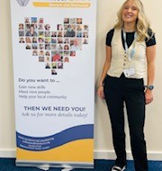
Tuesday 2 July 2024, 1 – 1.45pm (online)
Lunch & Learn Session: Top Tips for Involving Children & Young People
During this free session, Anna Stancill, Youth Development Worker, will:
Provide insight into engaging & involving children and young people.
Introduce the Golden Thread Project (volunteering programme).
Explore the impact volunteering can have on children and young people.
Share some top tips on how to get children & young people interested in what you are doing and bring them along on your involvement journey!
Book today by scanning the QR code below or emailing the Coproduction Team on nnicb-nn.icbcoproductionteam@nhs.net.

Slide 4
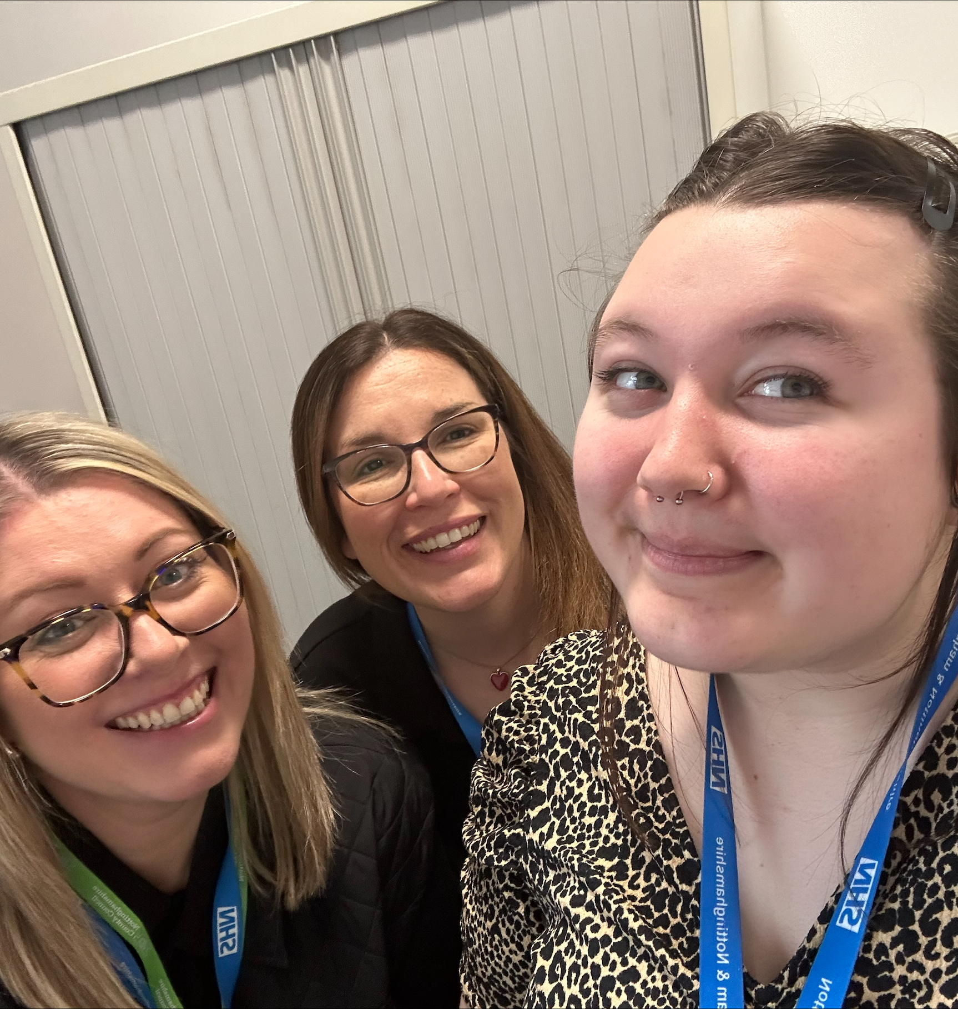
Tuesday 2 July 2024, 2.30 – 3.30pm (in person)
Drop-in Session: Come and ask the Coproduction Team a question!
Do you want to find out what coproduction is?
Do you want to learn more about coproduction?
Do you want advice or resources to help you coproduce? Or,
Do you have coproduction activity you’d like to promote?
If you do, drop and see us anytime between 2.30 - 3.30pm on the Tuesday 2 July.
We will be in the Boardroom, Sir John Robinson House, NG5 6DA!
Let us know you’re coming by scanning the QR code below or emailing the Coproduction Team on nnicb-nn.icbcoproductionteam@nhs.net.

Slide 5
Wednesday 3 July 2024, 10 - 11.30am (online)
Shared Learning Webinar: Getting Started with Meaningful Coproduction
Hosted by Small Steps Big Changes (SSBC), this free session will provide an in-depth understanding of meaningful coproduction and its impact on people’s lives. During the session, participants will:
Develop confidence working in coproduced ways by identifying helpful skills and knowledge.
Hear directly from people who have worked in a coproduced way and learn about their experiences and how it has impacted them.
The webinar is designed to showcase the powerful impact of coproduction when done correctly. By sharing stories from people with lived experience, SSBC hope to inspire and motivate participants to embrace coproduction and its potential to create positive change.
Whether you are a service provider, researcher or someone with lived experience, this webinar will equip you with the necessary tools and knowledge to engage in meaningful coproduction.
Book your place today, on the registration page.

Slide 6
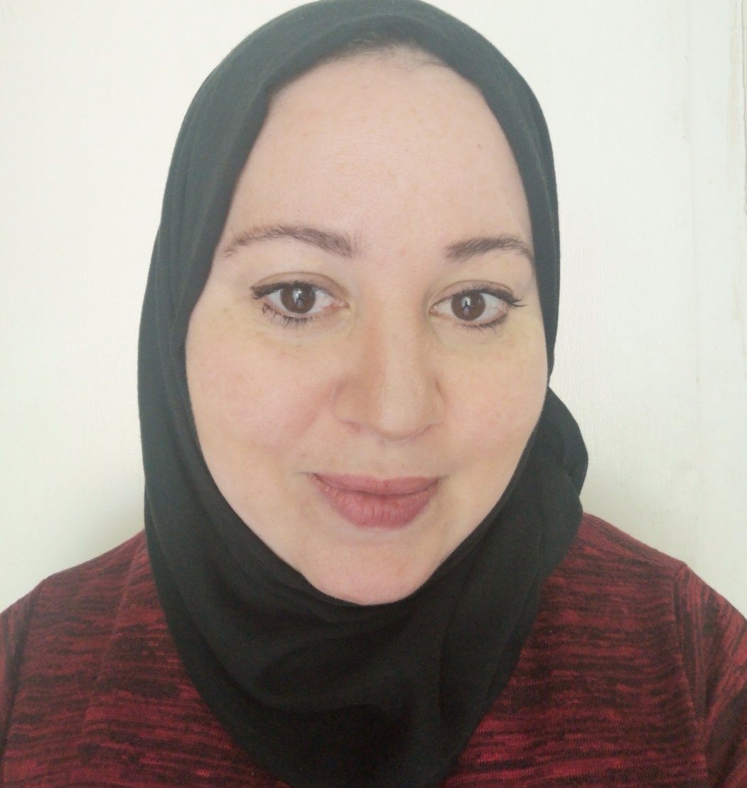
Thursday 4 July 2024, 12.30 – 1.30pm (online)
Lunch & Learn Session: Top Tips for engaging with Refugees & Asylum Seekers
During this free session, Halima Hamza & Ophélie Allard will:
Provide insight into engaging and involving refugees and asylum seekers.
Explore the health & wellbeing challenges, and barriers to involvement faced by refugees and asylum seekers,
Share some top tips for inclusive & compassionate involvement.
You will also have chance to ask questions, share your experiences & access resources to strengthen your involvement approach.
Book today by scanning the QR code below or emailing the Coproduction Team on nnicb-nn.icbcoproductionteam@nhs.net.

Slide 7
WE WANT TO LISTEN TO YOUR VIEWS, IDEAS AND OPINIONS
COPRODUCTION
Listening
Events
TALK. LISTEN. CREATE. INSPIRE. CONNECT
Subject of this listening event:
Strategic Coproduction
Reflecting and listening about how we could work in a strategically coproduced way in the future.
Share your thoughts and opinions in an interactive facilitated session. The same session will be held in the different locations or online.
Talk and share with Executive members of the NHS Nottingham & Nottinghamshire Integrated Care Board (ICB).
Free Tea and Coffee
COMING SOON IN JULY AND AUGUST 2024
In-person and online events

Slide 8
Also happening….
Keep an eye out for special edition Coproduction Week newsletter! Sign up to receive it today by emailing nnicb-nn.icbcoproductionteam@nhs.net.
SCIE’s online Coproduction Week Conference – 3 July 2024. Find out more and book on their website.
SCIE’s lived experience leadership in coproduction online event – 4 July 2024. Find out more and book on their website.
We will be sharing our Celebrating Coproduction video!
And inviting you to contribute to our ongoing work on our system Coproduction Resource, by telling us what coproduction means to you.

